Slide 2
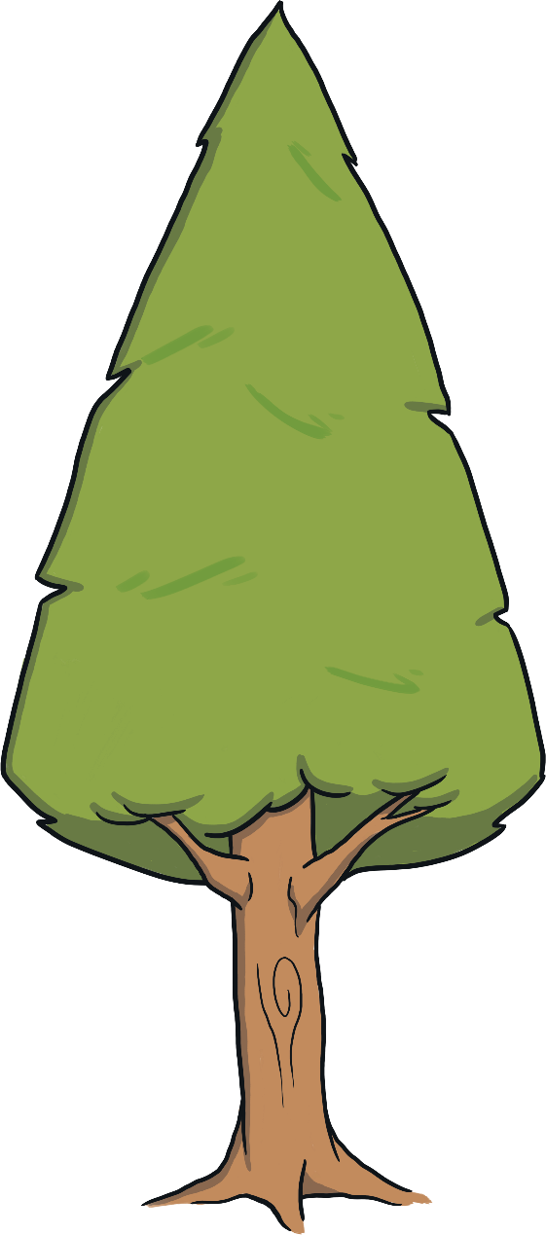
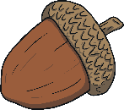
What Am I?
Can you follow the clues to work out which animal is being described?
Click on the acorns to reveal each clue!
Start

Slide 3
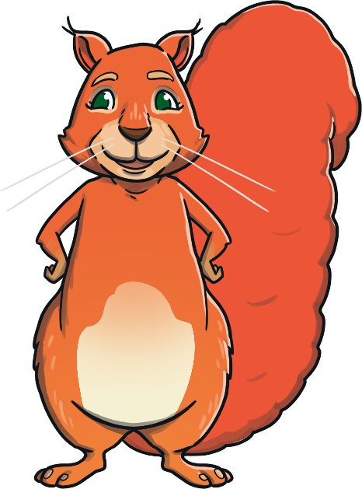
What Am I?
I am an orangey-red colour.
I am a red squirrel!
I eat acorns.
I am a good climber.
What am I?
Click to reveal the answer.
Previous
Next

Slide 4
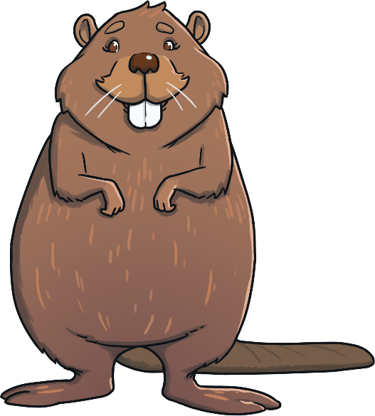
What Am I?
I am a beaver!
I have a long flat tail.
I have two big front teeth.
I can chew through wood.
What am I?
Click to reveal the answer.
Previous
Next

Slide 5
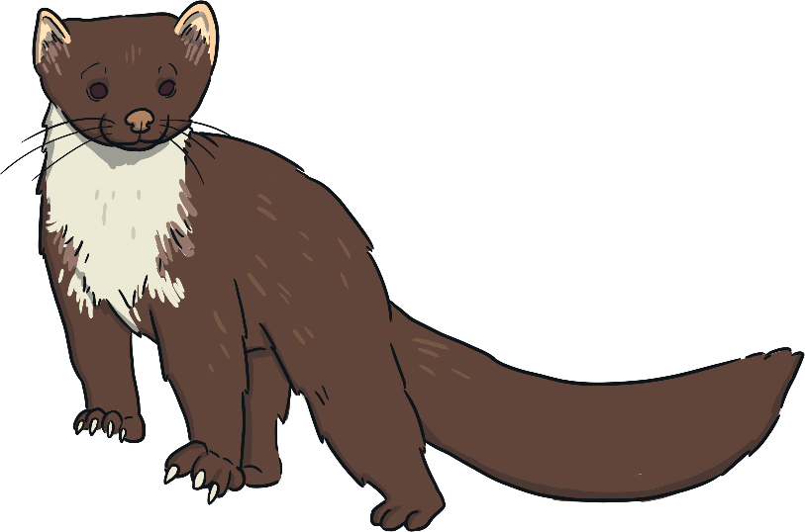
What Am I?
I look a bit like a ferret.
I am a pine marten!
I live in holes in trees.
I am a very good climber.
What am I?
Click to reveal the answer.
Previous
Next

Slide 6
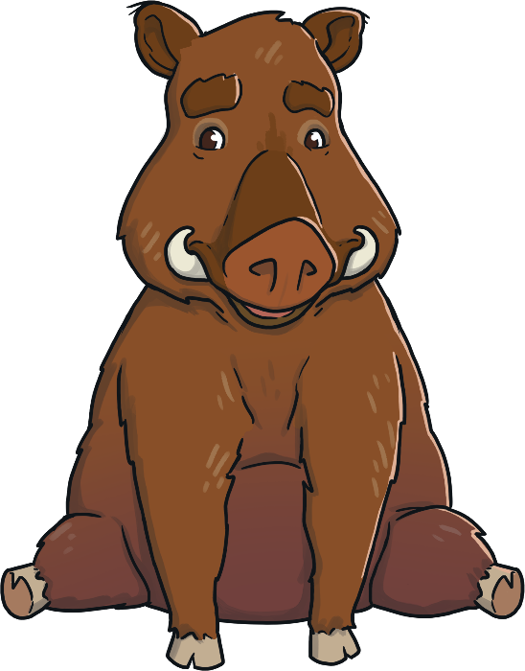
What Am I?
I have two tusks.
I am a wild boar!
I look a bit like a pig.
I walk on four legs.
What am I?
Click to reveal the answer.
Previous
Next

Slide 7
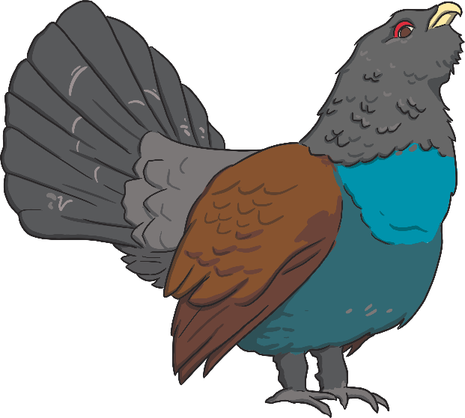
What Am I?
I am a type of bird.
I am a capercaillie!
I eat leaves, berries and insects.
I have red feathers around my eyes.
What am I?
Click to reveal the answer.
Previous
Next

Slide 8
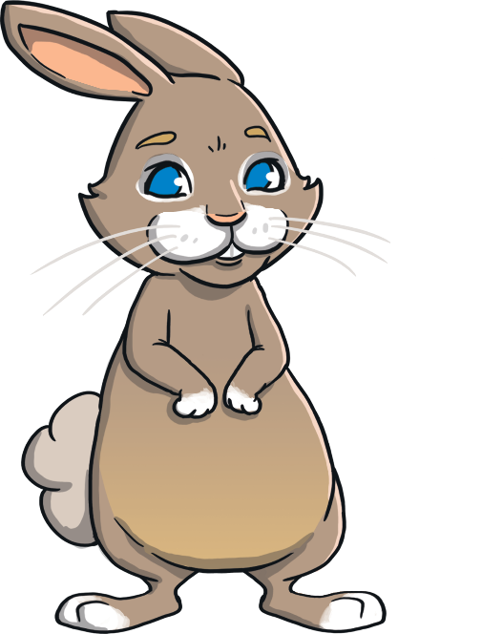
What Am I?
I have a fluffy tail.
I am a rabbit!
I have long ears.
I live in a warren.
What am I?
Click to reveal the answer.
Previous
Next

Slide 9
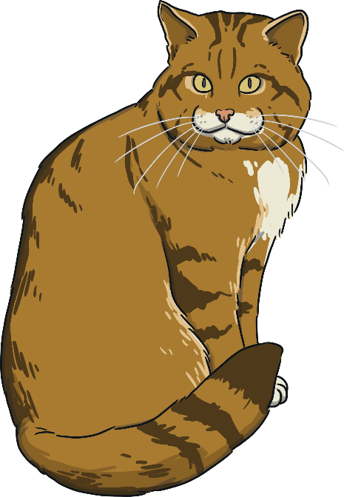
What Am I?
I am a wildcat!
I look like a type of pet.
My babies are called kittens.
I have sharp teeth.
What am I?
Click to reveal the answer.
Previous
End

