Slide 2
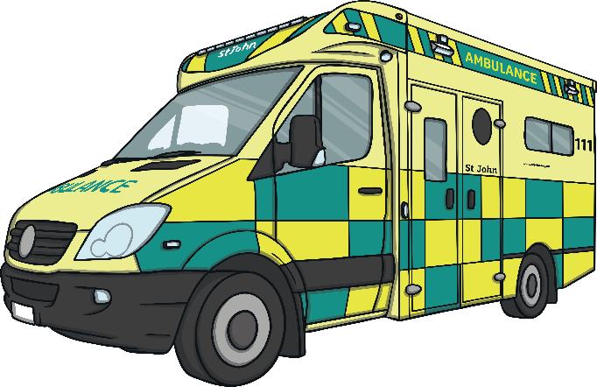
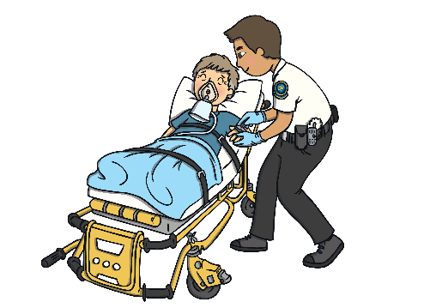
What Job Does a Paramedic Do?
A paramedic’s job is to give emergency care to very sick or hurt people. They may travel in an ambulance, car, motorbike or bicycle. They use their equipment to be the first to give medical help and they often save lives.
Paramedics work very long hours. They work in the day and in the night.
In an emergency, a paramedic will be there to look after anyone who is hurt while they travel to a hospital.

Slide 3
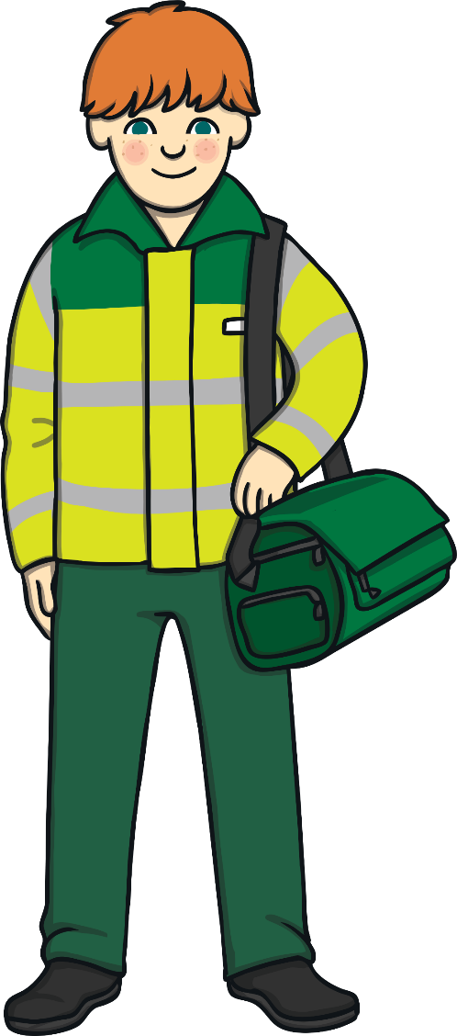
Great Paramedics Are…
caring
calm
helpful
quick-thinking
responsible
good at problem-solving

Slide 4
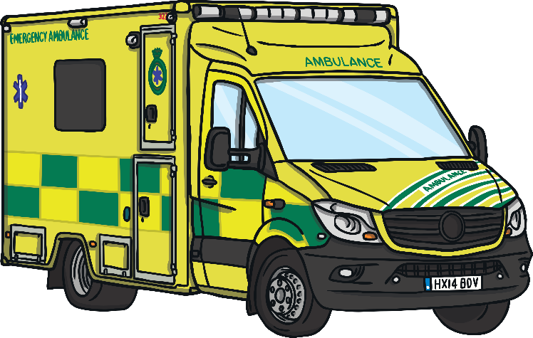
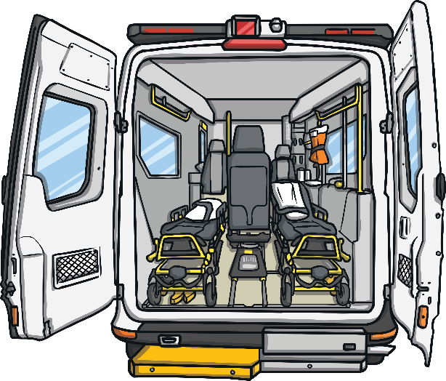
Where Do They Work?
Paramedics usually work in ambulances.
They may also drive emergency response cars, motorbikes, bicycles or helicopters to get to the scene of an emergency.
They may have to help very sick or hurt people inside or outside, whatever the weather.

Slide 5
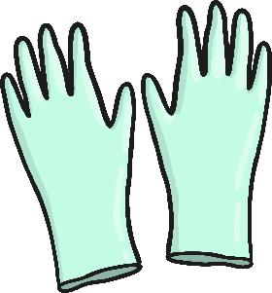
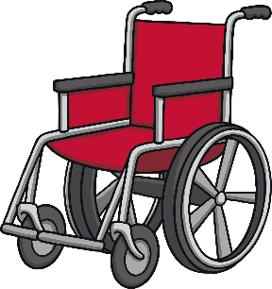
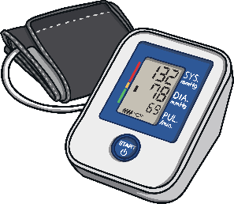
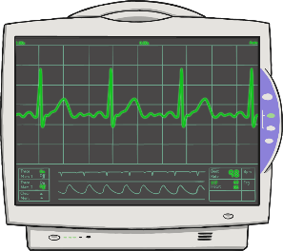
What Do Paramedics Use?
Paramedics use tools that will help to save lives.
Gloves
Stretcher
Wheelchair
Blood Pressure Monitor
Heart Monitor
Drip

