Slide 1
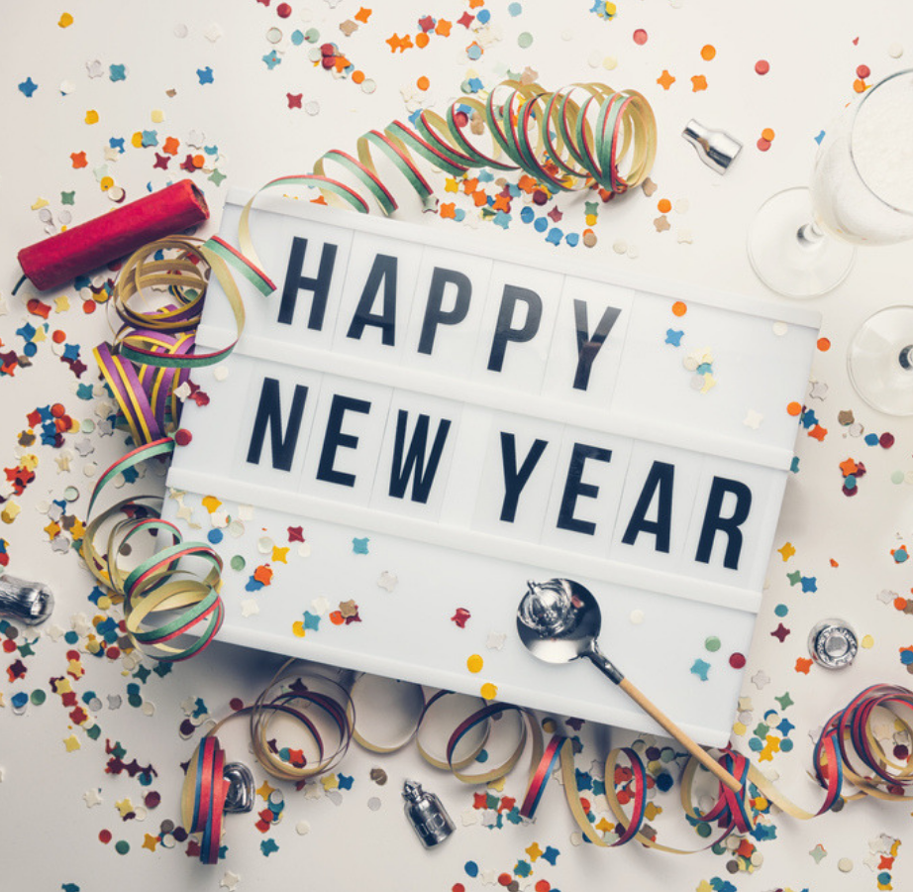
Health and Wellbeing 2021
Reflecting and Looking Ahead

Slide 2
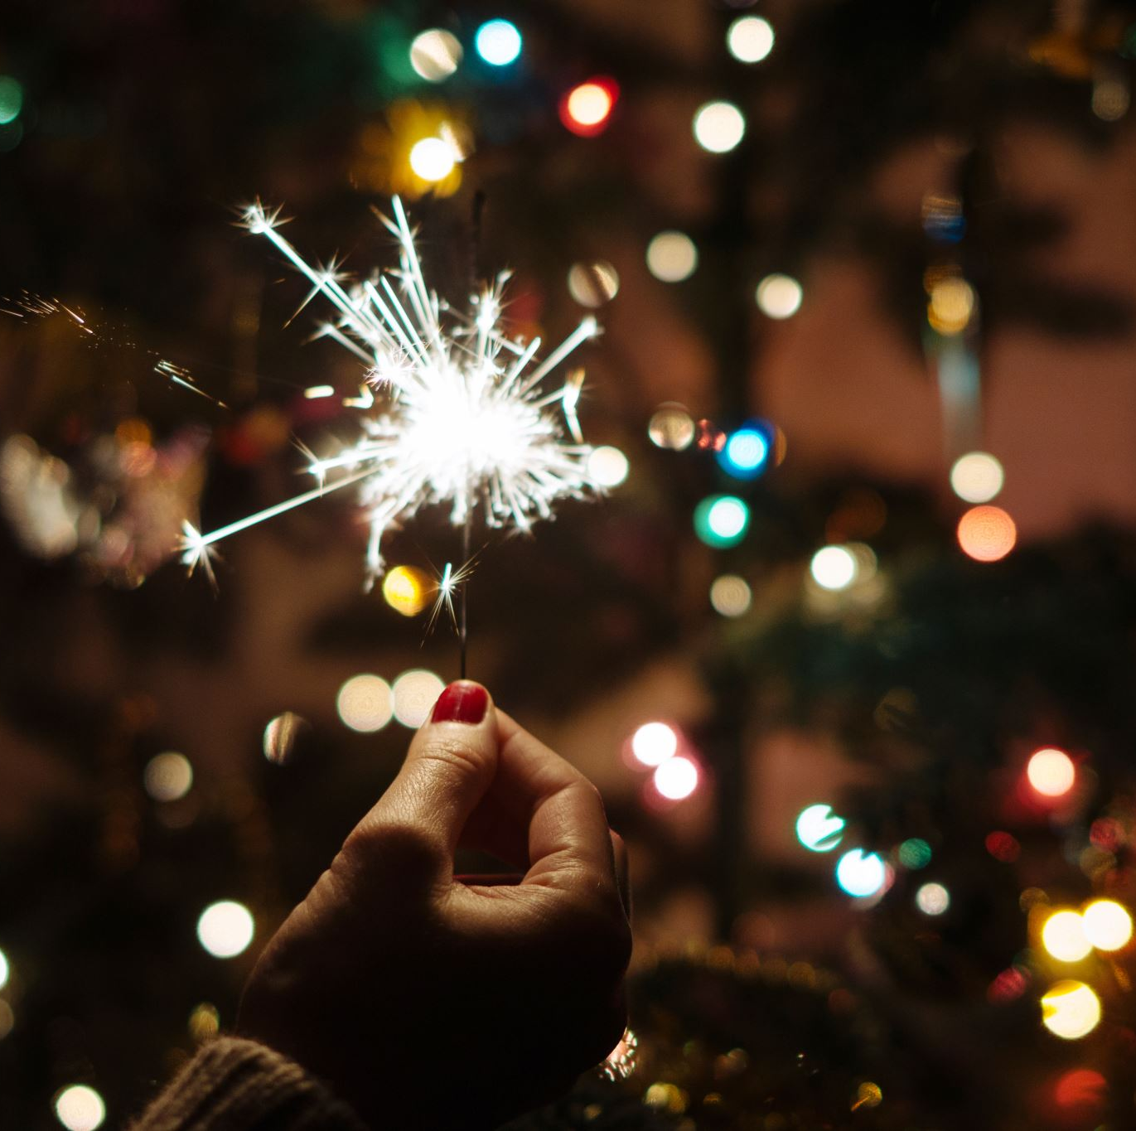
New Year’s Resolutions
At the start of a New Year, people like to reflect on the past year and also set goals for the year ahead.
A goal for the year ahead is called a ‘New Year’s Resolution’.
It is best to make your resolution something fun and achievable.

Slide 3
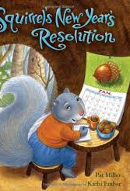
Squirrel’s New Year’s Resolution
If we were in class I would have read this story to you. Here is a link to let you watch and listen to the story.
Squirrel's New Year's Resolution - Pat Miller - New Year's Books Read Aloud - New Year Storytime (video.link)
Note: This video format does not allow the story to be forwarded.

Slide 4
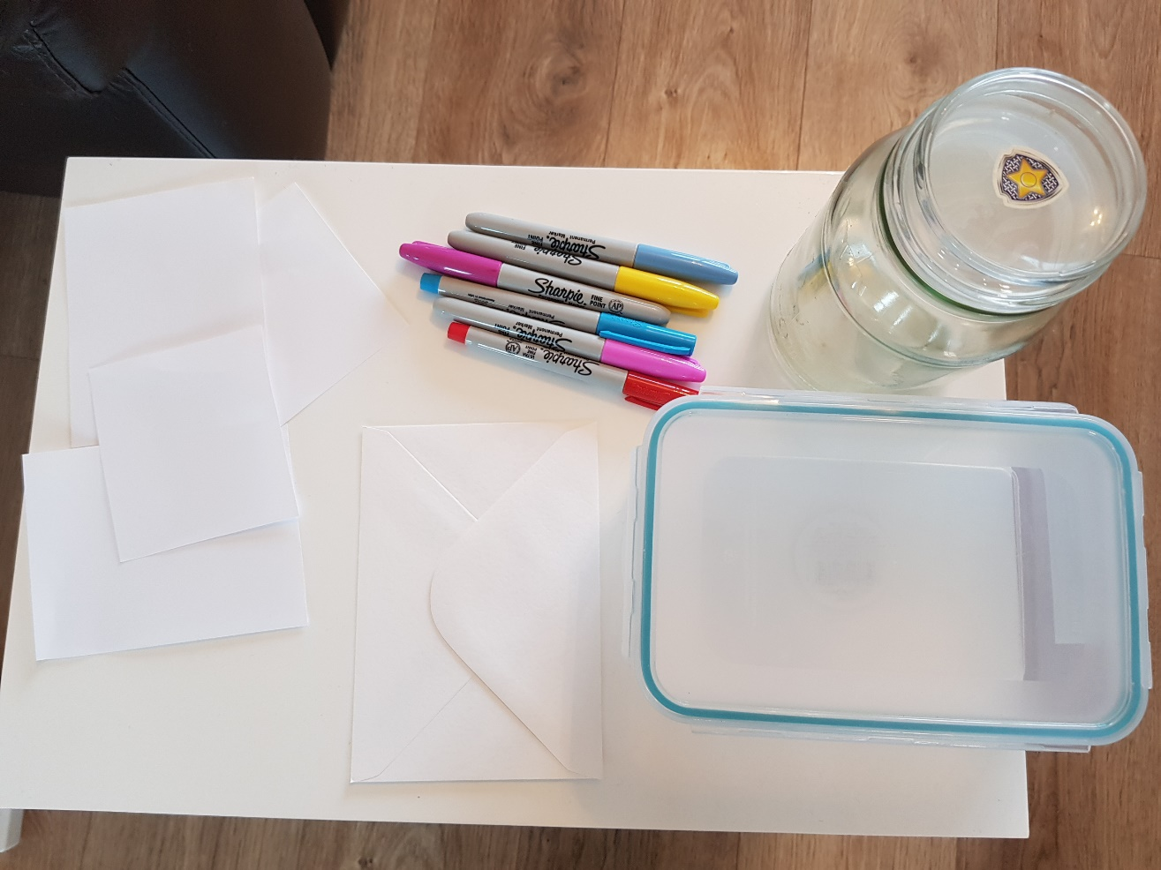
Creating a 2020/21 Time capsule
You will need:
4 small pieces of paper
Pencil/pens/colours (To write with and decorate)
Choice of a jar/tub/box/envelope (Container to put notes into)

Slide 5
My Time capsule
On each piece of paper you are going to write down a thought.
Paper 1: Write down your happiest memory of 2020
Paper 2: Write down your hardest/unhappiest memory of 2020.
Paper 3: Write down an achievement/proud moment of 2020.
Paper 4: Write down a New Year’s Resolution/goal/hope for 2021.

Slide 6
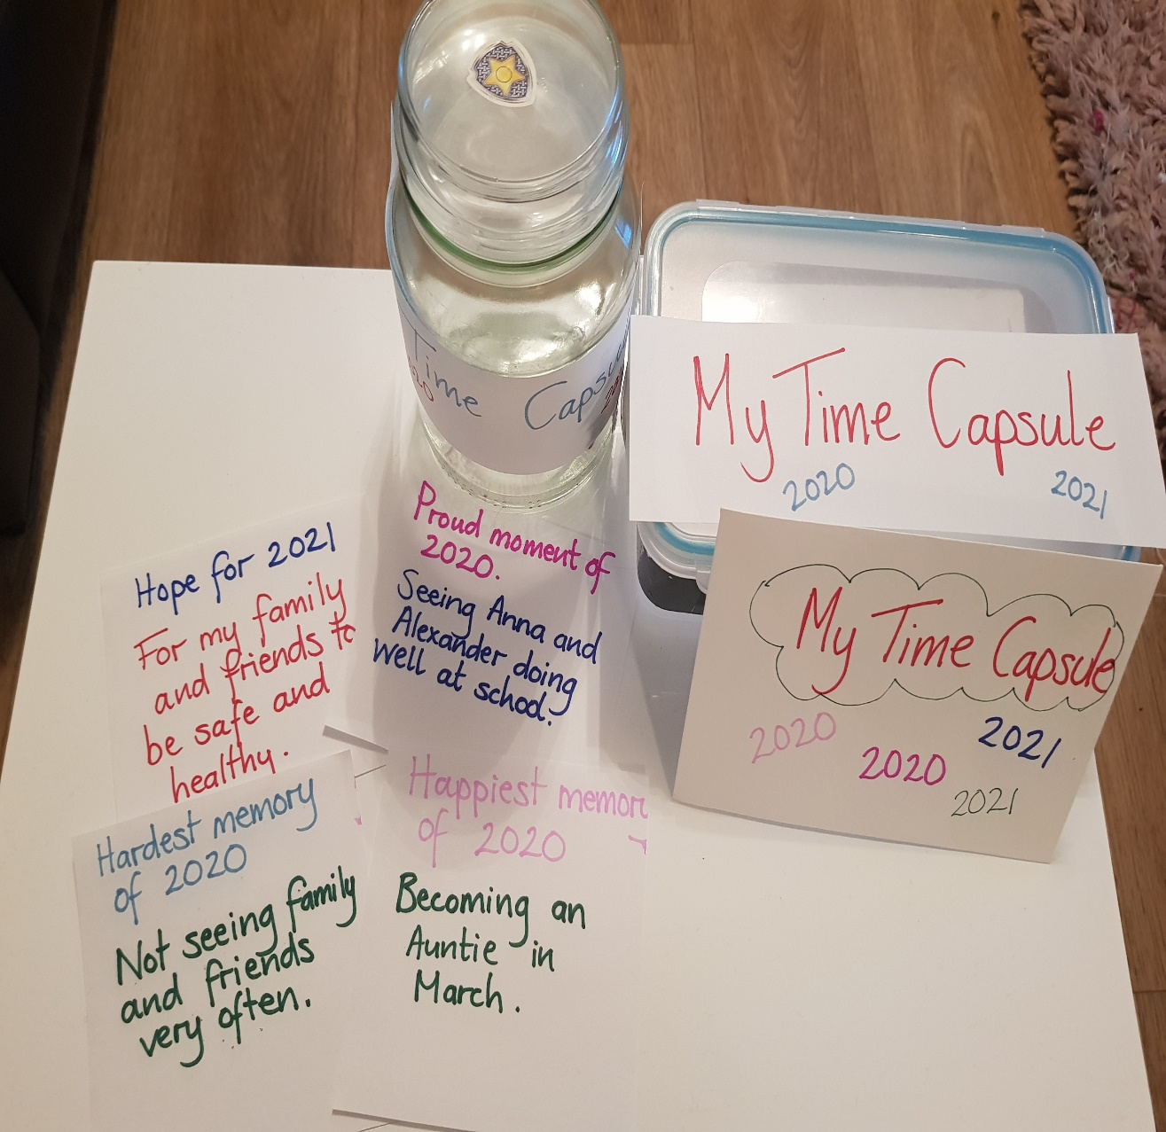
Finishing Touches…
Fold over each piece of paper and place in your chosen time capsule container. You can decorate the container.
Other people in your household could add to the time capsule if they wish.
Hide your time capsule in a secret place and at the end of 2021 you can open it and reflect on what you wrote.

Slide 7
Fun and Fitness
Have a look at some Disney New Year’s Resolutions (This wee video will make you smile!;-) :
Disney Top 10 New Year's Resolutions (video.link)
Participate in New Year’s Resolution Fitness:
NEW YEARS RESOLUTION - This or That PE Activity Game for Remote or In-Person School (video.link)

Slide 8
2021

