Slide 1
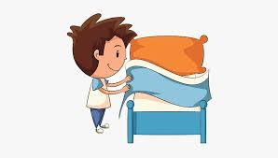
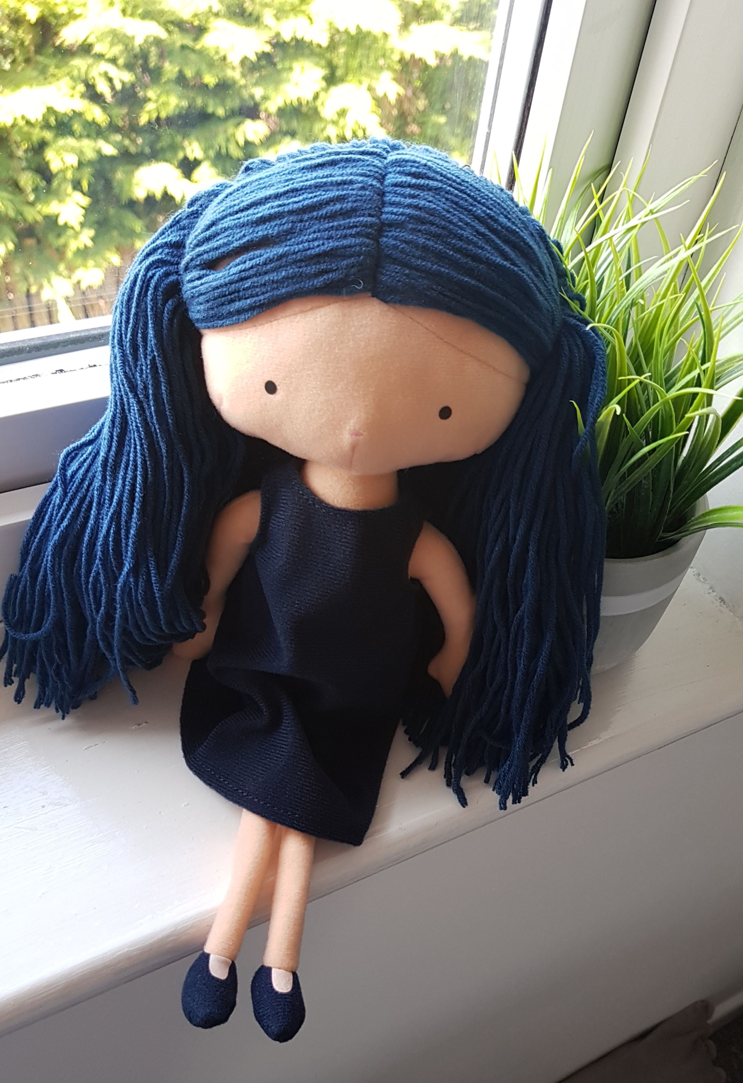
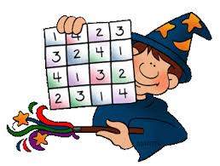
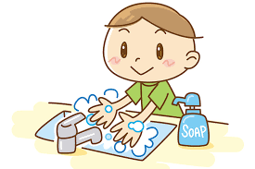
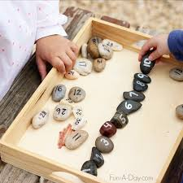
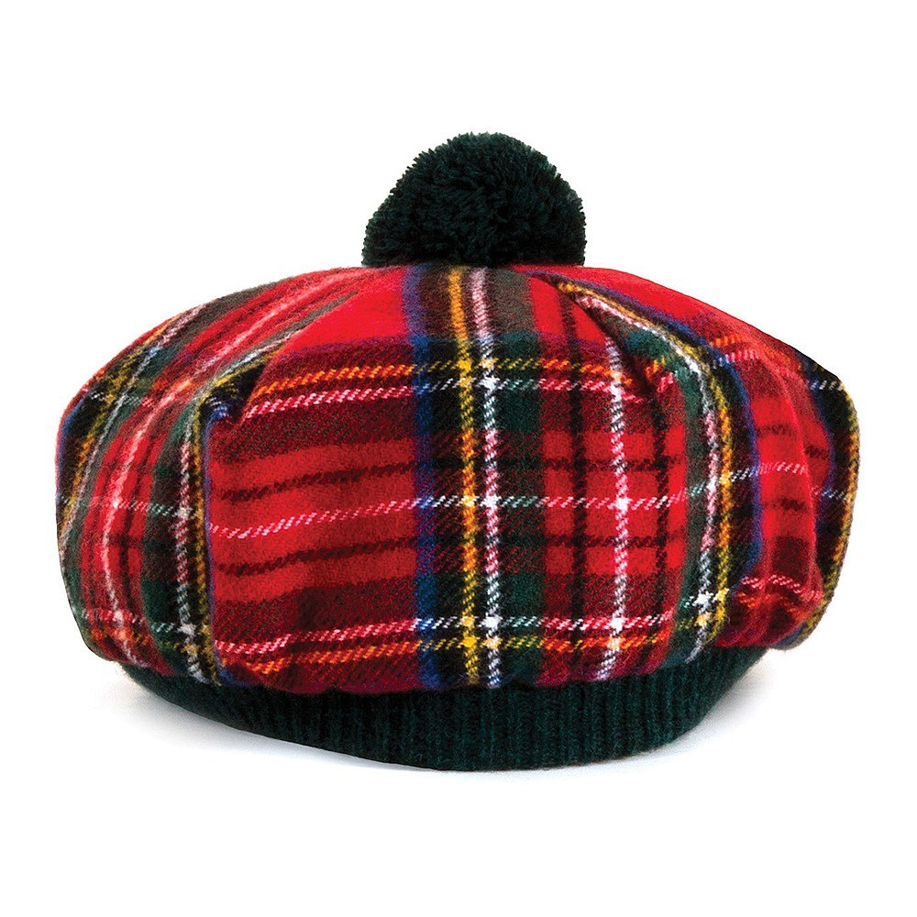
LITERACY | NUMERACY/MATHS | TOPIC/IDL | HEALTH & WELLBEING
Bug Club: Log on and read the books allocated by your class teacher. Remember to answer all of the bugs.
Log into Bug Club and complete the number games allocated by your class teacher.
Help out at home. Keep your room tidy, but this week learn to make your bed. Click on LINK 4 below. Try to make your bed.
Click on LINK 7 below: Sway based on Emotions, listen to the massage story: Lucy's Blue Day.
Mrs Kidd
Click on LINK 1 below: Sway based on "Susan Laughs" and try the activities given.
Mrs Easter
Click on LINK 3 below: Sway based on Applying Number Work in a Fun Way. Try the activities given. Mrs Kidd
Click on LINK 5 below: Sway based on Exercise/Dancing. Try the activities given.
Miss Telford
Click on LINK 7 below: Sway based on Health, watch a video about how to wash your hands.
Mrs Kidd
Can you find any small, smooth stones? If so, bring them into school.
Click on LINK 2 below: Sway of Phonics and Common Words REVISION and try the activities given. Miss Baillie
Click on LINK 6 below: Template for Tam O'Shanter hat.
Miss Telford
Click on LINK 7 below: Sway based on STEM. Try out the experiment if you have a Homework Buddy. Mrs Kidd

