Slide 1
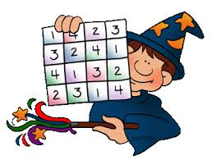
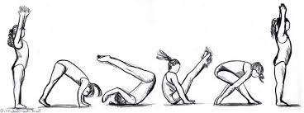
LITERACY | NUMERACY/MATHS | TOPIC/IDL | HEALTH & WELLBEING
Bug Club: Log on and read the books allocated by your class teacher. Remember to answer all of the bugs.
Log into Bug Club and complete the number games allocated by your class teacher.
Think about a way you can put a smile of someone's face. Show someone a random act of kindness.
Click on LINK 6 below: PATHS; Exploring ways to help us feel calm.
Miss Telford
Click on LINK 1 below: Sway based on "Stickman" and try the activities given.
Mrs Easter
Click on LINK 3 below: REVISION Sway based on Place Value and Adding. Try the activities given. Mrs Kidd
Click on LINK 5 below: Sway based on Talking & Listening and Tartan. Try the activities given.
Miss Telford
Click on LINK 6 below: Internet Safety; Sharing online.
Miss Telford
Click on LINK 2 below: Sway of Phonics and Common Words REVISION and try the activities given. Miss Baillie
Click on LINK 4 below: Sway based on Half Past Times. Try the activities given.
Mrs Easter
Click on LINK 5 below: Sway based on STEM. Try the activities given.
Miss Telford
Click on LINK 6 below: Gymnastics and Active Videos
Miss Telford

