Slide 1
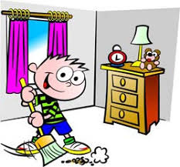
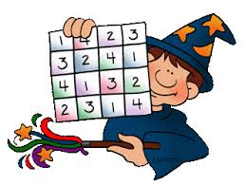
LITERACY | NUMERACY/MATHS | TOPIC/IDL | HEALTH & WELLBEING
Bug Club: Log on and read the books allocated by your class teacher. Remember to answer all of the bugs.
Log into Bug Club and complete the number games allocated by your class teacher.
Linked to Mrs Saxelby’s story this week, tidy your room and keep it tidy each day this week.
Mrs Saxelby
Click on LINK 6 below: PATHS Video – Daphne Stays Home. Try the activities given.
Mrs Telford
Click on LINK 1 below: Sway based on ‘Neeps and Tatties” and try the activities given.
Mrs Easter
Click on LINK 3 below: Sway based on Place Value – Counting and Adding. Try the activities given. Mrs Kidd
Click on LINK 5 below: Art & Design – Drawing the Loch Ness Monster and try the activities given. Mrs Saxelby
Click on LINK 6 below: Building Confidence/Complimenting Myself. Try the activities given.
Miss Telford
Click on LINK 2 below: Sway of Phonics (ea) and Common Words and try the activities given.
Miss Baillie
Click on LINK 4 below: Sway based on The RSPB Big Garden Birdwatch. Try the activities given. Mrs Easter
Click on LINK 5 below: Robert Burns/Scottish music and try the activities given.
Miss Baillie/Mrs Saxelby
Click on LINK 6 below: Active Videos and Circuits. Try the activities given.
Miss Telford

