Slide 1


Slide 2
At Ochiltree we are implementing the use of an online system of Learning Journals to record and share significant points of learning with our parents/carers. This system enables you to access and comment on your child’s ongoing progress and learning. Our older pupils will be able to upload and share their own learning with parents/carers.

Slide 3
The school has created an account for you and you will receive an email from us with instructions on how to activate your account.
Once active you can login using a browser at:
parentzone.yourlearningjournals.co.uk
or use the free iOS and Android apps, just search “Learning Journals ParentZone” in your app store.

Slide 4
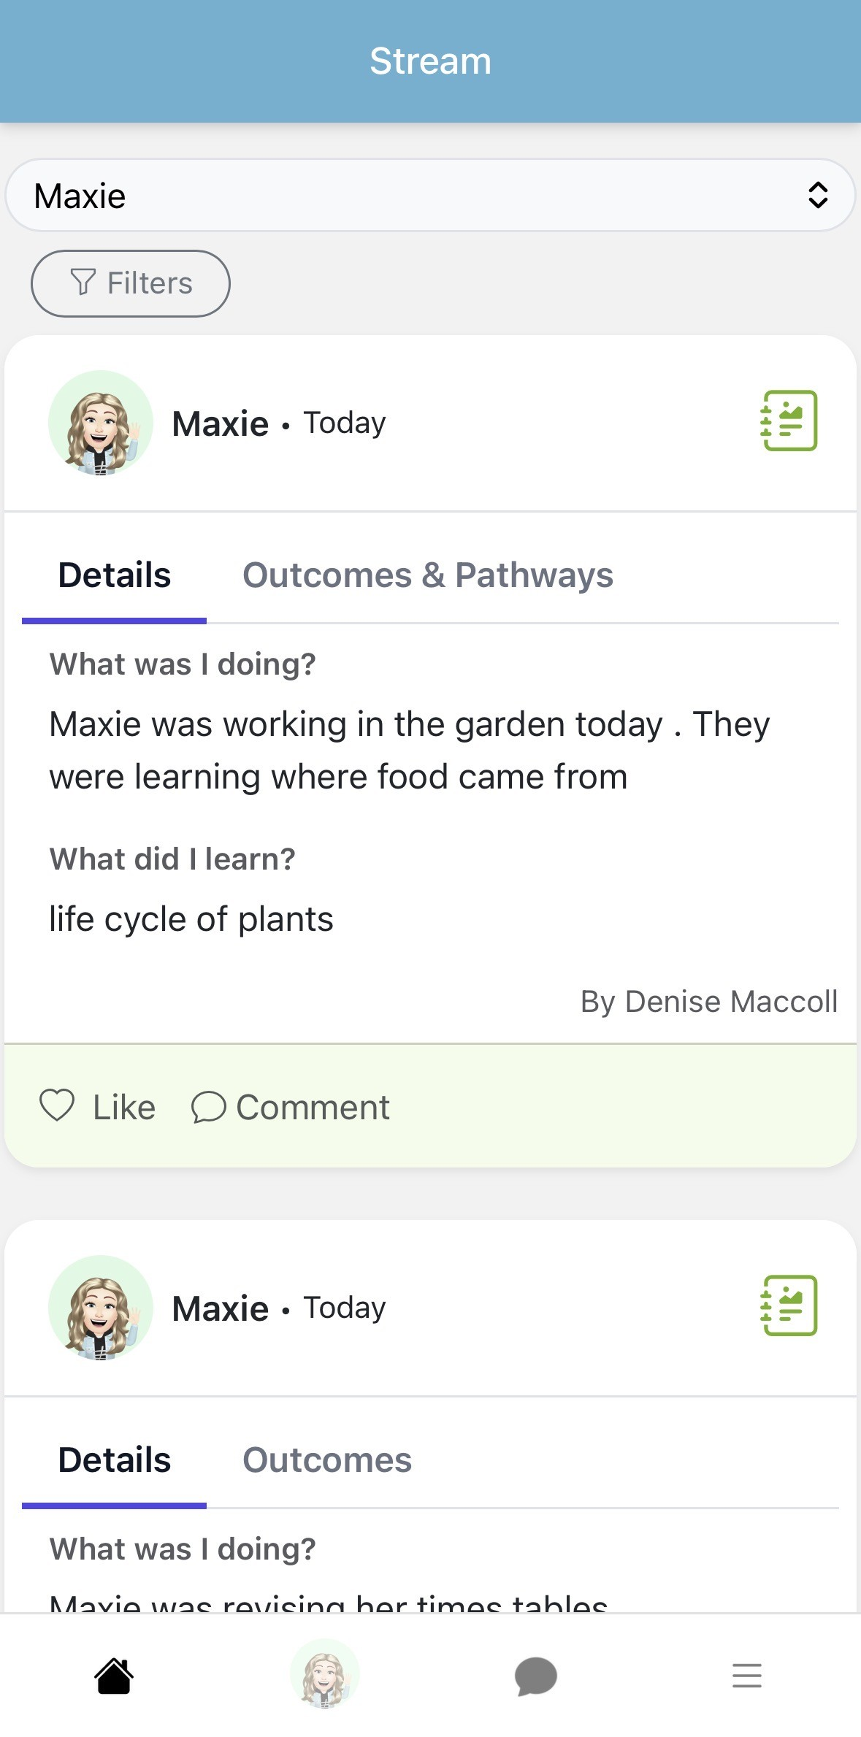
Home Page
If you click on the ‘Home’ button, you will see all activities uploaded by staff on what your child has been up to. You can like or leave a comment for your child to see.

Slide 5
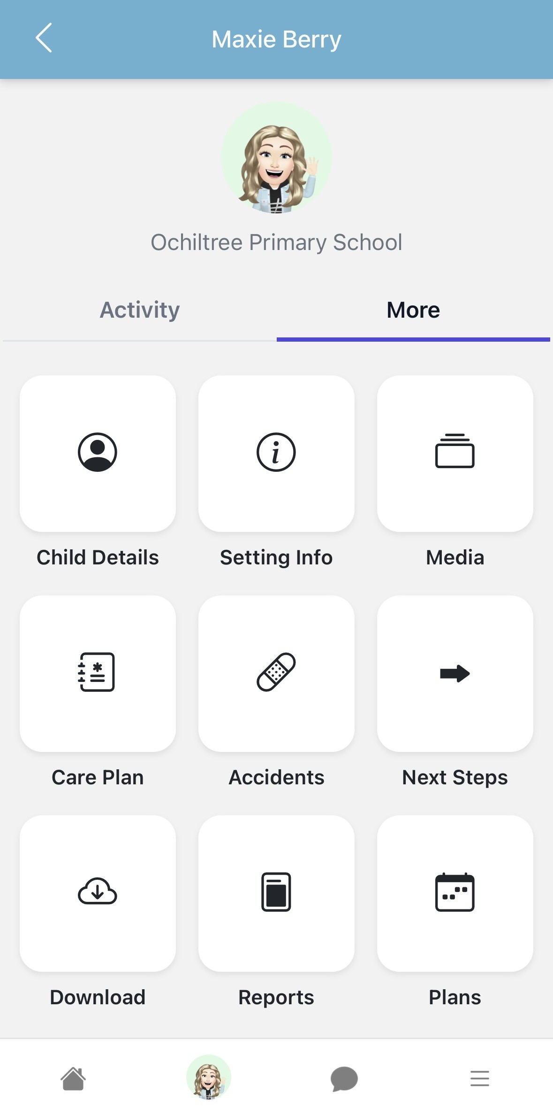
All children that you have access to will appear for selection along the bottom of the screen.
The Stream page gives you a view of everything that has been added to the profiles of the children that you have access to. This could be observations, stories, daily diary events, messages etc.

Slide 6
Child Page
Click on your child’s photo on the bottom bar to access their Child Page. Here you can access other links and settings relating to this child. Some of these links may not be active yet.

Slide 7
Parent Contributions
We may be looking at enabling Parent Contributions so you will be able to add wider achievements. This is currently not enabled so it will not appear.

