Slide 1
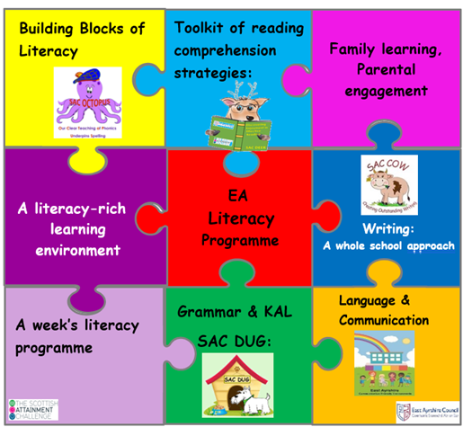

EA Literacy Programme:
A focus on decodable readers
Listening and talking
Reading
Writing
Gail Elder
Quality Improvement Officer (Literacy)
East Ayrshire Council
gail.elder@eastayrshire.org.uk
Notes:
Integrating all aspects of how we teach children reading, writing, listening and talking in EA.

Slide 2
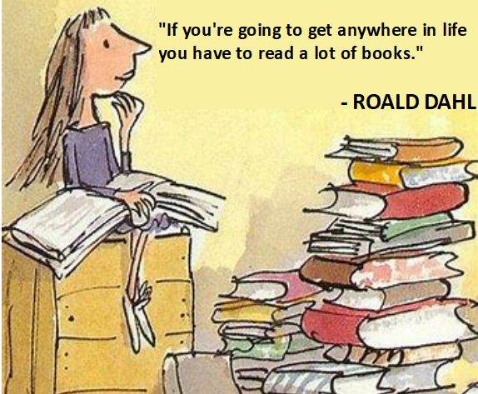
Do you remember how you learned to read?
Notes:
Reading is one of the most important things we can teach our children.
I can’t remember learning to read, but I can remember absolutely loving reading Enid Blyton books when I was about 8 or 9.
You may have learned to read during the time when teaching methods included giving children home lists of words to remember. At that time, it was believed that because good readers instantly recognise all the words they read, we needed children to instantly recognise the words they read. Over the past 50 years there have been lots of approaches to how children are taught to read. But due to huge amounts of research, we can confidently say that the best way to teach the mechanics of reading is to teach systematic phonics.

Slide 3
Building a reader
Comprehension Strategies
Vocabulary & Background knowledge
Fluency
Phonics
Phonological Awareness & Phonemic Awareness
Print Awareness & Book Concepts
Notes:
Phonological and phonemic awareness are key to children’s progress in developing their phonics skills, Phonological awareness is how we break down spoken language into smaller parts: such as rhyme, alliteration, syllables, words and onset and rime. The final part of this process is the breakdown of words into individual sounds known as phonemes. This is referred to as phonemic awareness. This helps us with phonics code. At the start of P1 and throughout, we have a focus on the PA skills and assess them during daily activities and play. Where there are gaps e.g. in being able to sit still and listen, or in being able to pick out words in a sentence, we build in activities to develop those skills. We keep an eye on PA skills as gaps in this can flag up future difficulties.
Print awareness is about knowing which way we read the words, how we handle a book – what’s on the cover etc.

Slide 4
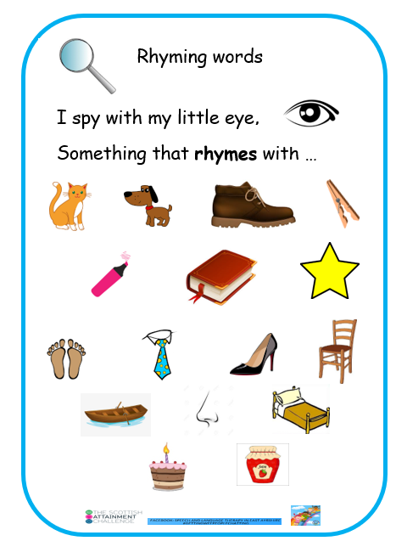
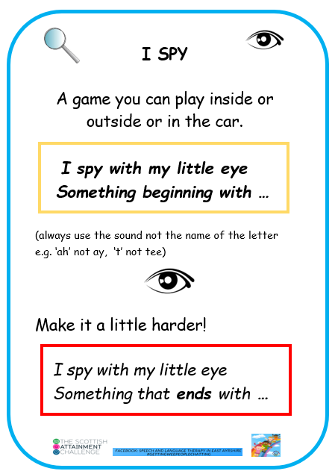
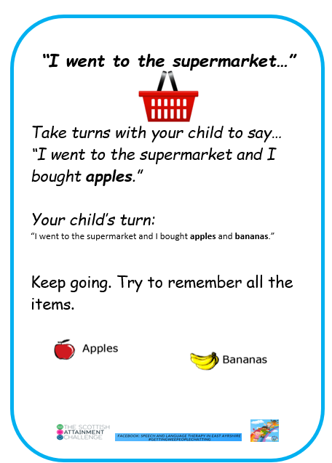
Phonological awareness
Notes:
At this stage in P1 – use the sounds of letters not the names.

Slide 5
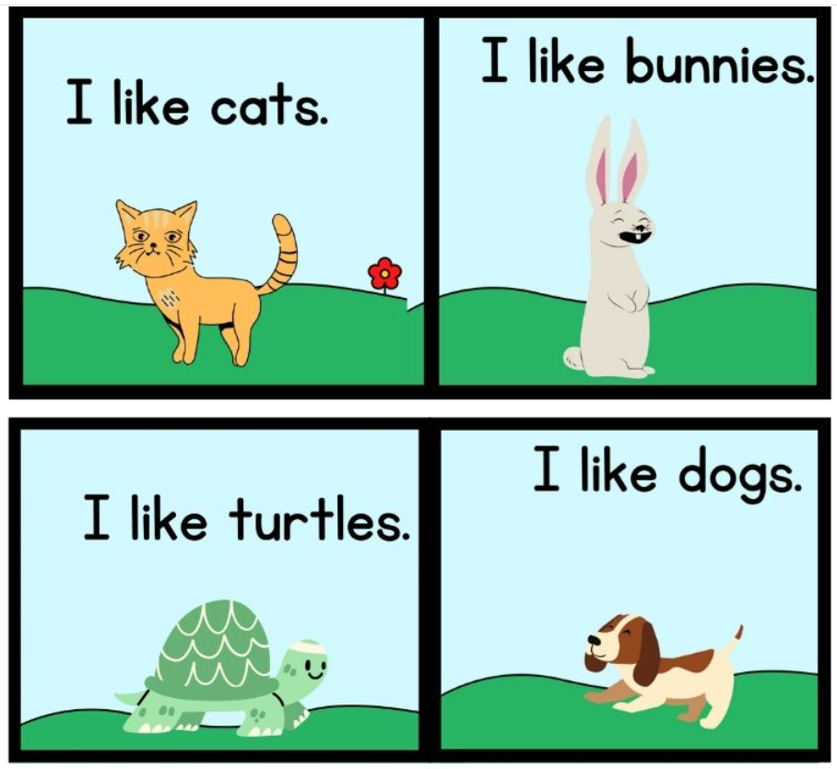
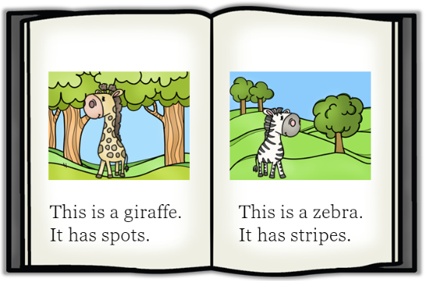
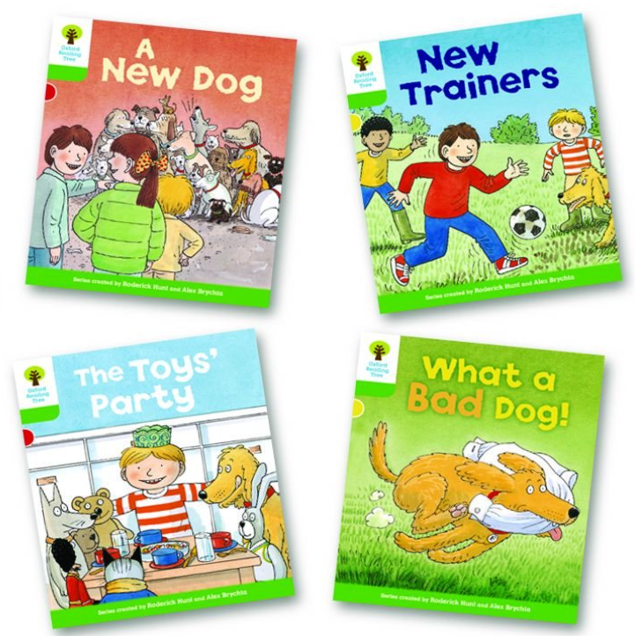
Reading books we have used previously to teach reading…
Levelled texts
Predictable texts
Notes:
At this stage in P1 – use the sounds of letters not the names.

Slide 6
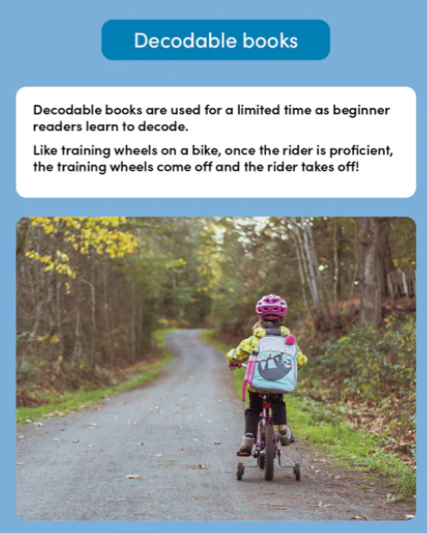
Decodable books
All books and text are ‘decodable’ in the sense that they can be read, but only if the reader has sufficient reading ability for the complexity of the text.
For beginning readers, the only books that are truly decodable are those that contain the alphabetic code they have learned.
Notes:
At this stage in P1 – use the sounds of letters not the names.

Slide 7
So, what are decodable books
They-
are designed for children who are learning to read,
are carefully written stories and texts that only use the letter sounds children have been taught.
offer children the opportunity to practise decoding words
help to develop children’s reading fluency as they sound out the letters on the page and blending them into words.
develop word recognition for high-frequency words that will help them to read fluently.
With repeated practice, children can read words quickly and fluently (orthographic mapping)
Notes:
At this stage in P1 – use the sounds of letters not the names.

Slide 8
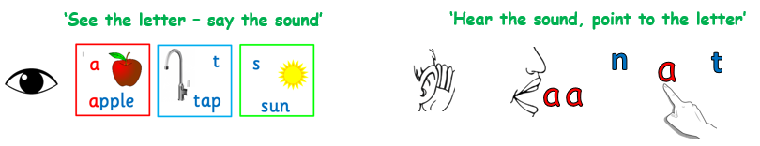
Phonics
Phonics is how we teach children to read by linking sounds (phonemes) and the symbols that represent them (graphemes, or letters).
It is a code - the alphabetic code.
Notes:
Phonics teaches the link between the words we say or think, and the words that are written on the page. When we speak, all our speech sounds or phonemes, will have a letter or grapheme to represent them in writing. That is what phonics is. It is a code – the alphabetic code and we need to teach children the code and not leave them to work it out for themselves. Systematic synthetic phonics helps us teach the alphabetic code. We continue teaching the code until all the complex letter to sound correspondences have been taught. This means we carry on teaching phonics throughout primary school. At later stages it is our ‘go to’ spelling strategy. As an adult, it is how we read a word we have never seen before.

Slide 9
As adults, we use our phonics knowledge…
pseudofolliculitis barbae
razor bumps!

Slide 10
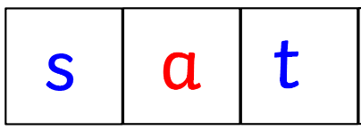
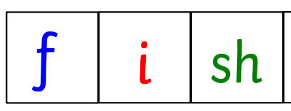
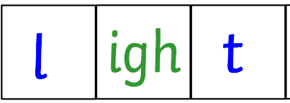
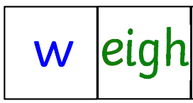
We have 44 sounds or phonemes that we use in our spoken language… but we only have 26 letters.
Sounds can be spelled with 1 letter,
2 letters,
3 letters
or 4 letters
Sounds can be spelled in many ways. Take the /ae/ sound:
way
wait
gate
straight
grey
great
eight
baby
Spellings can represent more than one sound. Take the <o> letter:
hot
most
to
some
Notes:
English – most difficult language to learn to read and write.
Phonics gives children the key to unlocking this alphabetic code for their reading and spelling.
But in P1 we will start with the simple code where one letter represents one sound in VC and CVC words.

Slide 11

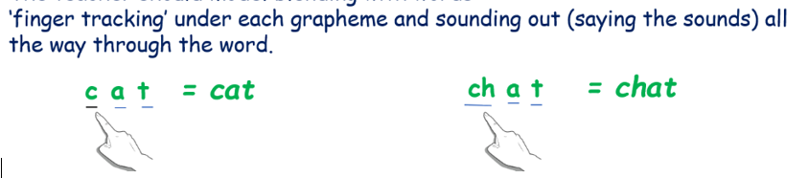
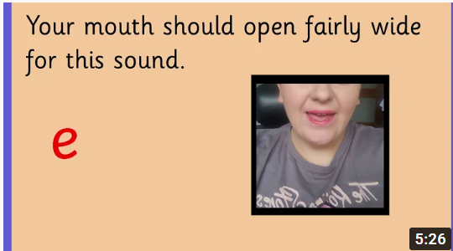
Phonics skills we teach:
Blending:
For reading we teach blending: sound out and blend the sounds all through the word (decoding)
‘finger tracking’ under each grapheme and sounding out (saying the sounds) all the way through the word.
Initial Sounds Mouth Shapes - YouTube
Notes:
We need children to know the letter/sound correspondences
So they can blend

Slide 12


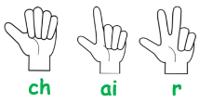
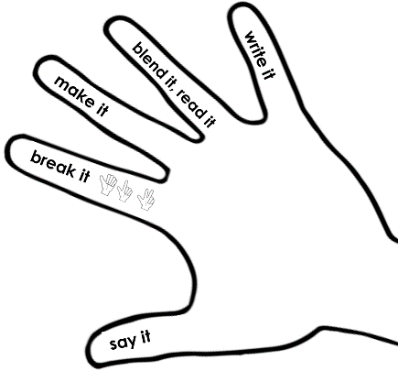
Phonics skills we teach:
Segmenting:
For spelling we teach segmenting.
We start with a spoken word
we say the word, sounding out each of the sounds
tally how many sounds
then match the letter(s) we need
to write it (encoding) or use our magnetic letters
Notes:
We need children to know the letter/sound correspondences
So they can blend
And segment….on the screen
When it comes to writing in P1, we usually start off with children drawing: with their picture representing their words or story. We will ask children to have a go – and use their phonics knowledge and the words they have learned. We do not ask them to copy writing.

Slide 13

Phonics skills we teach:
Letter formation:
Your child learns how to write the letters (graphemes) as they are taught each sound (phoneme).

Slide 14
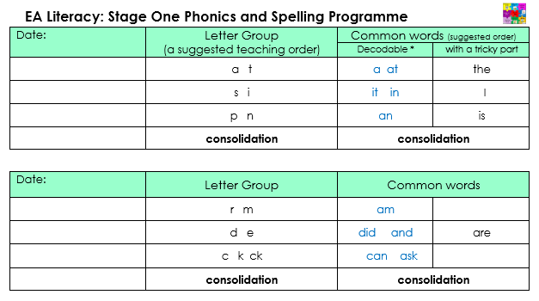
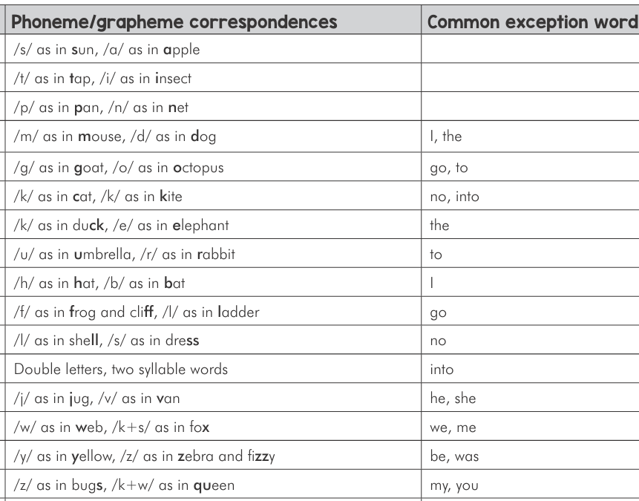
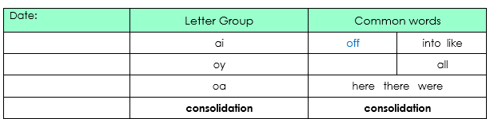
Common or High Frequency Words
Notes:
The only word that we ask children to memorise by sight is the word ‘the’ – we teach this word very early in the programme and the children do not have the phonics knowledge to read it yet. When they meet <I> they have learned the /i/ sound. We teach them that sometimes this letter represents the sound /igh/. However, they can read the others using their sounds knowledge. We just point out the tricky bit, and children use their phonics knowledge to read the rest. That is how good readers read. Memorising words is not an efficient strategy as we cannot remember all the words we may come across.

Slide 15
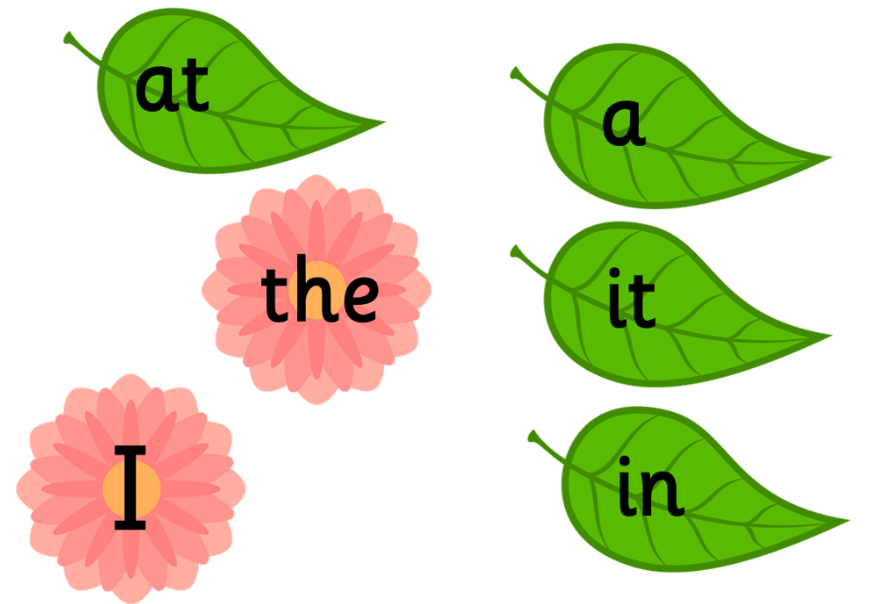
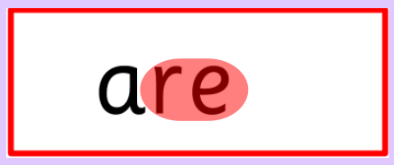


Common or High Frequency Words
We teach these words as part of our phonics programme.
Notes:
The only word that we ask children to memorise by sight is the word ‘the’ – we teach this word very early in the programme and the children do not have the phonics knowledge to read it yet. When they meet <I> they have learned the /i/ sound. We teach them that sometimes this letter represents the sound /igh/. However, they can read the others using their sounds knowledge. We just point out the tricky bit, and children use their phonics knowledge to read the rest. That is how good readers read. Memorising words is not an efficient strategy as we cannot remember all the words we may come across.

Slide 16
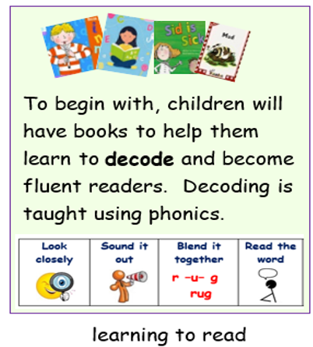
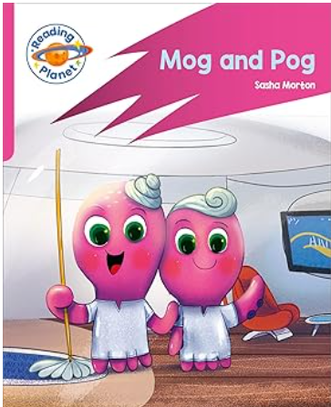
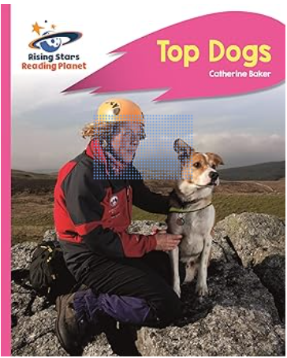

Phonics is only part of how we teach reading
“If a child memorises ten words, the child can only read ten words. If a child learns the sounds of ten letters, the child will be able to read 350 three sound words, 4,320 four sound words, 21,650 five sound words.”
Kozloff, 2002
Decodable readers
Notes:
Decodable books – these are books for children to be successful as they begin their reading journey. They are books that are matched to the sounds that have been taught in class. They might not be inspirational in terms of the storyline or vocabulary. They are not meant to be. They are for children to put into practice their phonics knowledge and skills – recognizing the sounds represented by letters and blending them to make words.
Once children have mastered Phonics learning to read doesn't stop there! It is essential that we recognise the importance of fluency in the journey to become effective and enthusiastic readers.
We give a lot of time to explicitly teach Phonics and assess comprehension but do you put as much emphasis on teaching fluency? Fluency makes reading easier and consequently learning easier too!

Slide 17
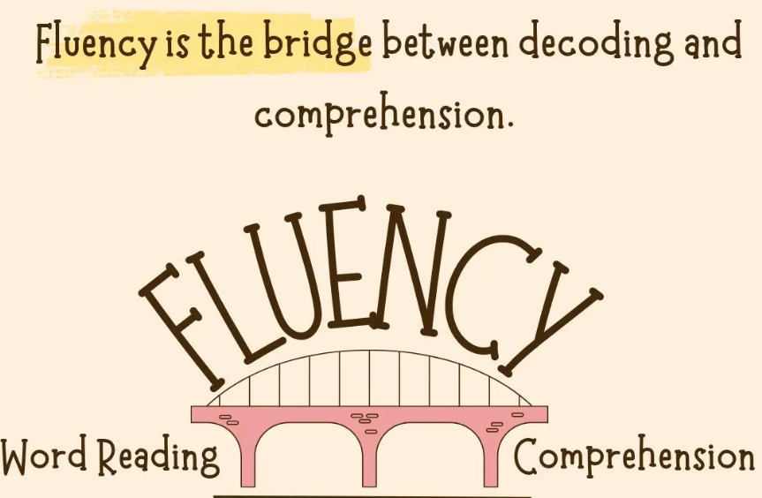
Fluency
Notes:
Once children have mastered Phonics learning to read doesn't stop there! It is essential that we recognise the importance of fluency in the journey to become effective and enthusiastic readers. We need children to learn to read with automaticity, accuracy and enough speed to sound like normal speech, so they can devote enough of their brain bandwidth to think about what they are reading.
Fluency makes reading easier and consequently learning easier too!

Slide 18
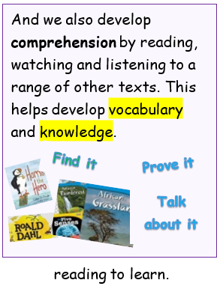
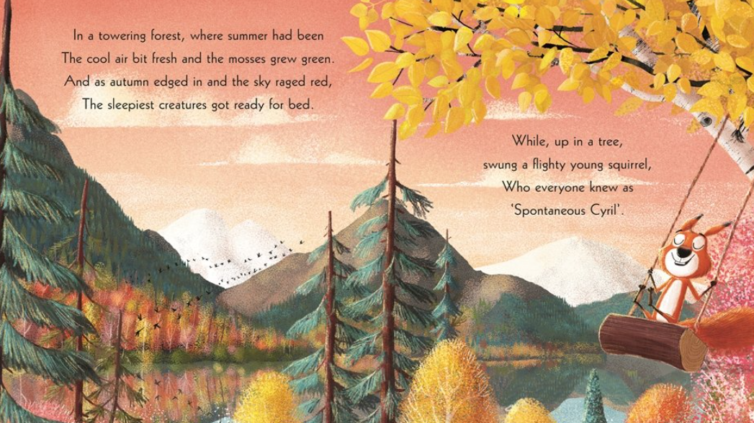
Vocabulary and background knowledge
Notes:
We do also read lots of other inspirational books. These are the books that have the wonderful pictures, fantastic characters and interesting vocabulary. They can be full of facts. These are the books that we read to children to develop their language comprehension and their vocabulary – and hopefully help inspire them with a love of books. Another key thing about reading as your children move through the school – they need to be able to read to learn about lots of different subjects. They move from learning to read to reading to learn.

Slide 19
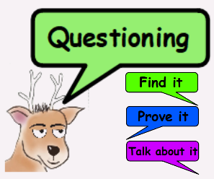
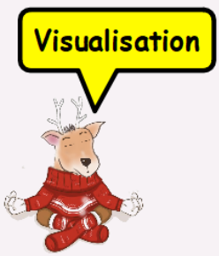
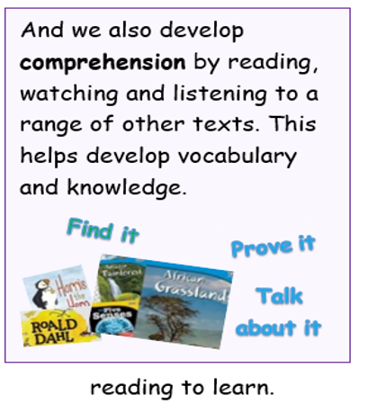
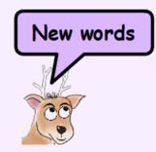
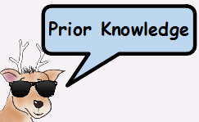
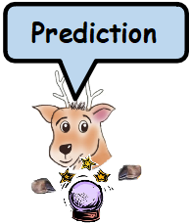
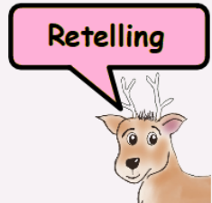
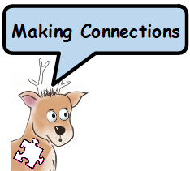
Comprehension strategies
Notes:
We teach children to use different comprehension strategies to use to help them understand what they read.

Slide 20
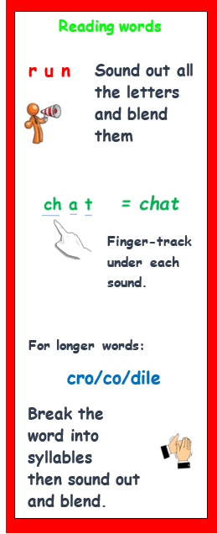

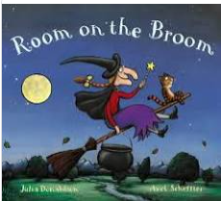
What can you do to help your child?
When children take a reading book home to practise their decoding skills:
Listen to them read their ‘reading book’.
If they stick at a word, give praise when they try to ‘sound out’ the sounds in the word.
If still stuck, you can give the word.
Talk about what is happening in the books you read.
Notes:
Make sure child has any ear and eye tests available. Glue ear fact: it is estimated that 1 in 5 children around the age of 2 will be affected by glue ear at any given time. About 8 in every 10 children will have had glue ear at least once by the time they’re 10 years old.
Books are where we find the most interesting vocabulary.
Books can teach us lots of information and facts about our world. Having this vocabulary and knowledge is one of the greatest foundations you can provide your child for becoming a reader and writer.

