Slide 1
Green Shutters
In other words
The pharmacy

Slide 2
Opening Hours
Opening Hours: Green Shutters Pharmacy Monday ➜ 09:00 - 17:30 Tuesday ➜ 09:00 - 17:30 Wednesday ➜ 09:00 - 17:30 Thursday ➜ 09:00 - 17:30 Friday ➜ 09:00 - 17:30 Saturday ➜ 09:0 Sunday ➜ Closed

Slide 3
Information
The birth place of George Douglas Brown,the ‘house with the Green shutters’ was sold in 1960 by Ayr County Council to the Royal British Legion for £60 and covented into a club. The club was sold in 2006 and was reopened in August 2007 as a pub known as the Green Shutters and later became a pharmacy

Slide 4
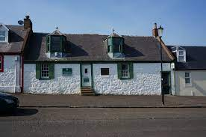
Location information
90 Main street
Ochiltree , East Ayrshire
KA18 2PF
Phone:01290700090

Slide 5
Fire information
The birthplace of George Douglas Brown ,the “House with the Green Shutters”, was sold in 1960 by Ayr County Council to the Royal British Legion for $60 and converted into a club . The building suffered from a fire in December 2004.The building was not insured , and the British Legion branch could not raise sufficient funds to restore it . The club was sold in 2006 and was reopened in August 2007 by Norman Wylie as a pub known as The Green Shutters . It has since been converted into a pharmacy.

Slide 6
Thank you

