Slide 1
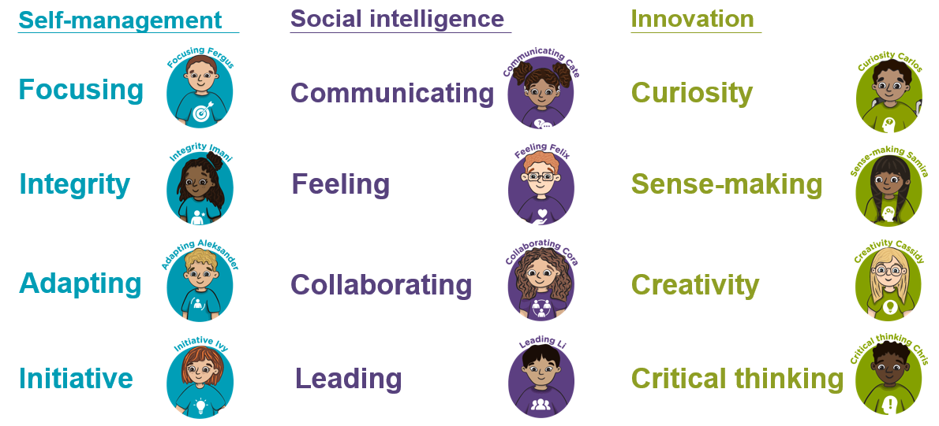
Where are meta-skills hiding in your house?

Slide 2
A new Mission will be put on the school app/class blog every
‘Meta-skills Monday’
Want to share your mission? You can choose to:
Send in a photo
Draw a picture
Write one sentence
Tell your teacher about it
Or simply enjoy doing it together. You don't have to send anything back!

Slide 3

Family Meta-Skills Mission 1
Collaborating
The No-Talking Challenge
Work together to build something with Lego, blocks, recycling or household objects...
but nobody is allowed to speak for the first 3 minutes!
Afterwards:
Family Question – “What helped you work as a team?”

Slide 4

Family Meta-Skills Mission 2
Critical Thinking
Would You Rather?
At dinner ask:
Would you rather have a school with no pencils or no computers?
Would you rather be able to fly or become invisible?
If you were in charge of the world for one day, what is the first problem you would solve?
Everyone must answer and give a reason for their answer. The challenge isn't choosing. It is explaining why.

