Slide 1
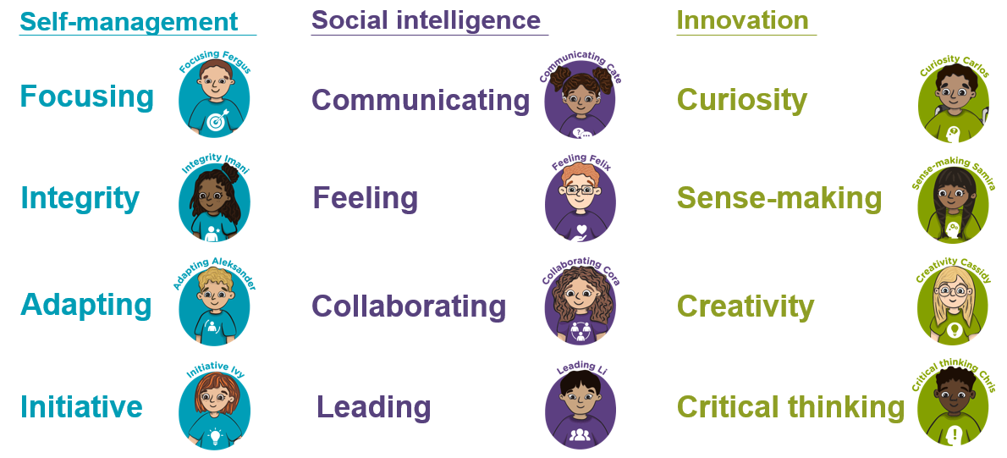
Where are meta-skills hiding in your house?

Slide 2
A new Mission will be put on the school app/class blog every
‘Meta-skills Monday’
Want to share your mission? You can choose to:
Send in a photo
Draw a picture
Write one sentence
Tell your teacher about it
Or simply enjoy doing it together. You don't have to send anything back!

Slide 3

Family Meta-Skills Mission 1
Collaborating
The No-Talking Challenge
Work together to build something with Lego, blocks, recycling or household objects...
but nobody is allowed to speak for the first 3 minutes!
Afterwards:
Family Question – “What helped you work as a team?”

