Slide 1
Primary 1
Workshop
Thursday 26th September

Slide 2
Welcome
Welcome
Introductions-
Head Teacher- Mrs Beveridge
Principal Teacher- Mrs Henderson
Class teachers- Miss Barrett and Miss Whiteford

Slide 3
Breakdown
Welcome and Introductions
A Day In Primary 1
Throughout the Week
Homework
Play
Other
Closing and additional discussions

Slide 4

A Day In Primary 1
Children come in
The plan for the day and Morning Teaching Block
Middle Block- Teaching and Learning Block
Break time
Transition time
Another block of direct teaching followed by lunch.
Afternoon- Teaching and Learning block
Big tidy up
Home time

Slide 5



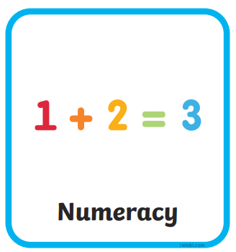


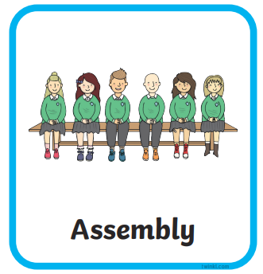
Throughout The Week
Literacy
Numeracy
Topic
P.E
Library
Digital Literacy
French and HWB with Mrs Singleton
Assembly
High Five Friday
Other events such as McMillan Coffee Morning or Maths Week Scotland

Slide 6
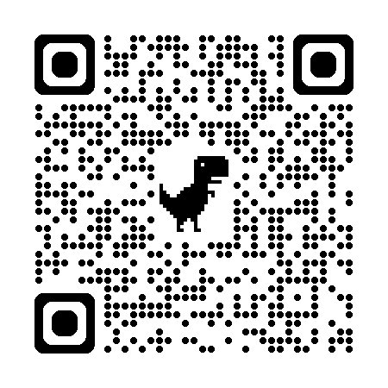
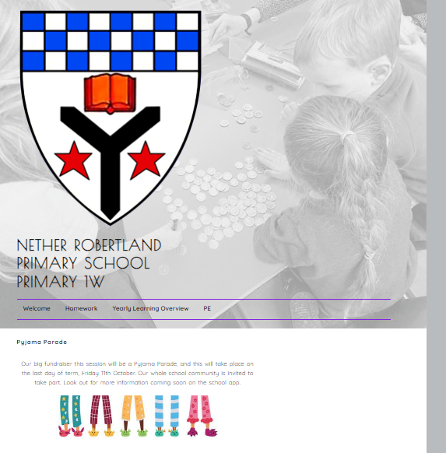
Homework
https://blogs.glowscotland.org.uk/ea/nrpsp1/
Blog- the blog is used for sharing homework, p.e kit guidelines, the yearly overview and some other information about school events such as the McMillan Coffee Morning (check the school app though for full details).

Slide 7
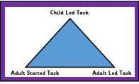
Play...
At Nether Robertland Primary we have a bespoke play pedagogy that has been developed over the last few years through professional development, practical implementation and evaluation.

Slide 8
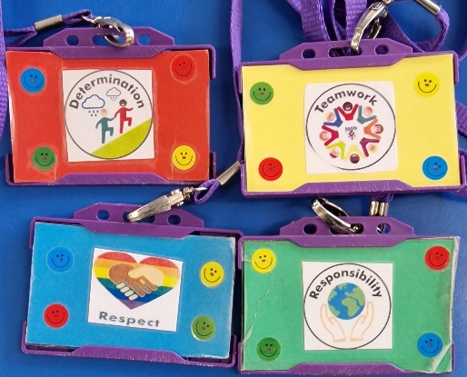
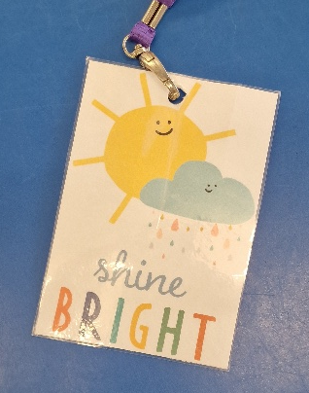
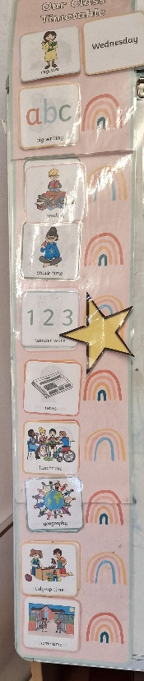
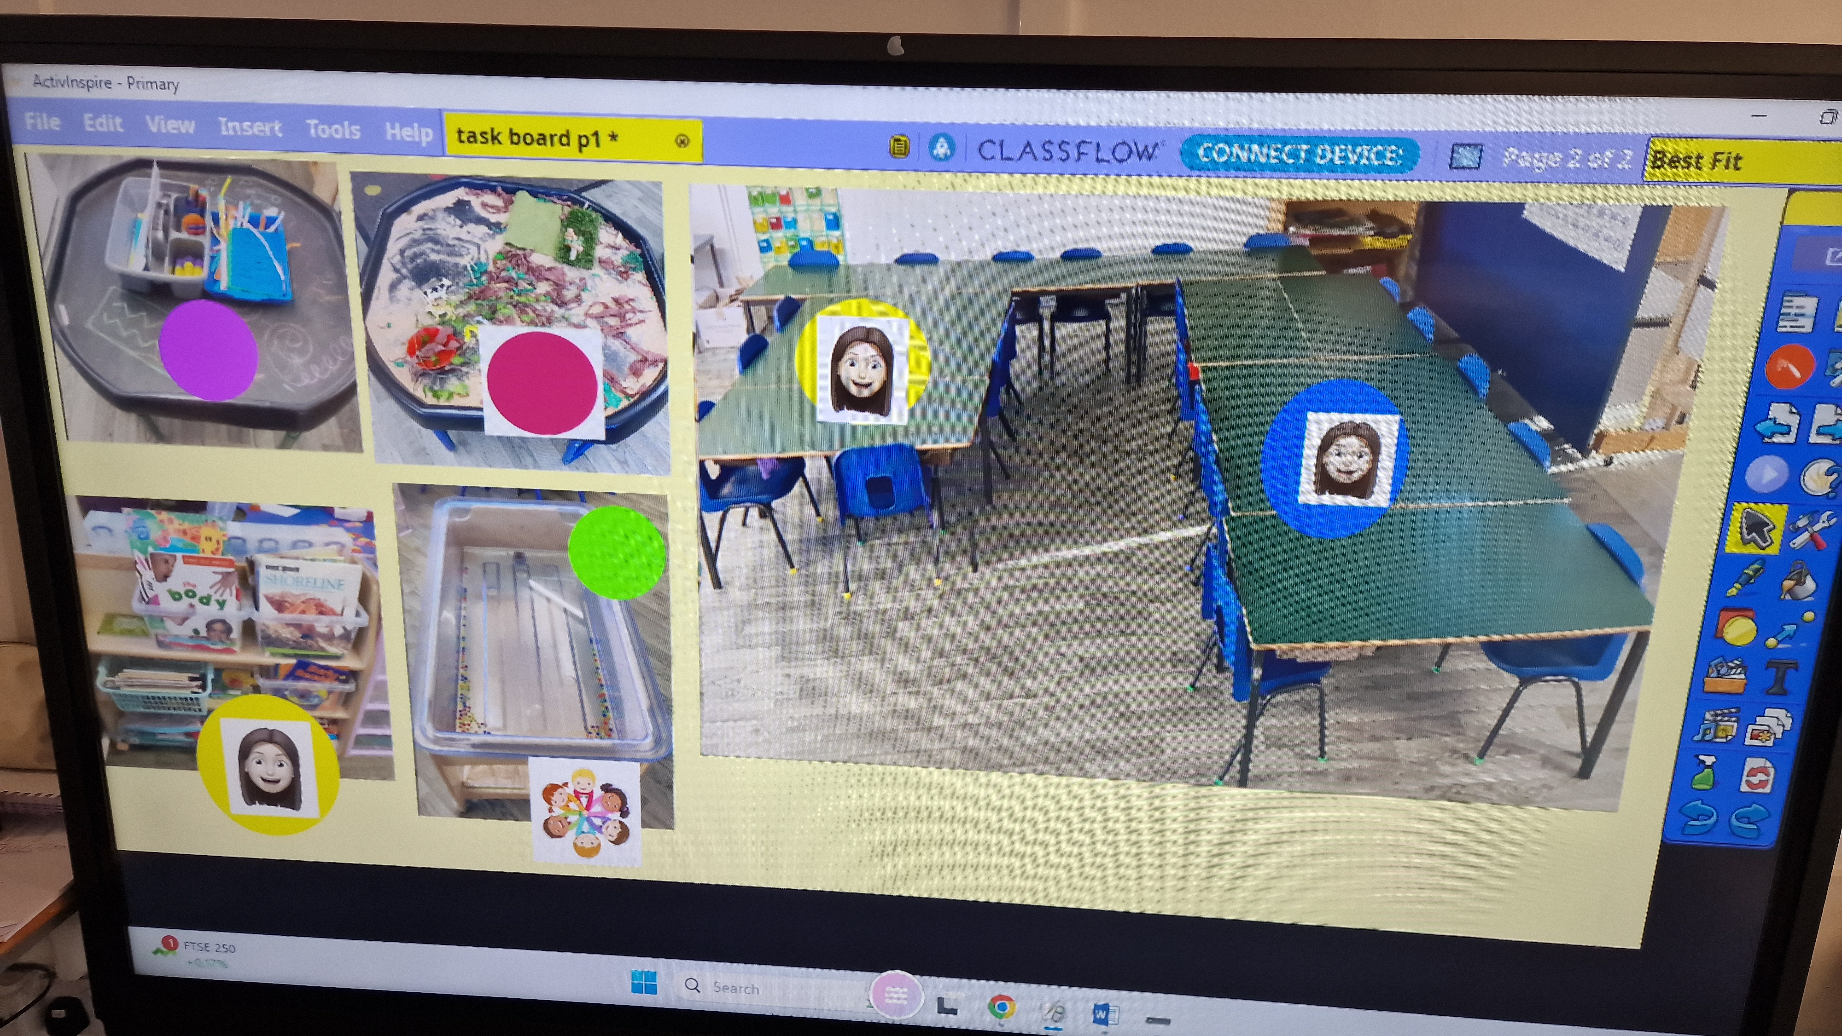
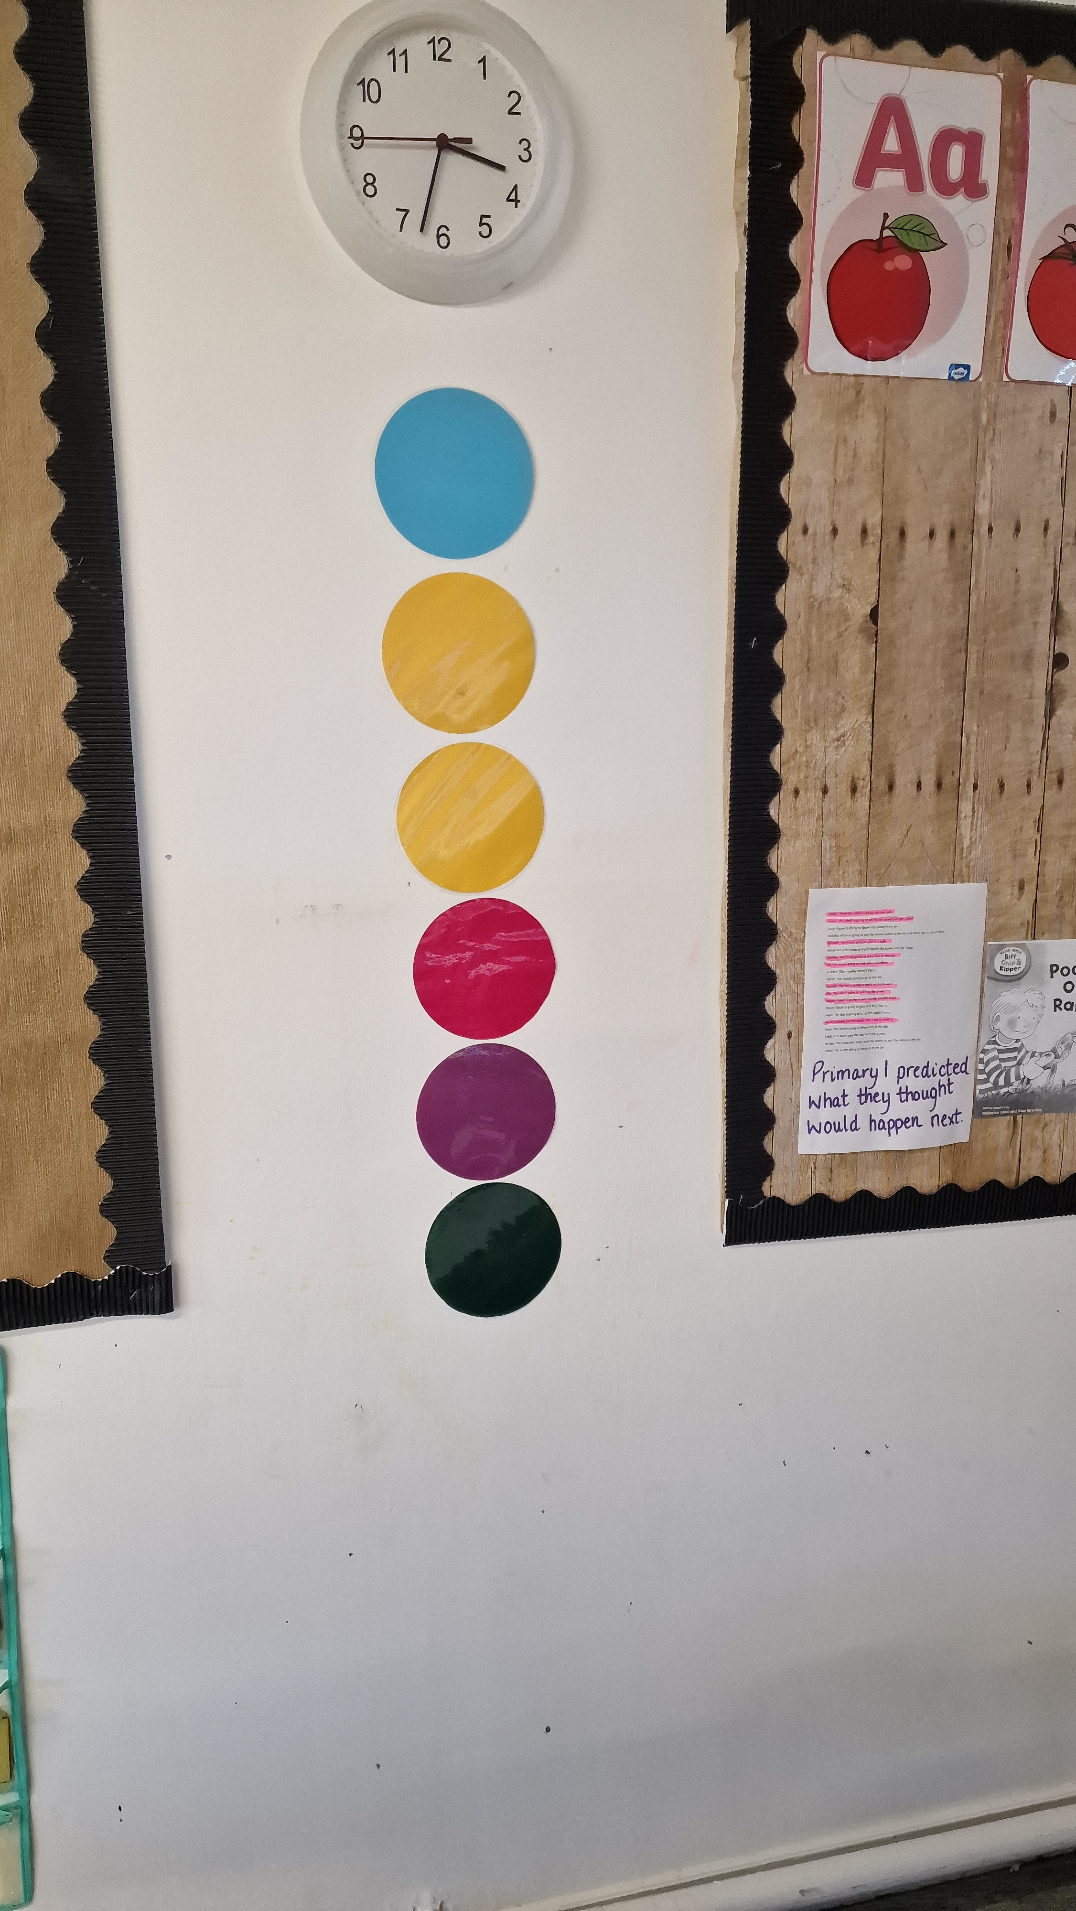
Other
School Values badges
Task boards
Shiny Sharers
Magic Moments

Slide 9

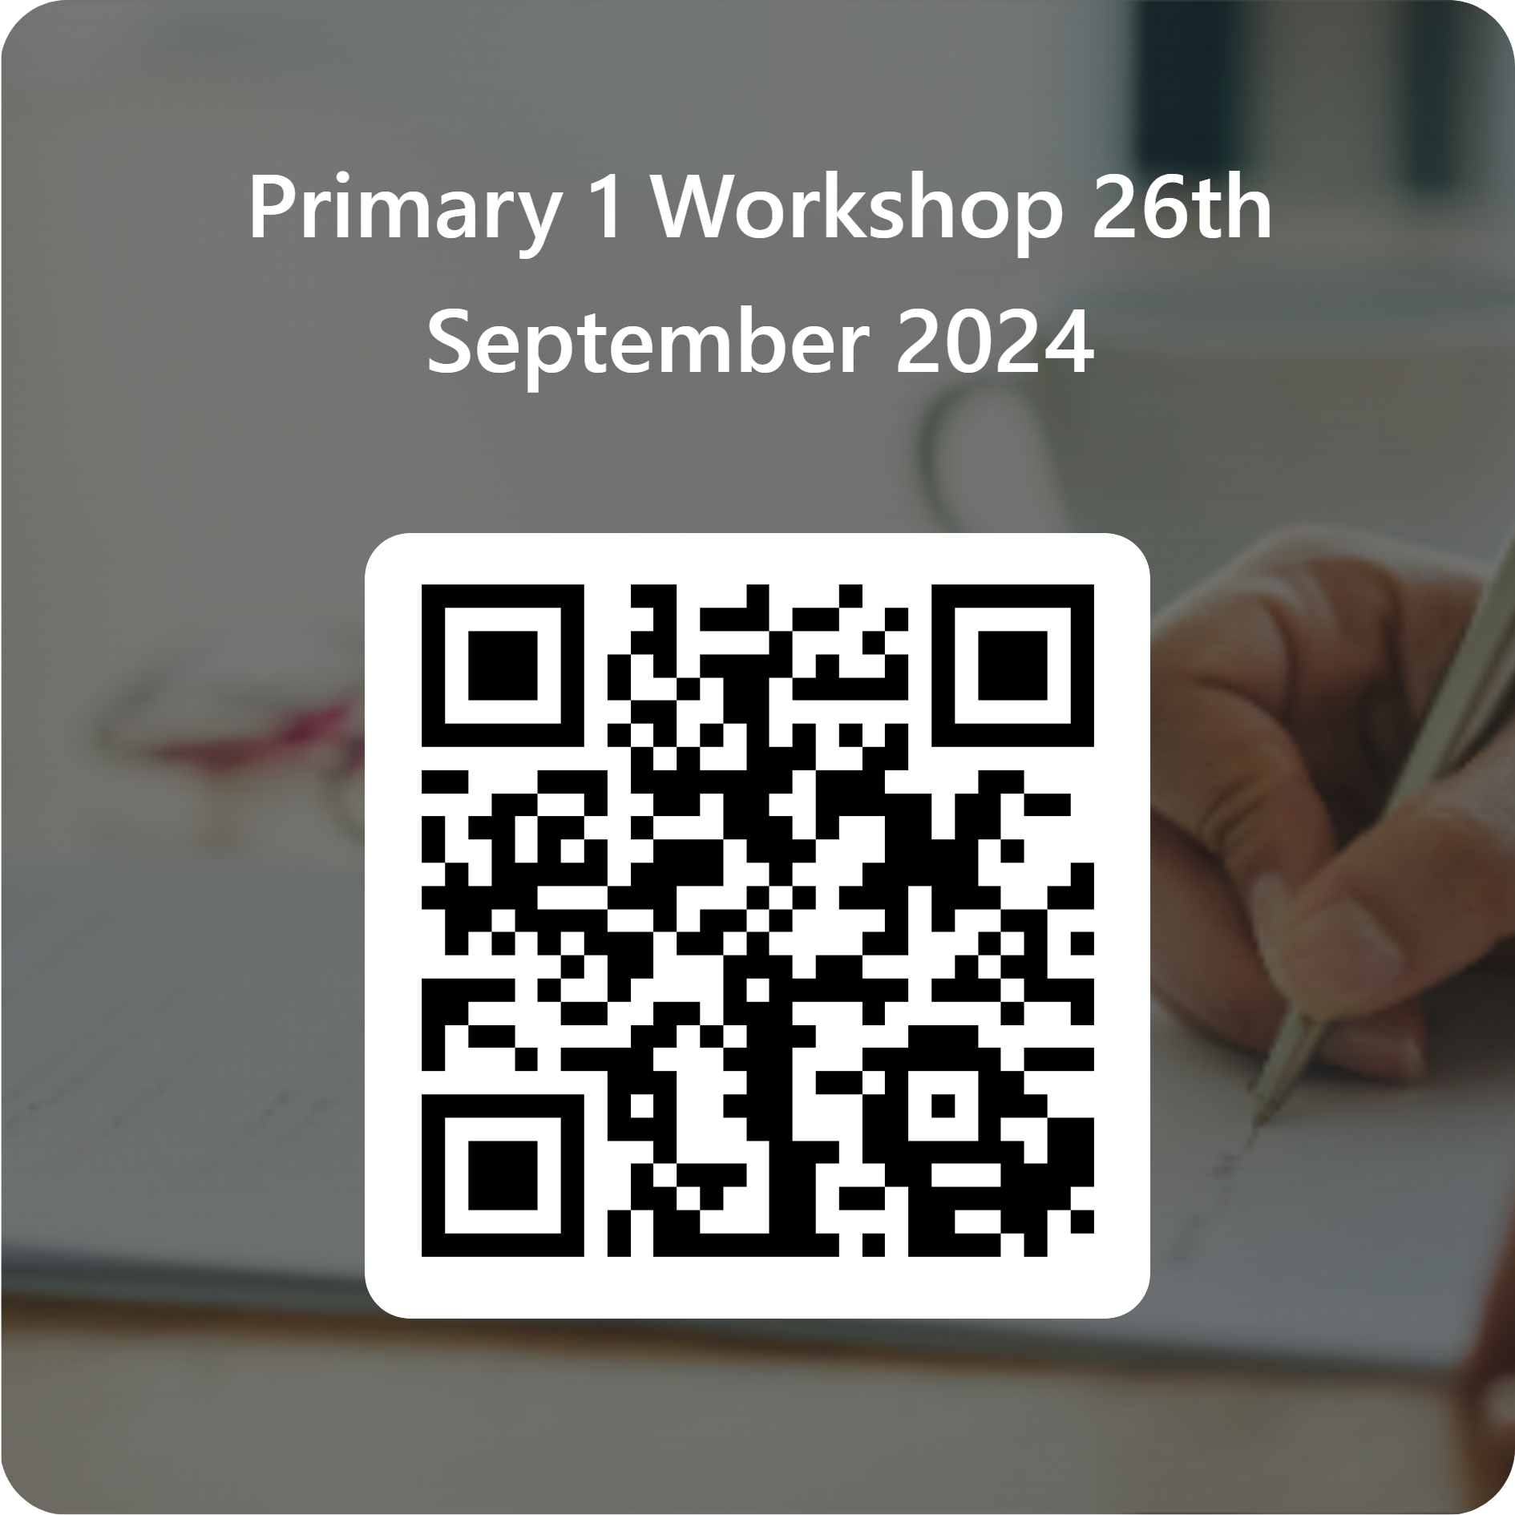
Closing and Thanks
https://forms.office.com/e/MQsbgdVFyn

