Slide 1
Something new is coming...
Your child is learning skills that they will use long after they leave our school.
They use them when they solve a problem. When they work with someone else. When something goes wrong. When they have a new idea. And even when they're helping at home.
We want you to discover them too.
Look out for your first Family Meta-Skills Mission.

Slide 2
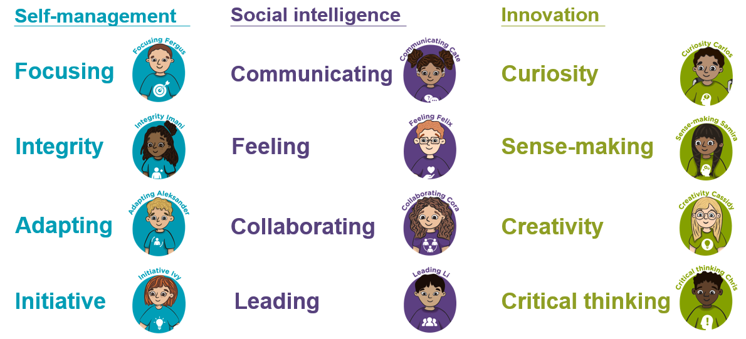
Where are meta-skills hiding in your house?

Slide 3
A new Mission will be put on the school app/class blog every
‘Meta-skills Monday’
Want to share your mission? You can choose to:
Ask your teacher for a Family Meta-skills Mission Passport
Send in a photo
Draw a picture
Write one sentence
Tell your teacher about it
Or simply enjoy doing it together. You don't have to send anything back!

