Slide 1
Primary 1 Workshop
Thursday 25th September

Slide 2
Welcome
Welcome
Introductions
Head Teacher - Mrs Beveridge
Deputy Head Teacher - Mrs Lindsay
Class teachers - Miss Barrett and Miss Ronald

Slide 3
Breakdown
Welcome and Introductions
A Day In Primary 1
Throughout the Week
Homework
Playful Learning
Other
Closing and additional discussions

Slide 4

School Vision and Values

Slide 5

A Day In Primary 1
Children come in
The plan for the day is shared
Emotional check in and morning song
Morning Block- Teaching and Learning
Break time
Transition time
Middle Block - Teaching and Learning
Lunch
Transition time
Afternoon Block - Teaching and Learning
Big tidy up
Home time

Slide 6



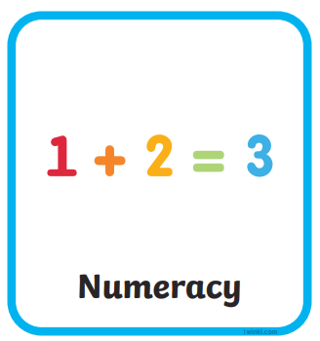


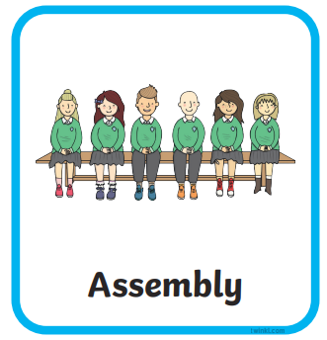
Throughout The Week
Literacy
Numeracy
IDL
P.E
Library
Digital Literacy
Outdoor Learning
French and HWB with Mrs Singleton
RRS covered in class by CT and Mrs Singleton
Assembly
High Five Friday
Shiny Sharers
Other events such as Macmillan Coffee Morning or Maths Week Scotland

Slide 7
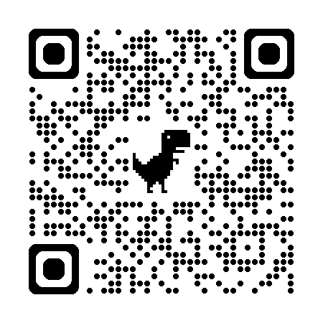
Homework
https://blogs.glowscotland.org.uk/ea/netherrobertland/
Blog- the blog is used for sharing homework, p.e kit guidelines, the yearly overview, sharing success and some other information about school events such as the MacMillan Coffee Morning (check the school app though for full details).

Slide 8
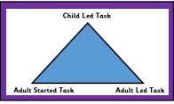
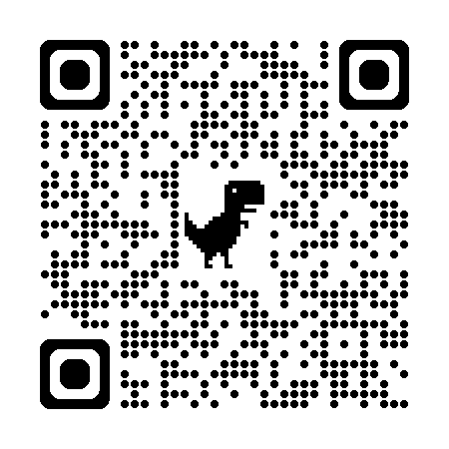
Play...
At Nether Robertland Primary we have a bespoke play pedagogy that has been developed over the last few years through professional development, practical implementation and evaluation.

Slide 9
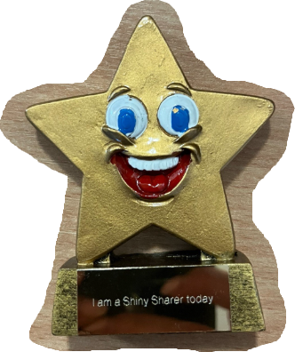
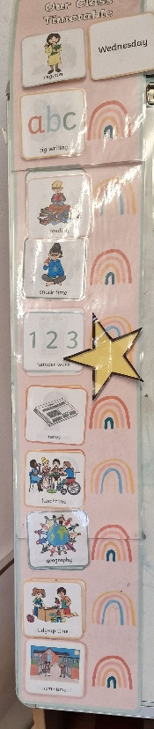

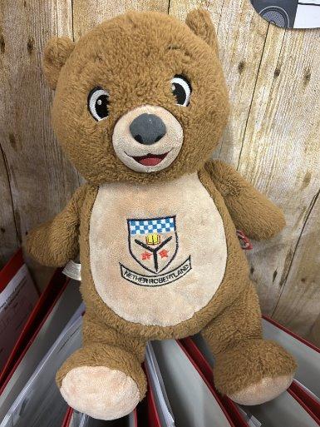
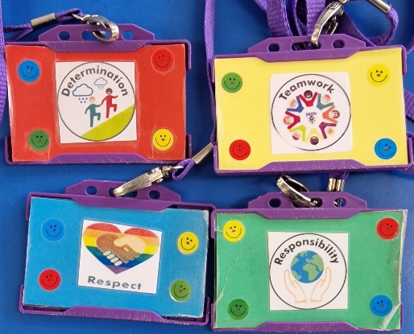
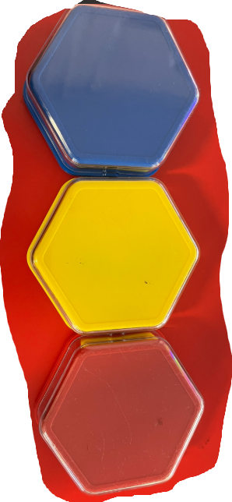
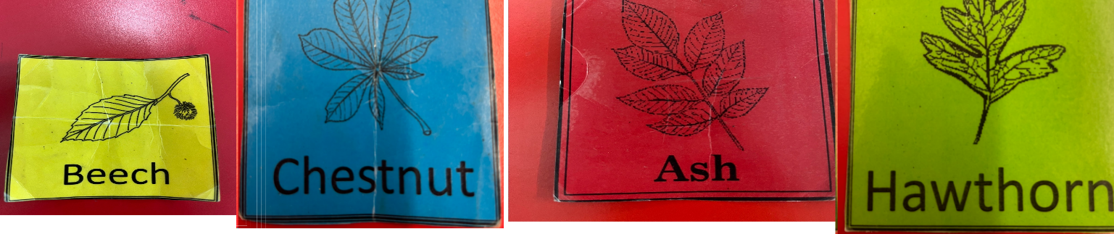
Other

Slide 10

Closing and Thanks

