Slide 1

FAB Friday
25/9/26

Slide 2

Xander M P2/3
Xander is enjoying being back into the shooting season, where he has the opportunity to work with his dogs and spend time outdoors. He takes great enjoyment and pride in caring for and training his dogs, while developing his skills, responsibility and confidence through this outdoor activity.

Slide 3
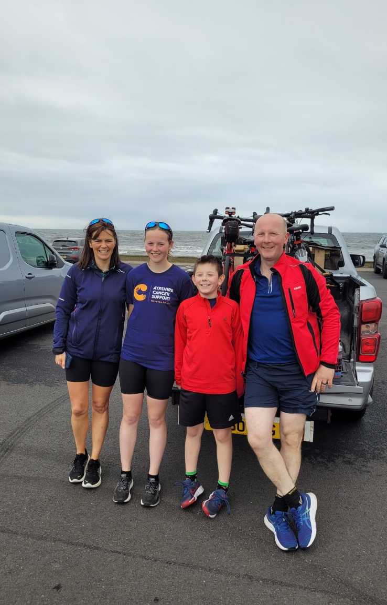
Stewart Y P6/7
Mauchline Young Farmers Club recently organised an olympic distanced Triathlon. Money raised was donated to Cancer Support. Stewart took part and completed in the bike ride which was 40K. A lot of training was done during the summer. Over £13,000 was raised.

Slide 4
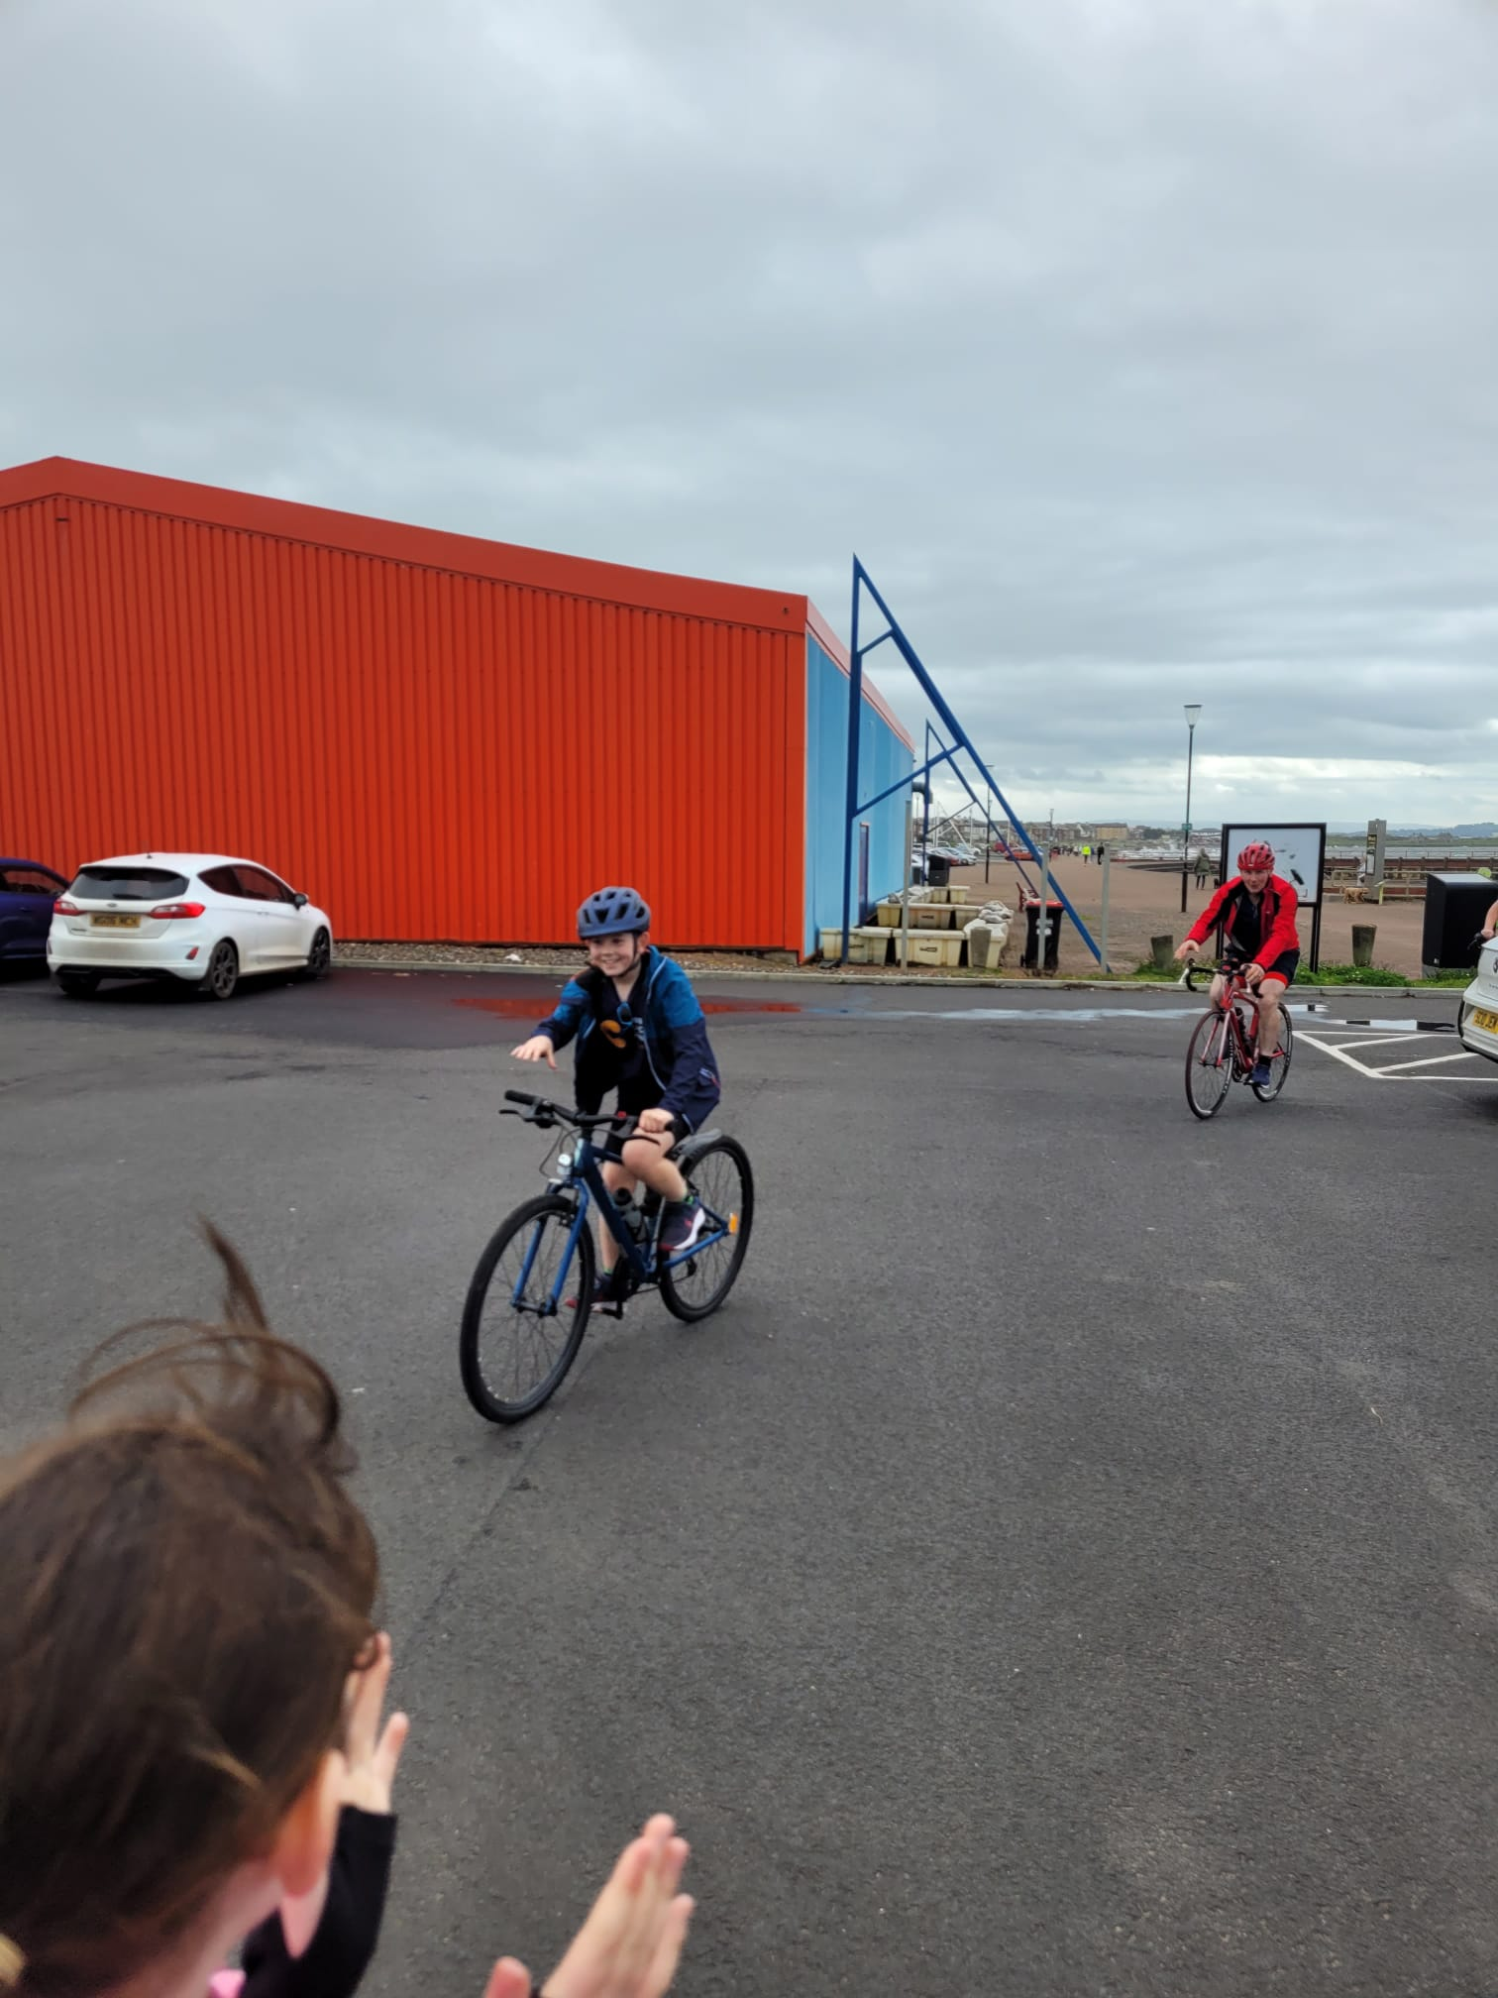
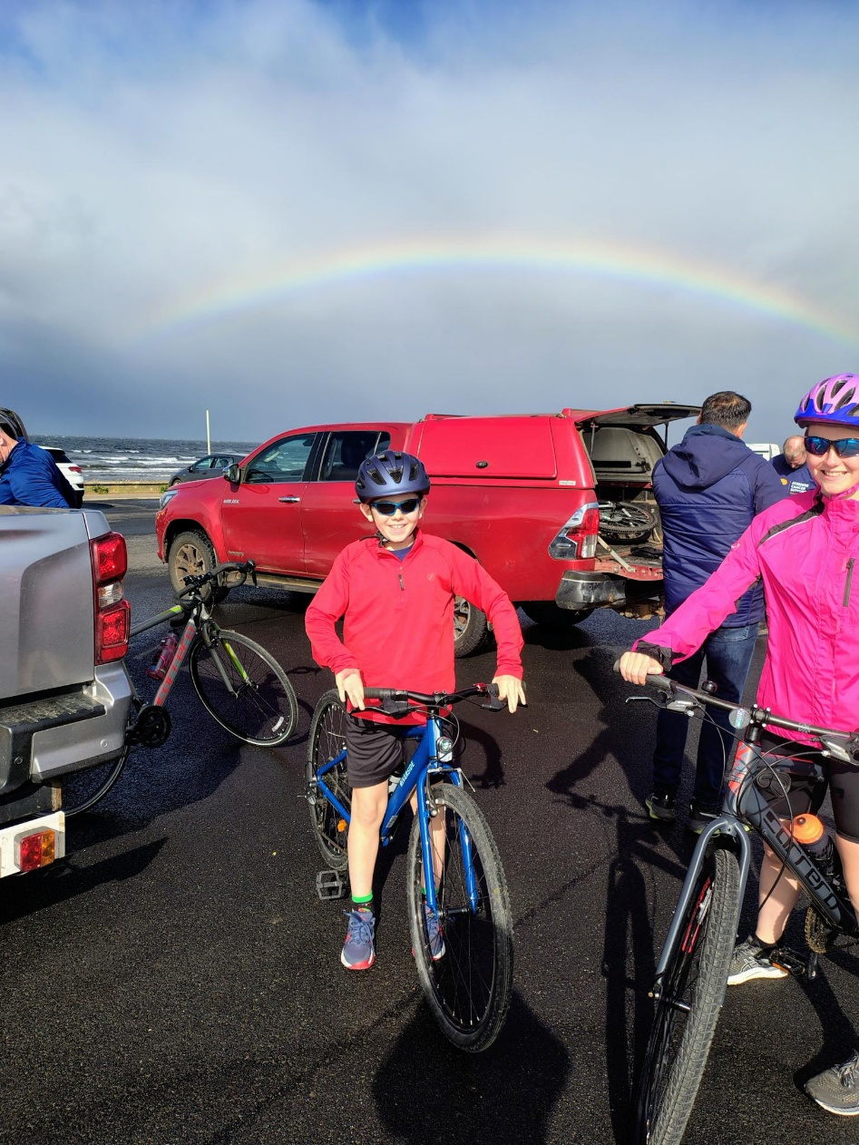

Slide 5

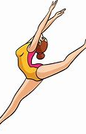
Ruby Sl P2/3
Ruby competed in her first lyrical solo competition at the beginning of September. She came 3rd and is excited for her next competition.

Slide 6
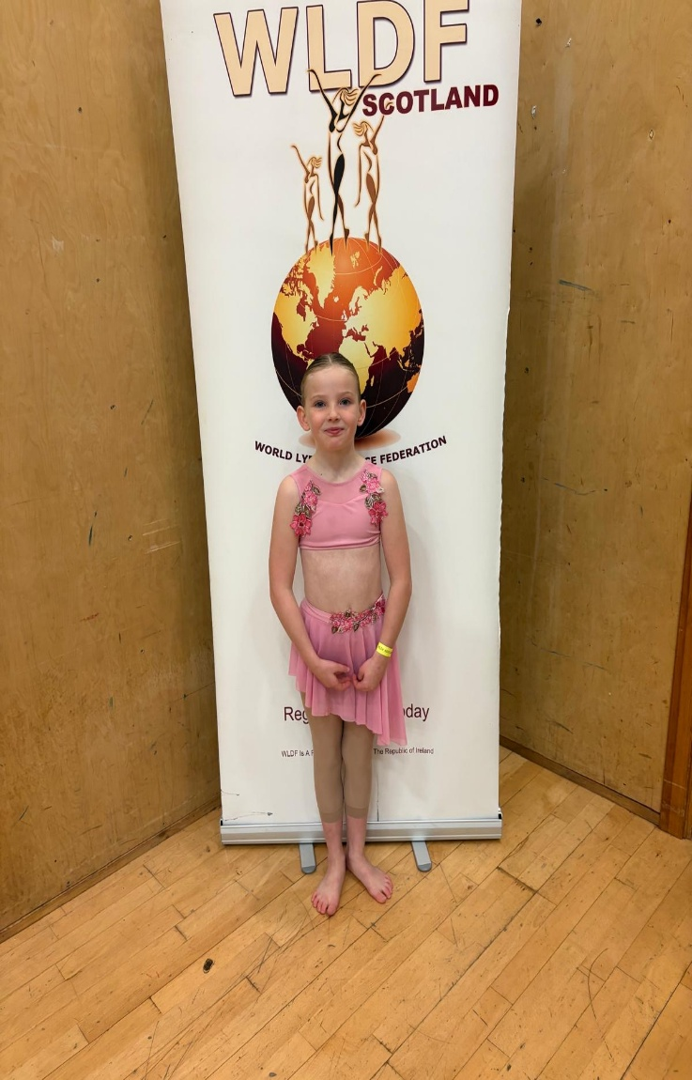
Beth S P3/4
Beth won first place in her first solo comp for lyrical dancing.

Slide 7
