Slide 1
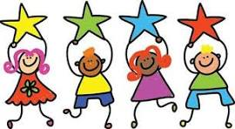
FAB Friday
20/3/26

Slide 2
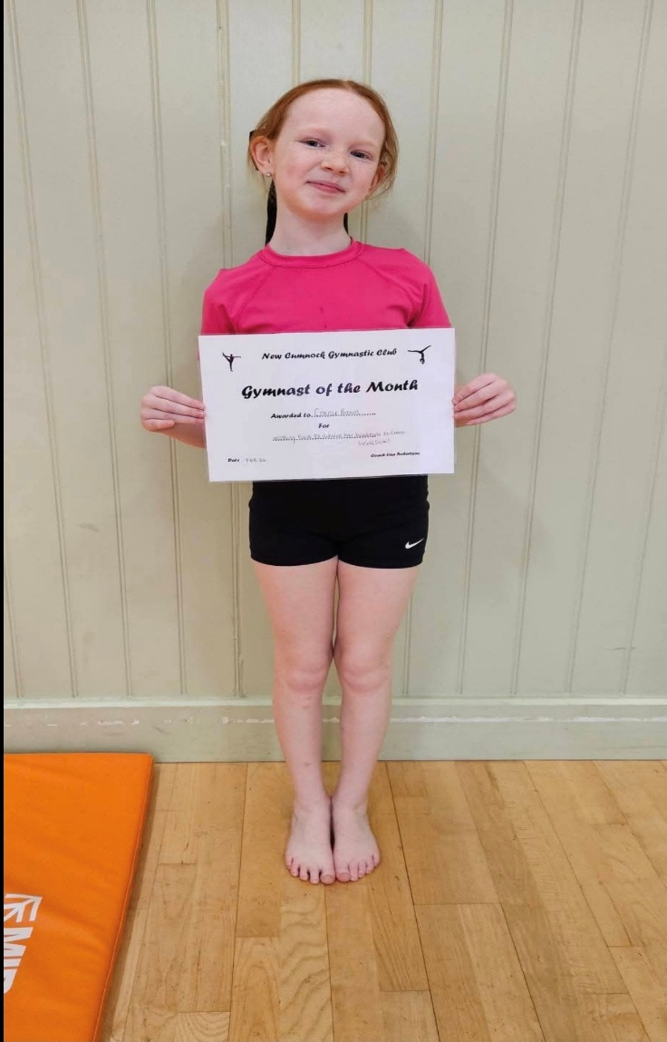
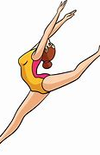
Connie B P5/6
Connie was awarded gymnast of the month for February and will receive her gold medal and assessment placing on the evening of Friday 20th March.

Slide 3
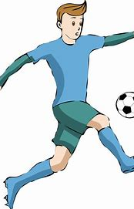
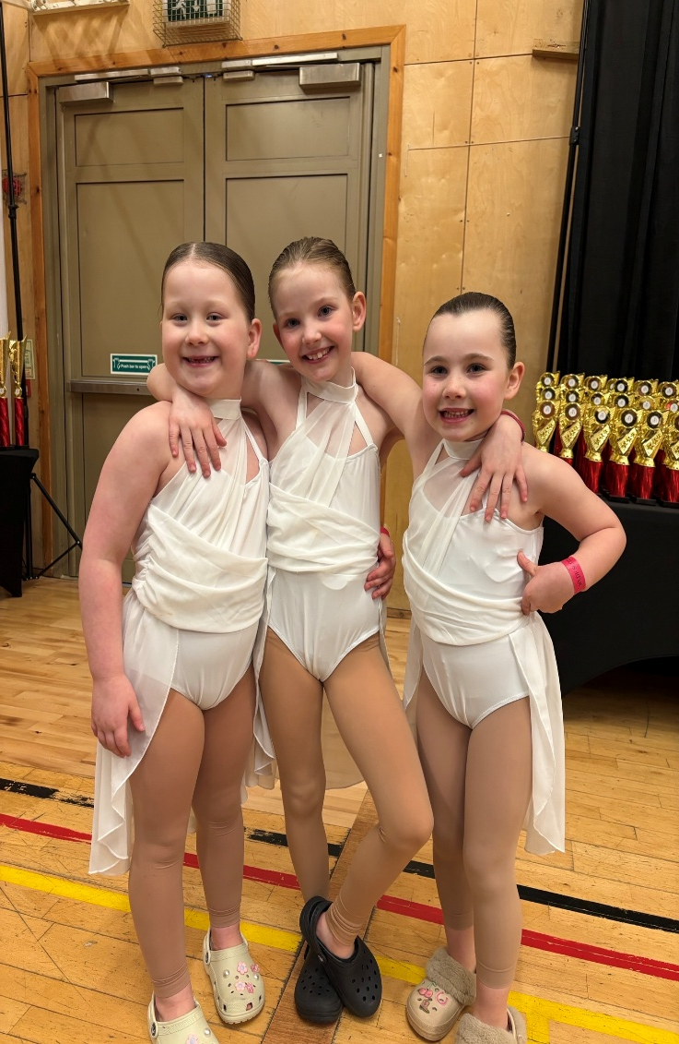
Beth S P3/4, Piper M P2/3 and Ruby Sl P2
The girls had their first ever dance competition and won 1st place for their group dance.

Slide 4
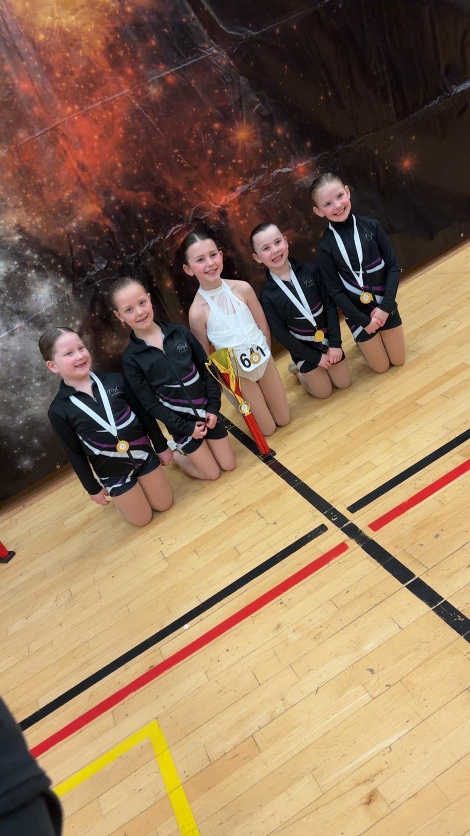
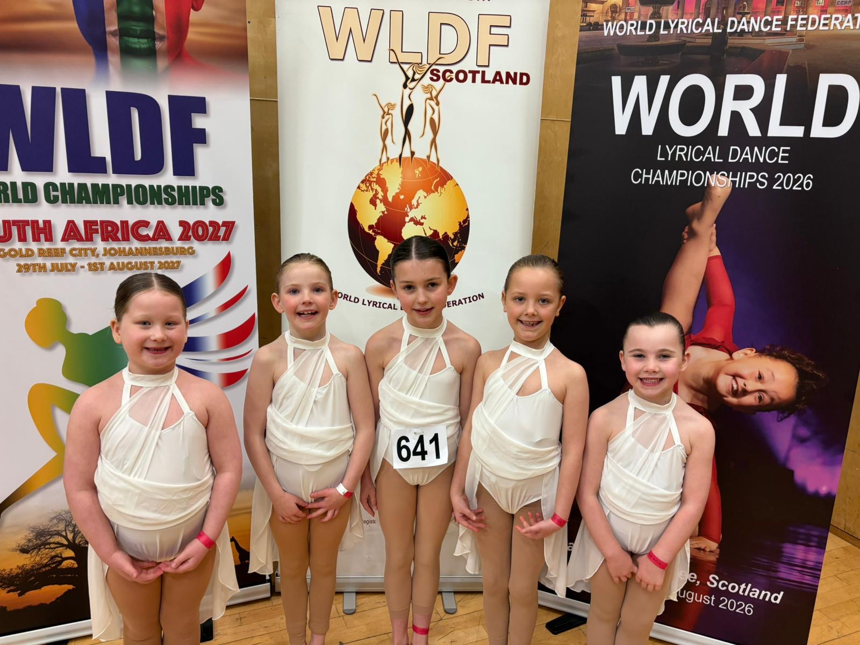

Slide 5
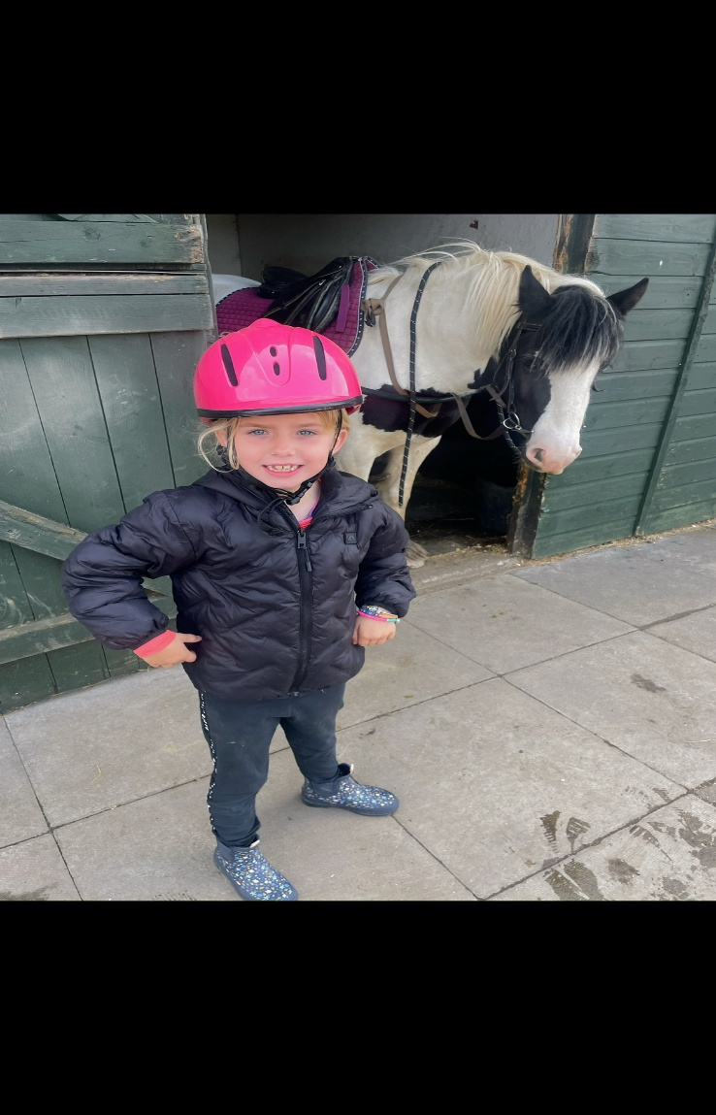
Lucy M P2/3
Lucy received a certificate and rosette for learning to ride and care for horses.

Slide 6
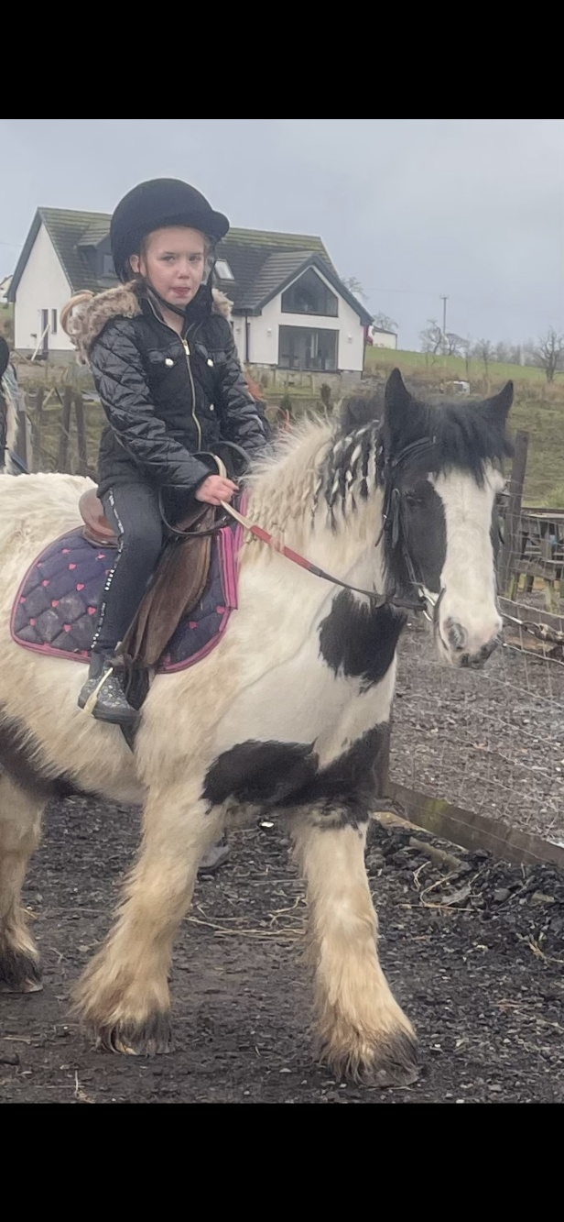

Slide 7
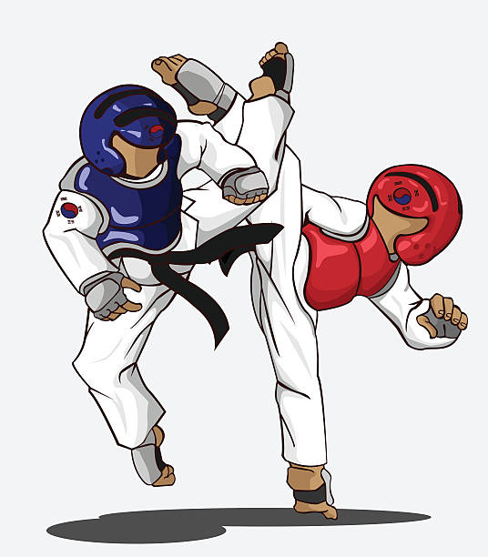
Elias B P5
Elias has now graded to 7th Kup/green tag in Taekwondo. He has also competed in English championship in Penrith and won Bronze medal in Sparring!

Slide 8
Idris B P3/4
Idris has competed in English Taekwondo championships in Penrith and won Silver in Sparring.

Slide 9
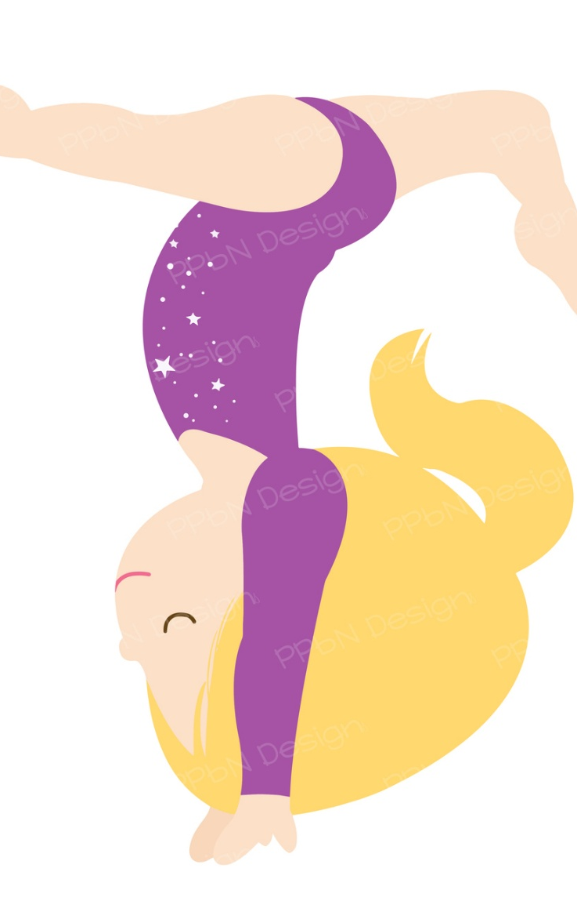
Carla C P3/4
Carla received a medal for gymnastics.

Slide 10
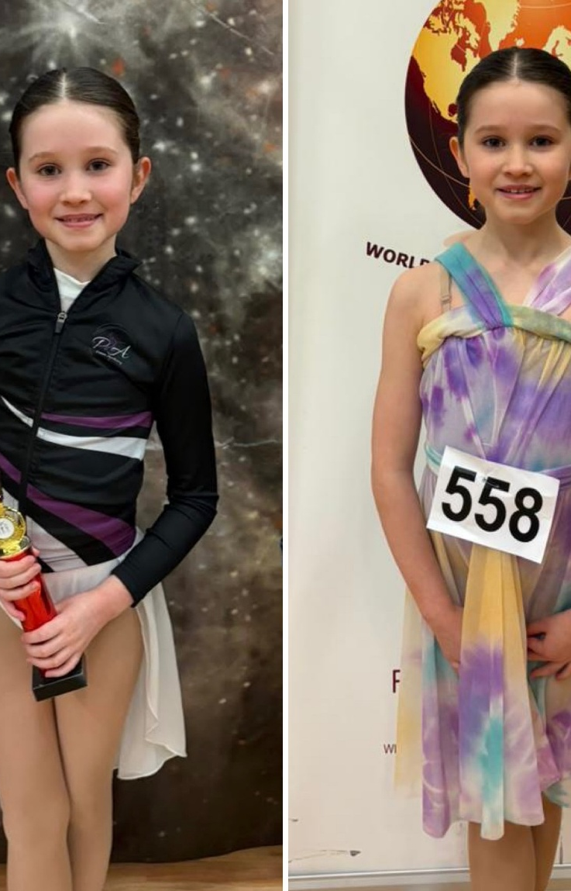
Daisy M P5
Daisy completed her first solo grading at her Lyrical dance competition last Sunday. She was placed 2nd in her group and received a trophy and a medal. The judges gave feedback on what went well with the dance and tips on areas for improvement.

