Slide 1

FAB Friday
13/12/24

Slide 2
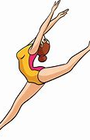
Carla Capperauld P3/4
Carla received a certificate at her gymnastics class for being Gymnast of the Month

Slide 3
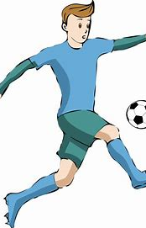
Dylan Marshall P5
Signed for Queens Park FC

Slide 4

Stewart Young P4
Stewart was picked to be a Scotland mascot at the recent Scotland v Fiji game at Murrayfield.
Stewart also won the 'Hammer' award for best tackling at a recent Cumnock v Biggar rugby game.

Slide 5
Cayla Cowley P3/4
Cayla received a certificate at her gymnastics class for being Gymnast of the Month

Slide 6

Lucia Ondrusik P6
Lucia was confident enough to host a stall at the Christmas Fayre. She worked very hard to make her bracelets to offer.

