Slide 1
Information Session
June 2023

Slide 2
Overview of transition this year…
Approaches to a smooth transition to Primary 1…
Friday afternoons have been spent -
Working in the Primary 1 classroom alongside our current Primary 1 children in play sessions
Developing relationships with their Buddy/buddies (our current Primary 6 pupils) who will be supporting them in various ways when they are in Primary 1 - playground activities, in the P1 classroom and in the ECC.
Other appropriate calendar events e.g. ECC children and Primary 1 children sharing about something they have been learning about with each other, Scottish Poetry and Choir Presentation, ECC Sports, playground fun together, P6 Biddies at Graduation, ECC through to see our Summer Show Dress Rehearsal.

Slide 3
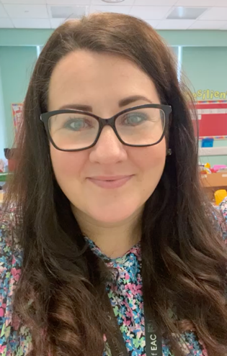
School Staff – Management Team
Mrs McMurdo Mr Hastings Mrs McNulty
Head Teacher Depute Head Teacher Principal Teacher

Slide 4
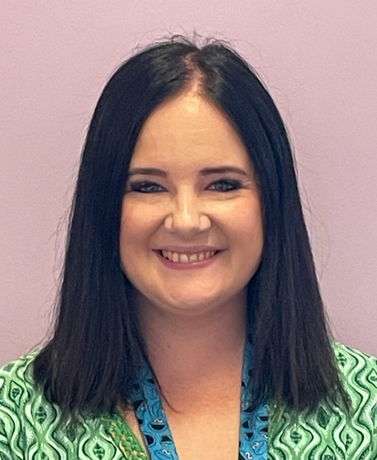
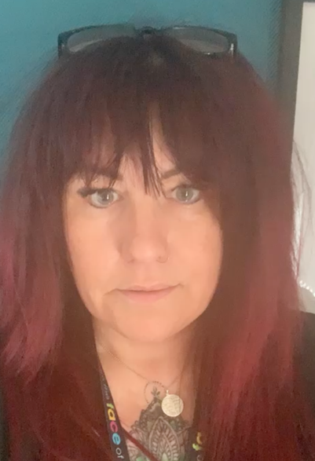
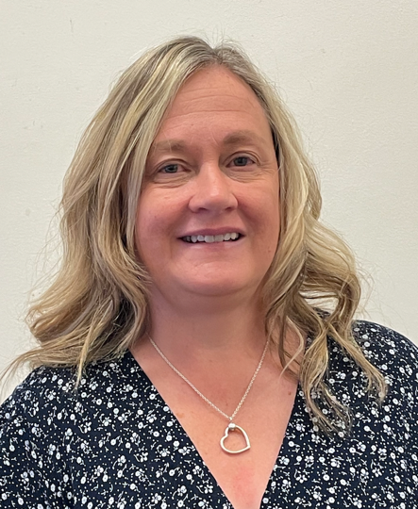
Other Key Staff Members
Mrs Clarke
Primary 1 Class Teacher
Mrs Elliott
Primary 1/2 Class Teacher
Mrs Bradford
Home Link Practitioner

Slide 5
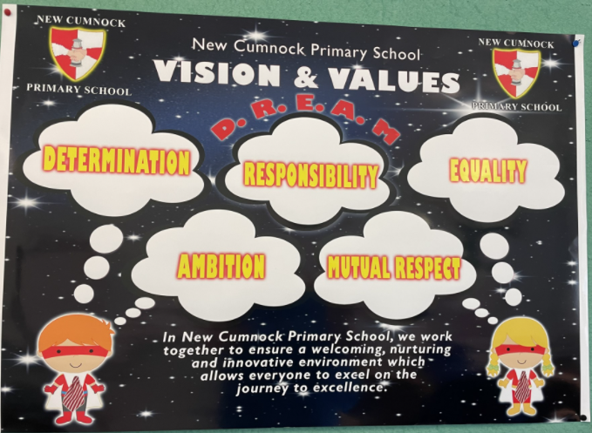
Vision, Values and Aims

Slide 6
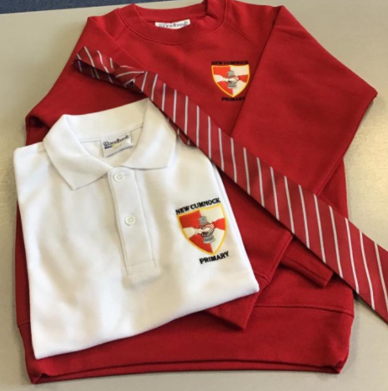
School Uniform
Donsport and Kenny’s in Cumnock stock our uniform.
We encourage the uniform is worn every day to school.
Please put first and second names on every piece of clothing – we have huge bundles of unclaimed clothing items and we know how much these items cost.

Slide 7
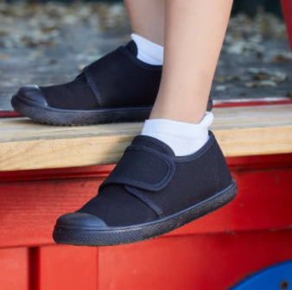
PE Days/Gym Kit
We ask that you provide a pair of shorts and gym shoes that your child will wear for PE. The kit will remain in the school throughout the year. If the kit becomes too small or dirty, we will send the shoes or shorts home with a note.

Slide 8
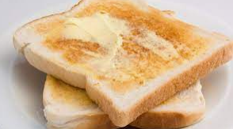
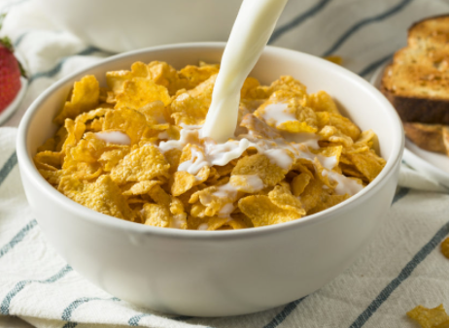
Breakfast Club
Breakfast Club will start at 8.15am and children are to enter via the door to the back of the gym hall (at the rear of the school car park). At 8.45am, children will be released into the school playground before coming into school with their classmates, all energised for the day ahead!

Slide 9
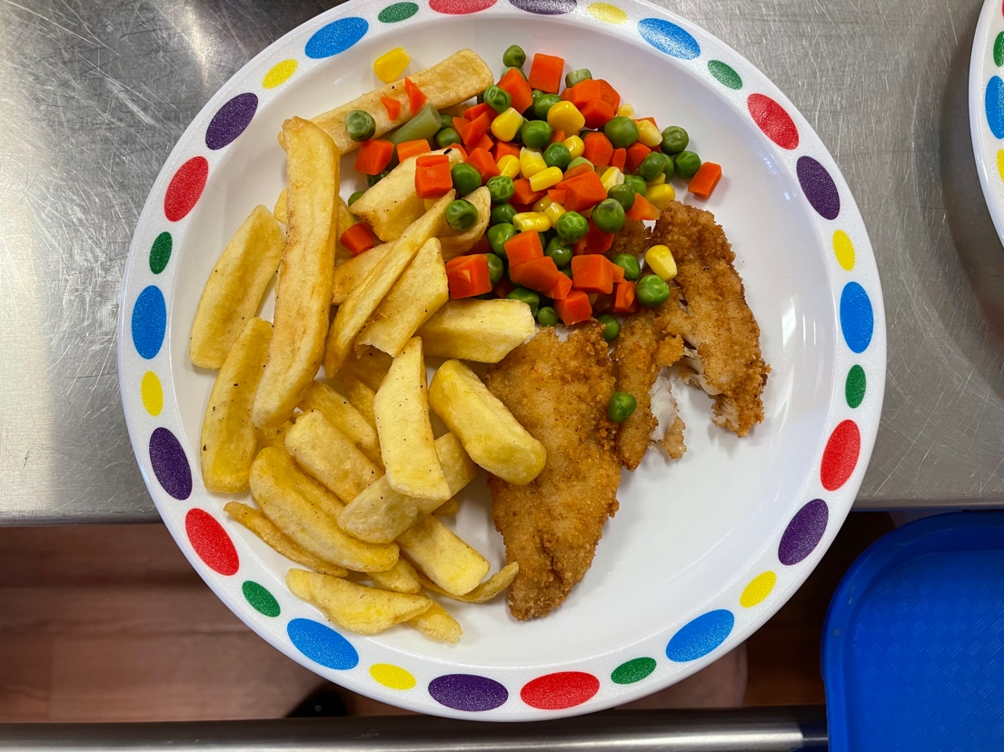
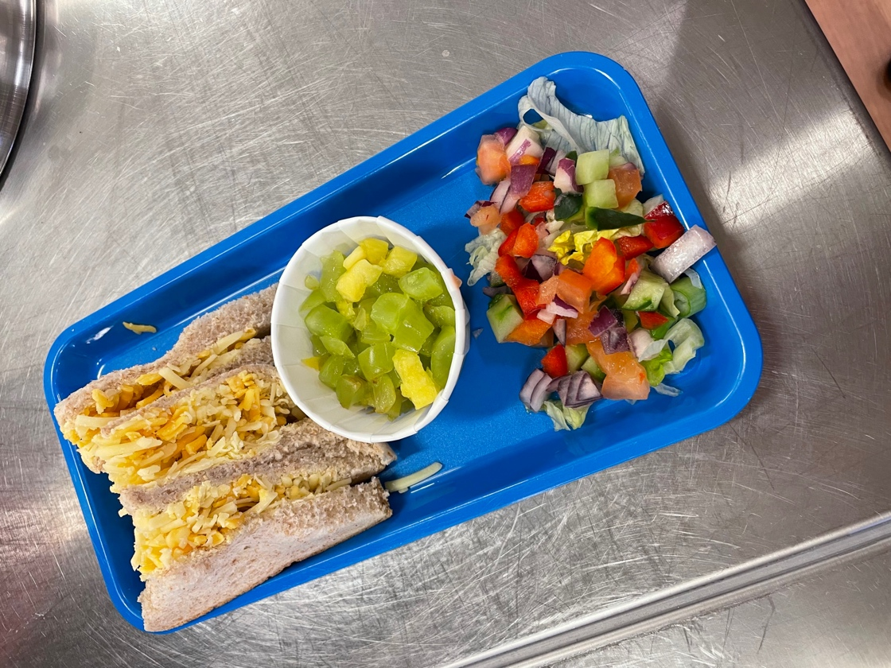
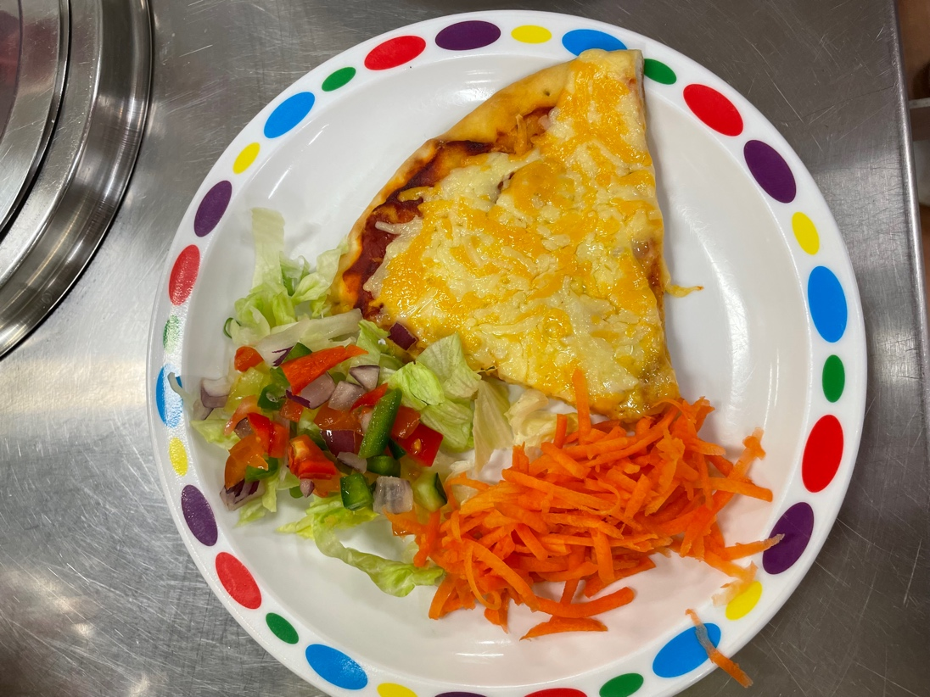
Play Time/Lunch Time
Playtime Snacks
Lunch
A small snack is all that they need – some children take too much and don’t manage to eat it all. We have pupils within the school that have a NUT ALLERGY, therefore please ensure your child’s snack or packed lunch does not contain nuts.
Primary 1 children are entitled to free meals and we have a system where the children can choose what they want from a varied and healthy menu. There is always soup and a choice of 3 main courses and fruit.
The School App will keep you up to date as to what the lunch choices are each day.
Some children prefer a packed lunch which is eaten in the hall at the same time. They are always supervised in the lunch hall by the Senior Management Team and Classroom Assistants.

Slide 10
Parent Pay
We are a cashless school – anything needing paid throughout the year, you will need to pay through Parent Pay – an activation letter will be given to you for this by the school.
Even though your child will receive free school meals, we encourage you to still set up this link when you receive your activation letter.

Slide 11
Communication by telephone or email
Please ask if there is anything that you ever need to know – we are always here to help and support.

Slide 12
Learning Journals
Learning Journals allows staff to upload photos and videos of your child’s learning. The system is clear, simple and easy to use for parents, staff and children.
Parents can instantly leave comments and feedback ensuring that the school have a strong link with the home.
It is a secure platform that only allows those people with login details to see the journal – therefore teacher and parents/carers who are linked.

Slide 13
Parent Council
The Parent Council represents parents’ views and supports the school in its work with pupils, reporting back to the Parent Forum.
In addition, the Parent Council organize fund-raising events and encourage links between the school, parents, pupils and the wider community.
Please get involved...

Slide 14
The Primary 1 Curriculum
What will my child learn?
How will my child learn?

Slide 15
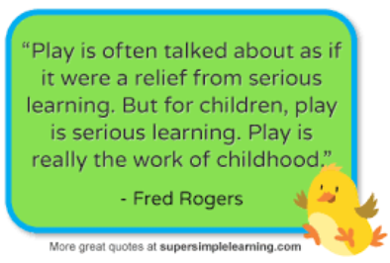
Play based Pedagogy
No formal sitting at desks – active learning situations.
Teacher directed tasks
Teacher initiated tasks
Child initiated tasks

Slide 16
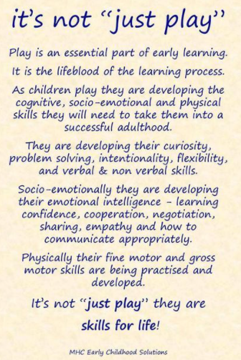

Slide 17
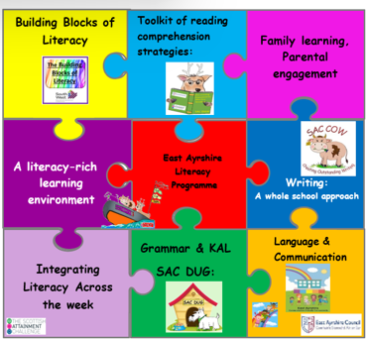
Literacy
Notes:
Jolly Phonics has been developed by practising classroom teachers.
It provides a systematic approach to teaching children how to read and write in their first year of school.
It is a synthetic phonics programme (also known as ‘systematic phonics’ in North America): the children first learn the letter sounds and are then taught to read words by ‘synthesising’, or blending, the sounds together.
This method allows children to work out unknown words for themselves, rather than being asked to memorise them. This is an important step towards independent reading.

Slide 18
Phonics
Phonics is how we teach children to read by linking sounds (phonemes) and the symbols that represent them (graphemes, or letters).
It is a code - the alphabetic code.
Notes:
Phonics teaches the link between the words we say or think, and the words that are written on the page. When we speak, all our speech sounds or phonemes, will have a letter or grapheme to represent them in writing. That is what phonics is. It is a code – the alphabetic code and we need to teach children the code and not leave them to work it out for themselves. Systematic synthetic phonics helps us teach the alphabetic code. We continue teaching the code until all the complex letter to sound correspondences have been taught. This means we carry on teaching phonics throughout primary school. At later stages it is our ‘go to’ spelling strategy. As an adult, it is how we read a word we have never seen before.

Slide 19
Say the word ‘cat’ out loud.
Can you identify the sounds you say in this word?
c
a
t
/c/ /a/ /t/
And we can then write the word - cat
Notes:
Say the word <cat> out loud. Can you hear the sounds you say? Phonics is a reversible code.

Slide 20
Phonics skills we teach:
Blending:
For reading we teach blending: sound out and blend the sounds all through the word (decoding)
Notes:
We need children to know the letter/sound correspondences
So they can blend

Slide 21
Phonics skills we teach:
Letter formation:
Your child learns how to write the letters (graphemes) as they are taught each sound (phoneme).

Slide 22
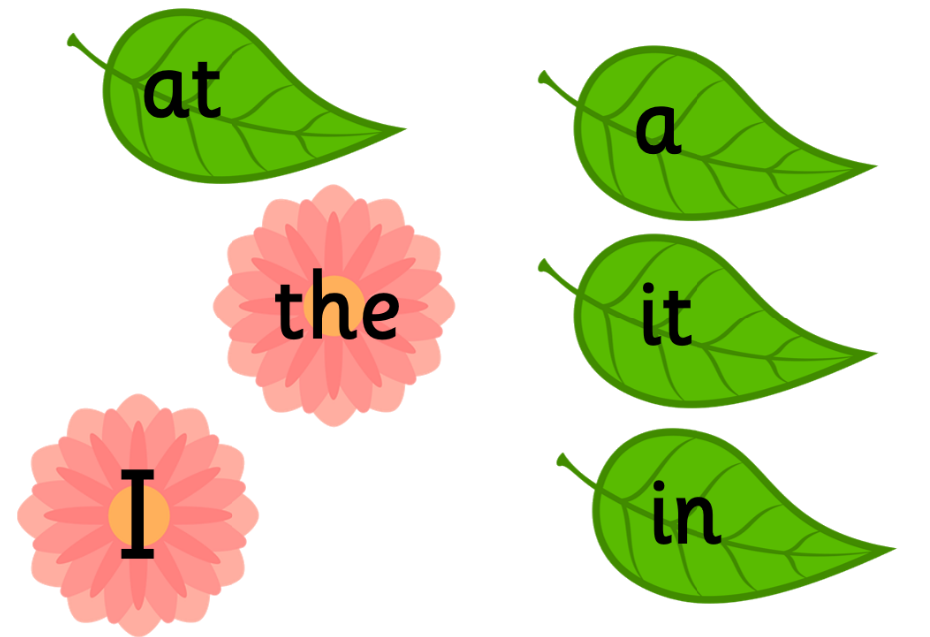
Common or High Frequency Words
We teach these words as part of our phonics programme.
Notes:
The only word that we ask children to memorise by sight is the word ‘the’ – we teach this word very early in the programme and the children do not have the phonics knowledge to read it yet. When they meet <I> they have learned the /i/ sound. We teach them that sometimes this letter represents the sound /igh/. However, they can read the others using their sounds knowledge. We just point out the tricky bit, and children use their phonics knowledge to read the rest. That is how good readers read.

Slide 23
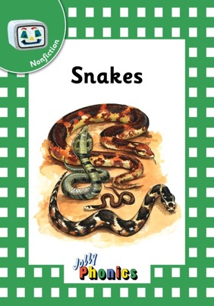
Jolly Phonics Readers
A wealth of interesting, decodable texts
23
Notes:
Once the children know the 42 letter sounds and the first set of tricky words, and can read and write regular words, the children are ready to read the first set of Jolly Phonics Readers.
There are three series of six books in each of the four levels, making 72 books in total. The series are: Inky Mouse and Friends, which has stories about the characters Inky, Snake, Bee and Phonic. General Fiction, with new stories or adaptations of old favourites, and Non Fiction, which features texts about nature, science and the real world.
The Readers are decodable texts, which means they have been carefully written using controlled vocabulary and using only the letter sounds, spellings and tricky words that the children will know. Because Jolly Phonics teaches the digraphs and tricky words early on, the texts are lively and interesting from the start.

Slide 24
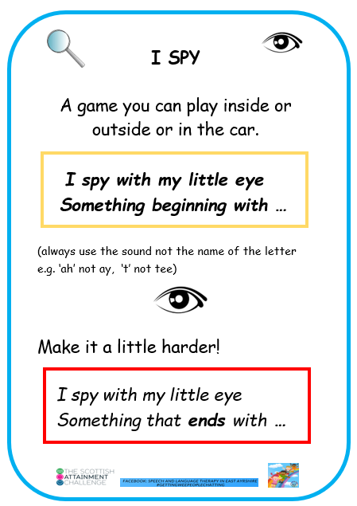
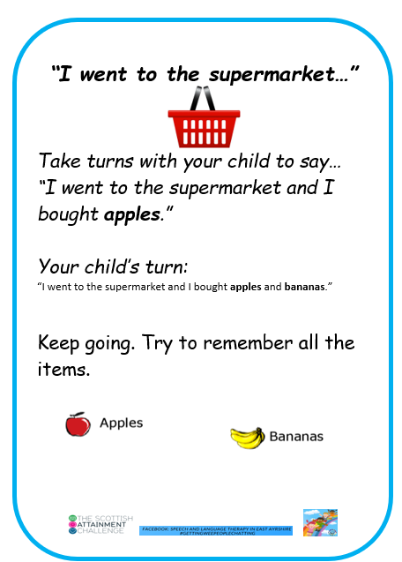
What can you do to help your child?
Notes:
At this stage in P1 – use the sounds of letters not the names.

Slide 25
Talk for Writing

Slide 26
Talk for Writing builds upon this simple understanding by developing systematic approaches to early language development through story and rhyme.

Slide 27
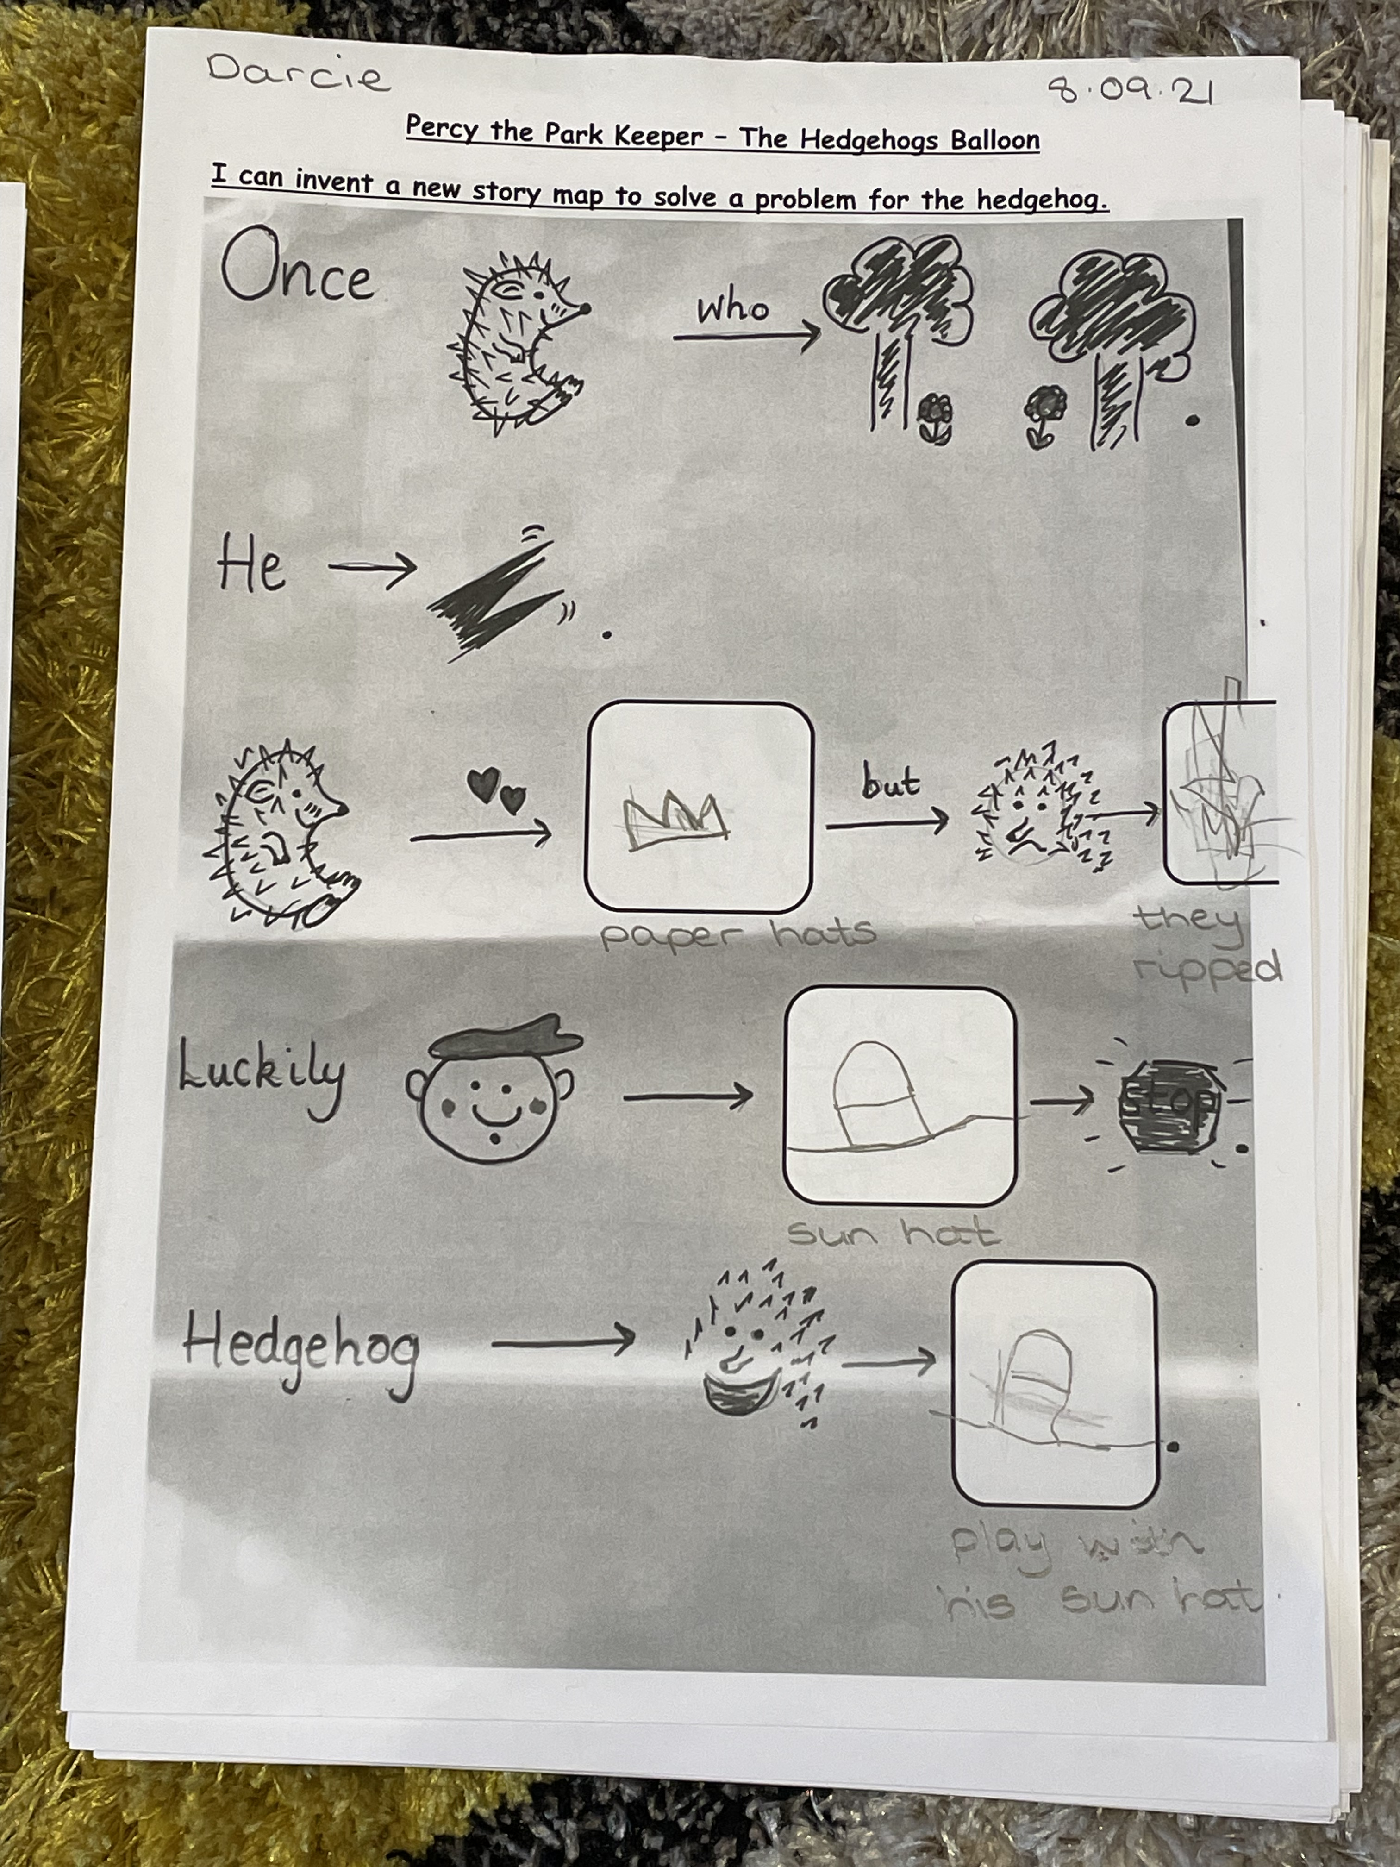
Pupil A
Using the story map to invent and
orally tell their own story – video
recordings as evidence.
Actions for words are used to help
the children remember their stories.

Slide 28
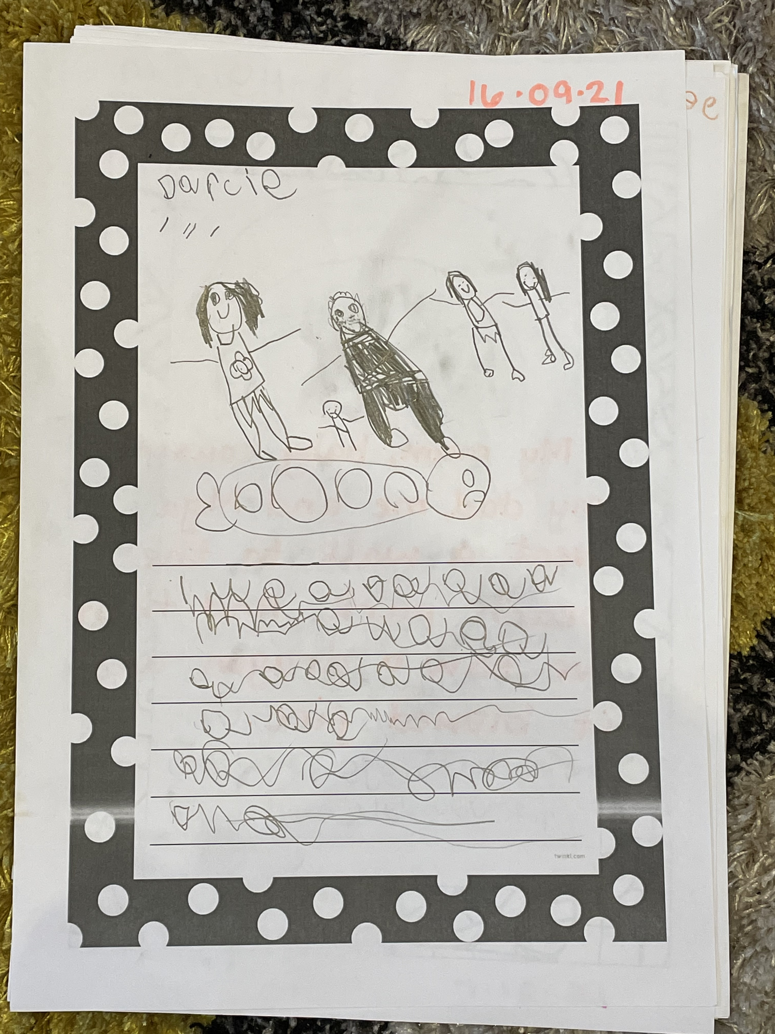
Pupil A
Happy to mark make their story
and then orally ”read” their story.

Slide 29
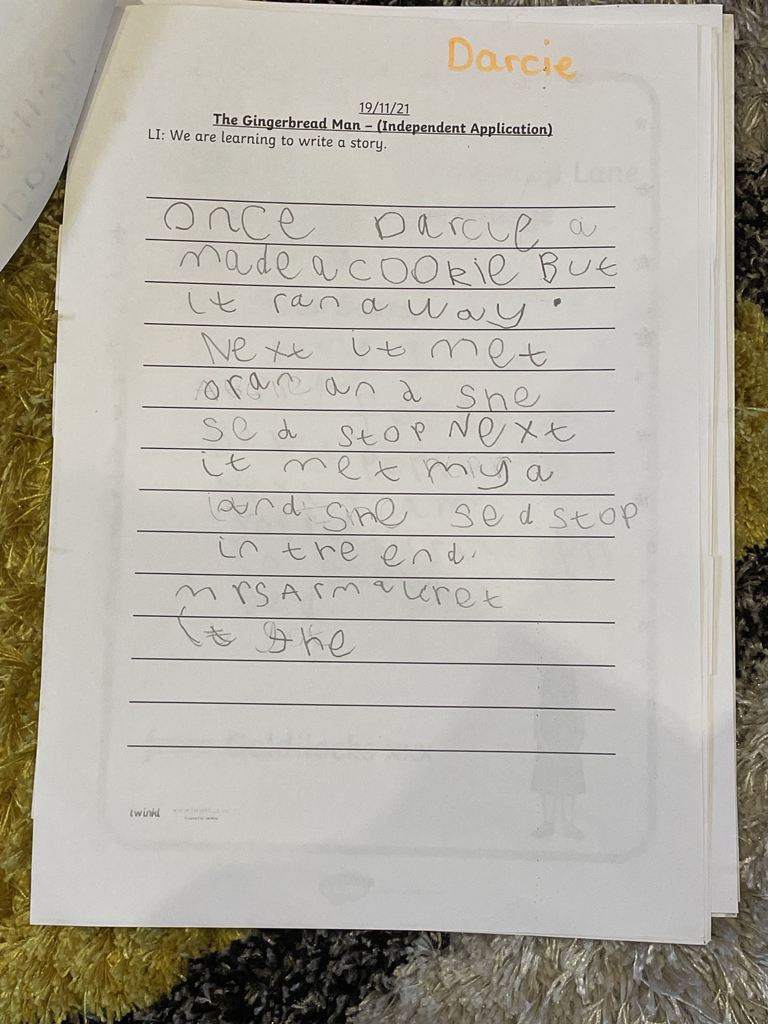
Pupil A
Beginning to write words and use
knowledge of phonemes/sounds
learned to then write their story –
including a full stop to mark the
End of the sentence!!!

Slide 30
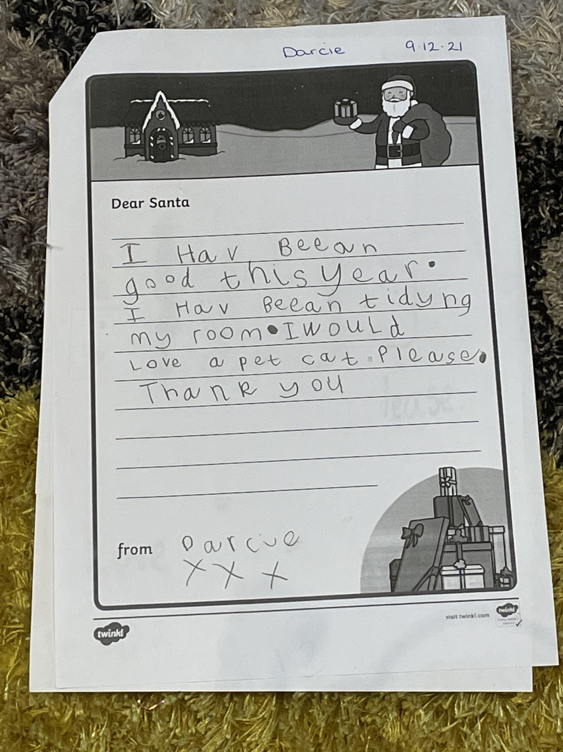
Pupil A
3 sentences independently written.
Using knowledge of sounds/phonemes
to spell and write words. Pupil A is also
actively using the common word wall
in class to support her writing.

Slide 31
4 sentences independently written.
Using knowledge of sounds/phonemes
to spell and write words.
Beginning to add in describing words – big,
quickly!!!

Slide 32
Numeracy
Active approaches –
Concrete, Pictorial Representations, Abstract

Slide 33
Concepts taught in P1
Number sense – counting, recognising, ordering and writing digits.
Addition.
Subtraction.
Money –recognition of the coins and be able to use coins to pay for items and receive change.
Fractions – sharing to create smaller groups.
Time – o'clock and half past – analogue and digital.
Shape – 2D and 3D shapes.
Pattern – repeating patterns.
Measurement – basic intro to measuring – comparing lengths, volumes…
Data Handling – introduction to picture graphs and tally marks

Slide 34
Explanation of the teaching approach…
Step 1 - Concrete
Step 2 - Pictorial Representations
Step 3 - Abstract

Slide 35
Parental Support for Numeracy
https://blogs.glowscotland.org.uk/ea/numeracyandmathematics/category/numeracy-strategies-for-parents-carers/

Slide 36
School Website
https://blogs.glowscotland.org.uk/ea/newcumnockprimaryschoolea/

Slide 37
Safer School Scotland App

Slide 38
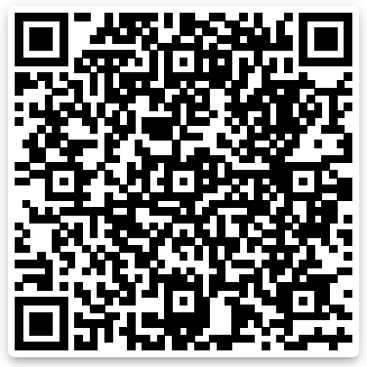
Learning Journals Demonstration

