Slide 1


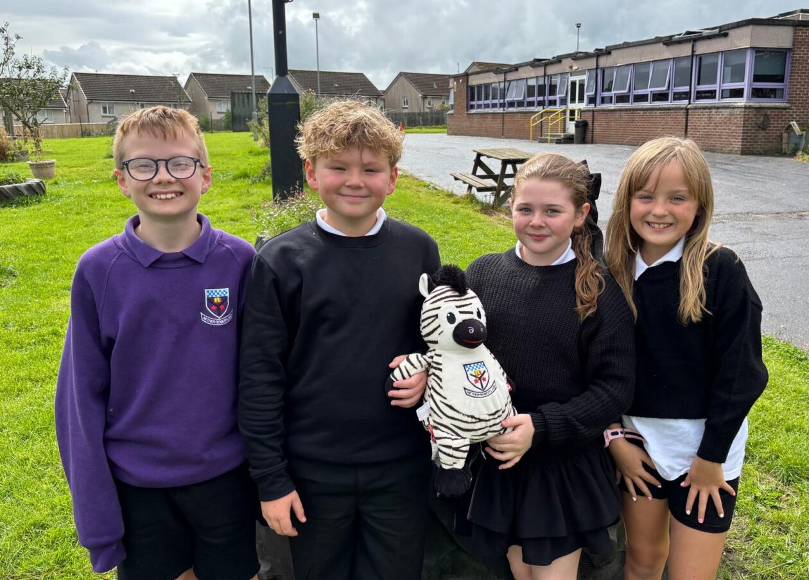



THE DANGERS OF
E-SCOOTERS

Slide 2


Our Aim
We have been asked by Ayrshire Roads Alliance to highlight with you, the dangers of E-Scooters.
What do you know about E-Scooters?
Do you think they are safe?

Slide 3
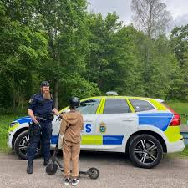
E-SCOOTERS
Children may see E-Scooters as toys, but they are not.
Did you know that E-Scooters are motorised vehicles?

Slide 4
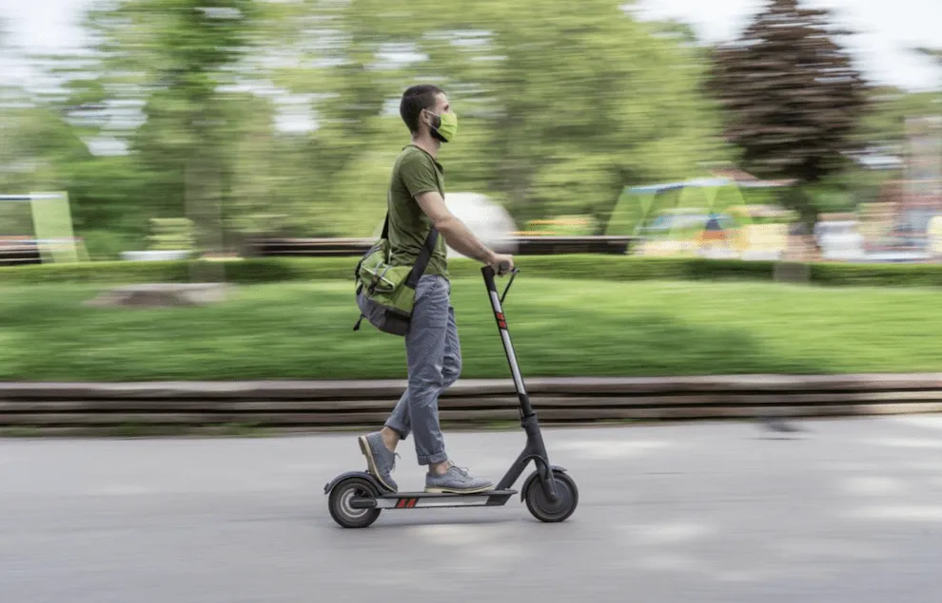
Dangers
How fast do you think an E- Scooter can go?
(Hint : average person walks at 4 miles per hour)
The maximum speed is 15.5 miles per hour, but they can go a lot faster.

Slide 5
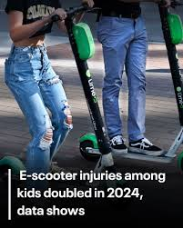
High risk of injury
E-scooters have become popular with children, but they come with huge safety risks.
Children are at greater risks because they have less balance and co-ordination compared to adults.
Accidents often happen due to sudden braking or loss of control.

Slide 6
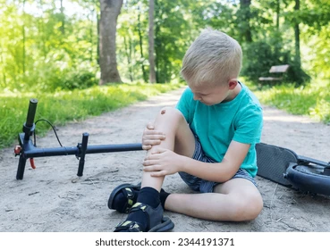
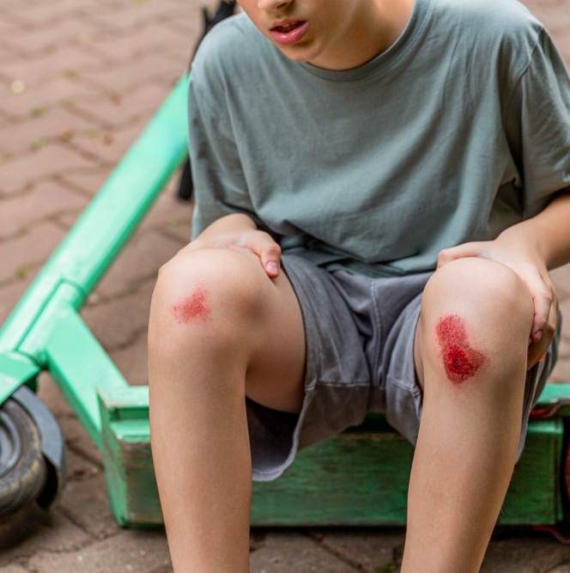
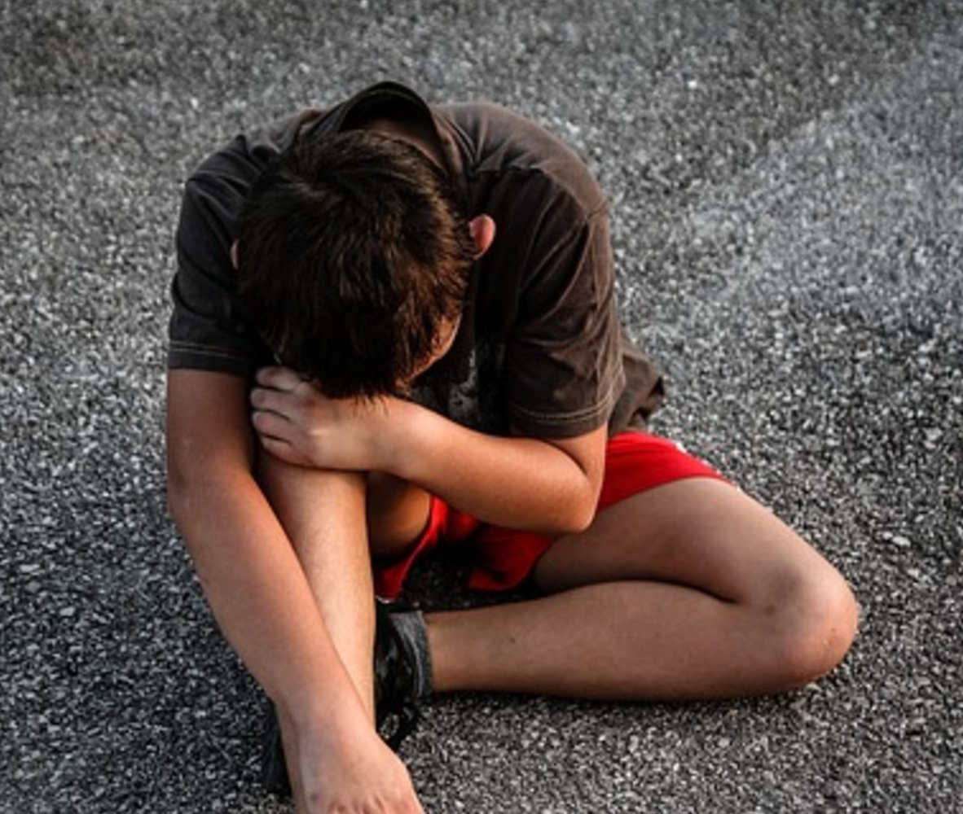
Types of injuries
Head Injuries. You can get a concussion and skull fractures. This is also often due to not wearing a helmet.
Broken and sprained limbs and bones from falls or crashes.
Cuts and bruises from skidding on the road or pavements.
Dental injuries to your mouth and teeth from landing face first.

Slide 7
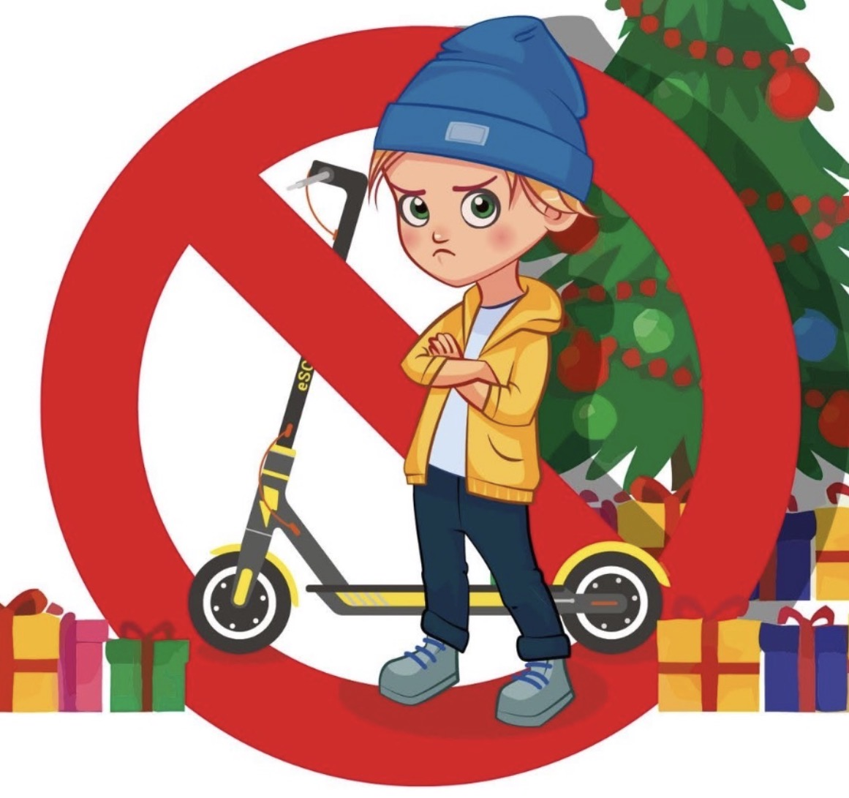
Why buy it if you can’t use it!!
It is illegal to use an E-Scooter on the streets, pavements and the park because they are motorised.
It is not possible to get insurance for privately owned E-Scooters, therefore it is illegal to use them on the roads.
You would only be able to ride them on your own private property or land.

Slide 8
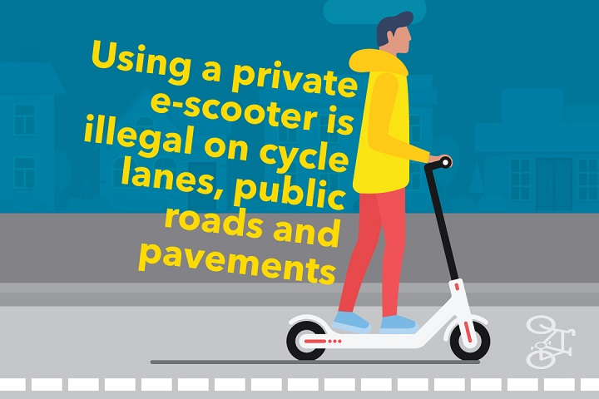
Don’t forget…..
You can only ride your E-Scooter on your own property.

Slide 9
Thank you for listening to our presentation.

