Slide 1

NRPS Reading Quiz
Based on popular children's books

Slide 2
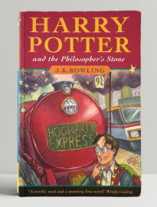
Harry Potter and the Philosopher's Stone
What is the name of the school Harry Potter attends?

Slide 3
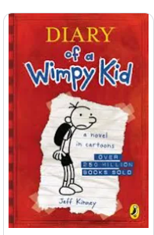
Diary of a Wimpy Kid
What is the name of the main character?

Slide 4
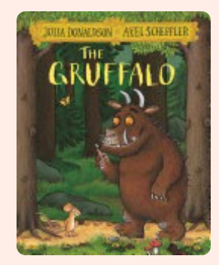
The Gruffalo
What animal is the main character who invents the Gruffalo?

Slide 5
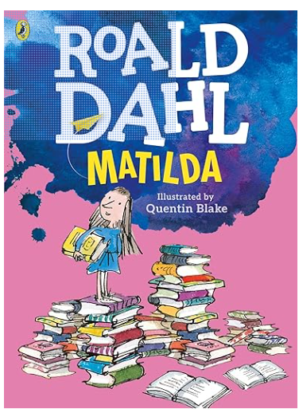
Matilda
What special power does Matilda have?

Slide 6
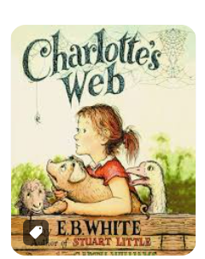
Charlotte's Web
What is the name of the pig Charlotte tries to save?

Slide 7
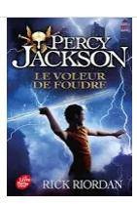
Percy Jackson and the Lightning Thief
Who is Percy Jackson's father?

Slide 8
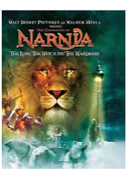
The Lion, the Witch and the Wardrobe
What magical land do the children enter through the wardrobe?

Slide 9

Wonder
What is the name of the boy with a facial difference?

Slide 10
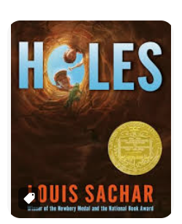
Holes
What does Stanley Yelnats find while digging at Camp Green Lake?

Slide 11
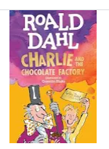
Charlie and the Chocolate Factory
What is the name of the chocolate factory owner?

Slide 12
Answer Slides

Slide 13
Answer: Harry Potter and the Philosopher's Stone
Hogwarts School of Witchcraft and Wizardry

Slide 14
Answer: Diary of a Wimpy Kid
Greg Heffley

Slide 15
Answer: The Gruffalo
A mouse

Slide 16
Answer: Matilda
Telekinesis (moving things with her mind)

Slide 17
Answer: Charlotte's Web
Wilbur

Slide 18
Answer: Percy Jackson and the Lightning Thief
Poseidon

Slide 19
Answer: The Lion, the Witch and the Wardrobe
Narnia

Slide 20
Answer: Wonder
August (Auggie) Pullman

Slide 21
Answer: Holes
A lipstick tube with the initials KB

Slide 22
Answer: Charlie and the Chocolate Factory
Willy Wonka

