Slide 1
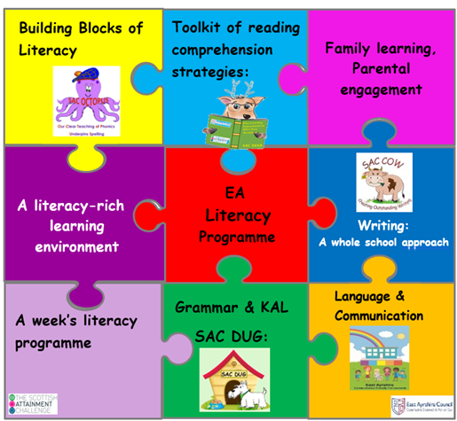
EA Literacy Programme
An introduction for parents
Gail Elder
Quality Improvement Officer (Literacy)
East Ayrshire Council
gail.elder@eastayrshire.org.uk
Notes:
Integrating all aspects of how we teach children reading, writing, listening and talking in EA.

Slide 2
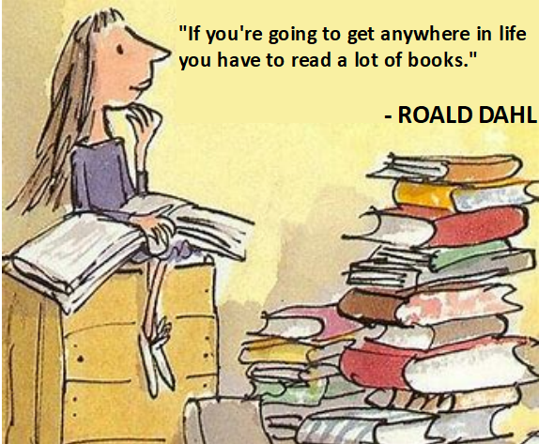
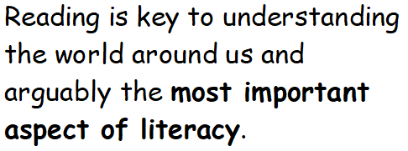
Do you remember how you learned to read?
Notes:
Reading is one of the most important things we can teach our children.
I can’t remember learning to read, but I can remember absolutely loving reading Enid Blyton books when I was about 8 or 9.
You may have learned to read during the time when teaching methods included giving children home lists of words to remember. At that time, it was believed that because good readers instantly recognise all the words they read, we needed children to instantly recognise the words they read. Over the past 50 years there have been lots of approaches to how children are taught to read. But due to huge amounts of research, we can confidently say that the best way to teach the mechanics of reading is to teach systematic phonics.

Slide 3
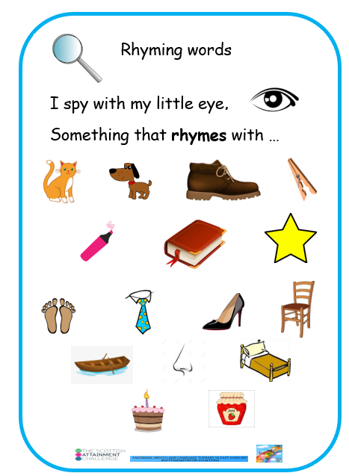
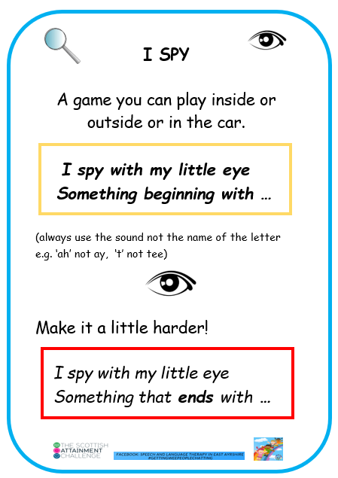
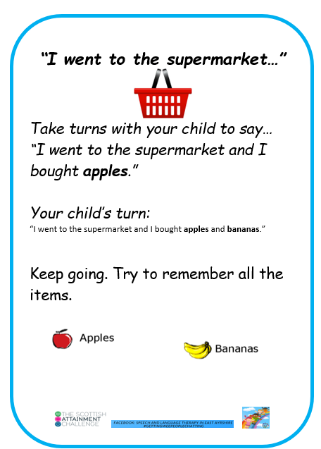
What can you do to help your child?
Notes:
At this stage in P1 – use the sounds of letters not the names.

Slide 4
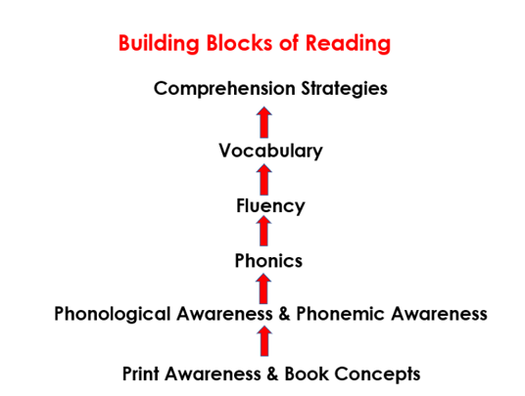
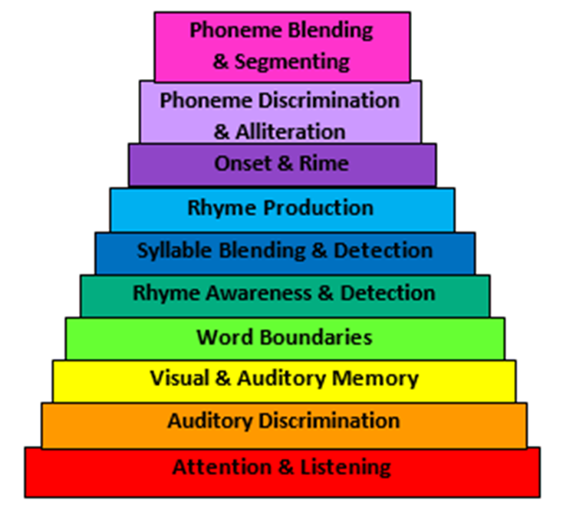
A word about phonological awareness
Notes:
Phonological and phonemic awareness are key to children’s progress in developing their phonics skills, Phonological awareness is how we break down spoken language into smaller parts: such as rhyme, alliteration, syllables, words and onset and rime. The final part of this process is the breakdown of words into individual sounds known as phonemes. This is referred to as phonemic awareness. This helps us with phonics code. At the start of P1 and throughout, we have a focus on the PA skills and assess them during daily activities and play. Where there are gaps e.g. in being able to sit still and listen, or in being able to pick out words in a sentence, we build in activities to develop those skills. We keep an eye on PA skills as gaps in this can flag up future difficulties.
Print awareness is about knowing which way we read the words, how we handle a book – what’s on the cover etc.

Slide 5
Phonics
Phonics is how we teach children to read by linking sounds (phonemes) and the symbols that represent them (graphemes, or letters).
It is a code - the alphabetic code.
Notes:
Phonics teaches the link between the words we say or think, and the words that are written on the page. When we speak, all our speech sounds or phonemes, will have a letter or grapheme to represent them in writing. That is what phonics is. It is a code – the alphabetic code and we need to teach children the code and not leave them to work it out for themselves. Systematic synthetic phonics helps us teach the alphabetic code. We continue teaching the code until all the complex letter to sound correspondences have been taught. This means we carry on teaching phonics throughout primary school. At later stages it is our ‘go to’ spelling strategy. As an adult, it is how we read a word we have never seen before.

Slide 6
As adults, we use our phonics knowledge…
pseudofolliculitis barbae
razor bumps!

Slide 7
Say the word ‘cat’ out loud.
Can you identify the sounds you say in this word?
c
a
t
/c/ /a/ /t/
And we can then write the word –
cat
Notes:
Say the word <cat> out loud. Can you hear the sounds you say? Phonics is a reversible code.

Slide 8
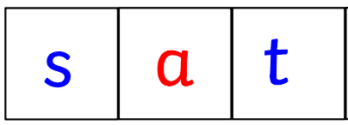
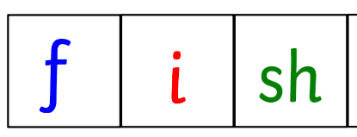
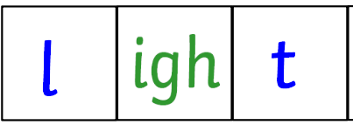
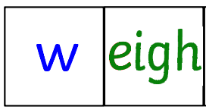
We have 44 sounds or phonemes that we use in our spoken language… but we only have 26 letters.
2 letters,
or 4 letters
Sounds can be spelled with 1 letter,
3 letters
Sounds can be spelled in multiple ways. Take the /ae/ sound:
way
wait
gate
straight
grey
great
eight
baby
Spellings can represent more than one sound. Take the <o> letter:
hot
most
to
some
Notes:
English – most difficult language to learn to read and write.
Phonics gives children the key to unlocking this alphabetic code for their reading and spelling.
But in P1 we will start with the simple code where one letter represents one sound in VC and CVC words.

Slide 9
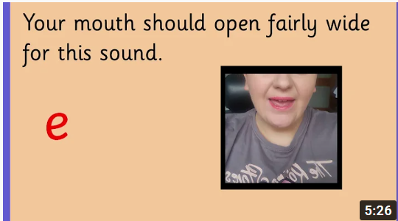
Phonics skills we teach:
Blending:
For reading we teach blending: sound out and blend the sounds all through the word (decoding)
Initial Sounds Mouth Shapes - YouTube
Notes:
We need children to know the letter/sound correspondences
So they can blend

Slide 10
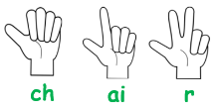
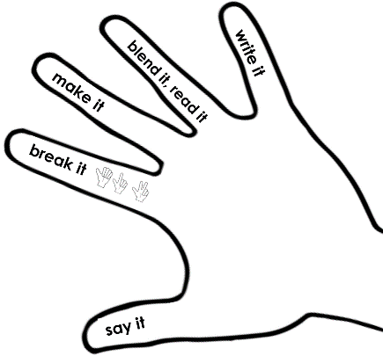
Phonics skills we teach:
Segmenting:
For spelling we teach segmenting.
We start with a spoken word
we say the word, sounding out each of the sounds
tally how many sounds
to then match the letter(s) we need
to write it (encoding) or use our magnetic letters
Notes:
We need children to know the letter/sound correspondences
So they can blend
And segment….on the screen
When it comes to writing in P1, we usually start off with children drawing: with their picture representing their words or story. We will ask children to have a go – and use their phonics knowledge and the words they have learned. We do not ask them to copy writing.

Slide 11
Phonics skills we teach:
Letter formation:
Your child learns how to write the letters (graphemes) as they are taught each sound (phoneme).

Slide 12
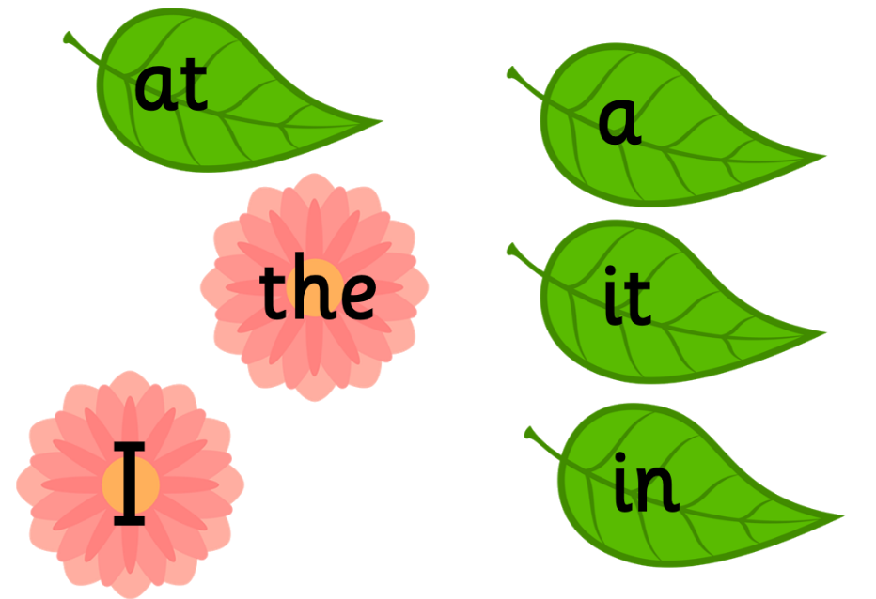
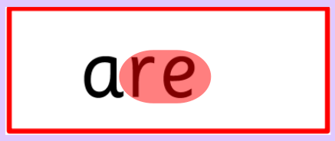
Common or High Frequency Words
We teach these words as part of our phonics programme.
Notes:
The only word that we ask children to memorise by sight is the word ‘the’ – we teach this word very early in the programme and the children do not have the phonics knowledge to read it yet. When they meet <I> they have learned the /i/ sound. We teach them that sometimes this letter represents the sound /igh/. However, they can read the others using their sounds knowledge. We just point out the tricky bit, and children use their phonics knowledge to read the rest. That is how good readers read. Memorising words is not an efficient strategy as we cannot remember all the words we may come across.

Slide 13
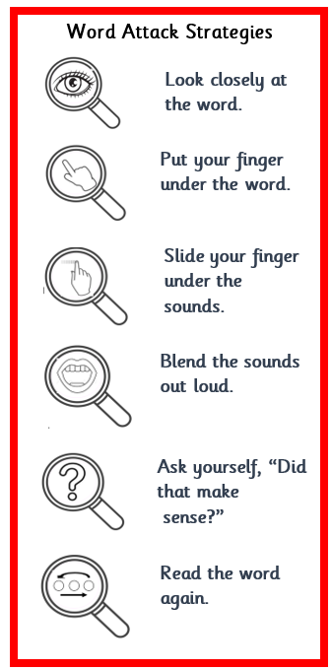
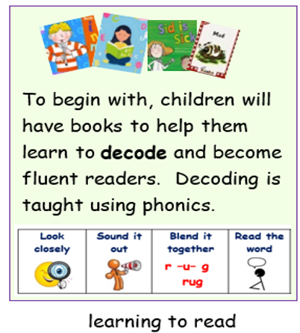
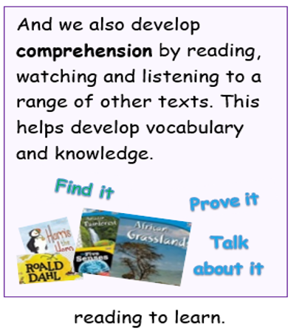
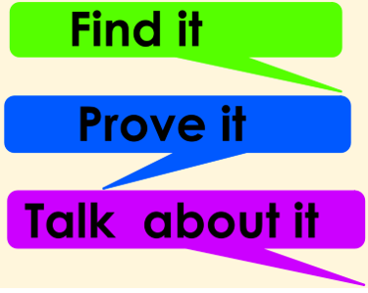
Phonics is only part of how we teach reading
Notes:
The Simple View of reading helps us as teachers ensure we teach all the aspects to build a reader.
Decodable books – these are books for children to be successful as they begin their reading journey. They are books that are matched to the sounds that have been taught in class. They might not be inspirational in terms of the storyline or vocabulary. They are not meant to be. They are for children to put into practice their phonics knowledge and skills – recognizing the sounds represented by letters and blending them to make words.
We do also read lots of other inspirational books. These are the books that have the wonderful pictures, fantastic characters and interesting vocabulary. They can be full of facts. These are the books that we read to children to develop their language comprehension and their vocabulary – and hopefully help inspire them with a love of books. Another key thing about reading as your children move through the school – they need to be able to read to learn about lots of different subjects. They move from learning to read to reading to learn.

Slide 14
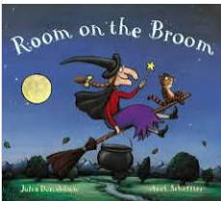
What can you do to help your child?
When children take a reading book home to practise their decoding skills:
Listen to them read their ‘reading book’.
If they stick at a word, give praise when they try to ‘sound out’ the sounds in the word.
If still stuck, you can give the word.
Read lots of books to your child and let them see you reading.
Most importantly, talk with your child. Talk about what you are doing, name objects all around us and name feelings to build your child’s ‘word store’.
Notes:
Make sure child has any ear and eye tests available. Glue ear fact: it is estimated that 1 in 5 children around the age of 2 will be affected by glue ear at any given time. About 8 in every 10 children will have had glue ear at least once by the time they’re 10 years old.
Books are where we find the most interesting vocabulary.
Books can teach us lots of information and facts about our world. Having this vocabulary and knowledge is one of the greatest foundations you can provide your child for becoming a reader and writer.

