Slide 2
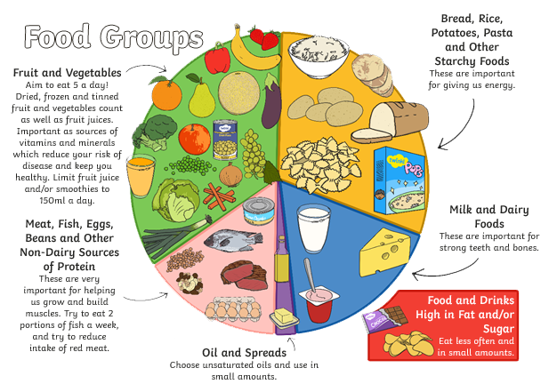
The Eatwell Plate
To be healthy, nutritious food is needed to provide energy for the body. A variety of food is needed in the diet because different foods contain different substances that are needed to keep you healthy.
An average meal should be made up of one-third carbohydrates and one-third fruit and vegetables, with the remaining one-third split between dairy, protein and a little bit of fat.

Slide 3
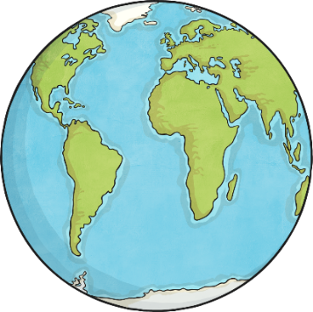
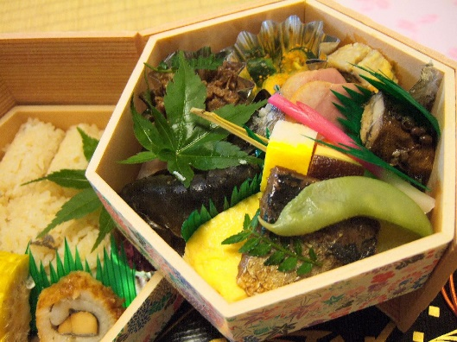
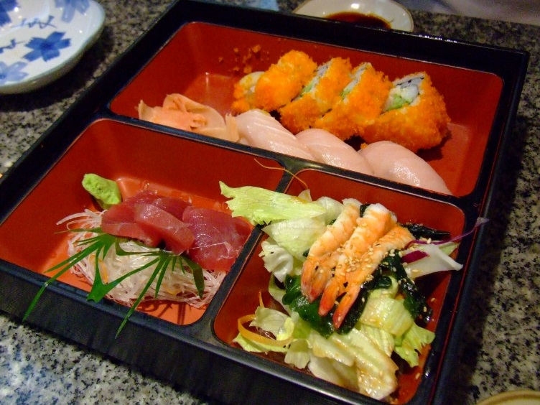
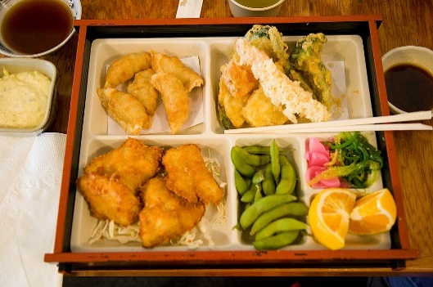
World Diets
People around the world eat a wide variety of food. Some food you might be familiar with and some you may never have seen before.
^{Photo courtesy of} kimmaki, pointnshoot and Keng Susumpow (@flickr.com) - granted under creative commons licence - attribution

Slide 4
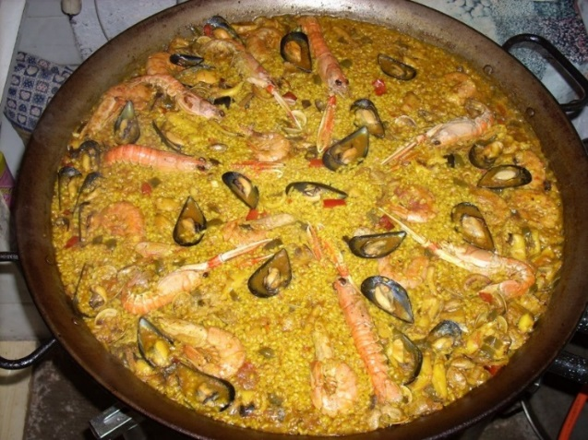
World Diets
Can you name the foods in this photo and name their food groups?
Paella
The dish is widely regarded as Spain’s national dish, as well as a regional Valencian dish.
^{Photo courtesy of} VRoig (@flickr.com) - granted under creative commons licence - attribution

Slide 5

World Diets
Can you name the foods in this photo and name their food groups?
Bento (弁当 bentō)
Japanese bento contains rice, fish or meat, with pickled or cooked vegetables, served in a box.
^{Photo courtesy of} pointnshoot (@flickr.com) - granted under creative commons licence - attribution

Slide 6
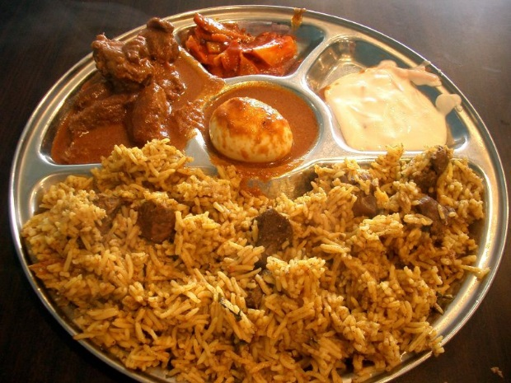
World Diets
Can you name the foods in this photo and name their food groups?
Biryani
Biryani is a mixed rice dish from the Indian subcontinent.
^{Photo courtesy of} avlxy (@flickr.com) - granted under creative commons licence - attribution

Slide 7

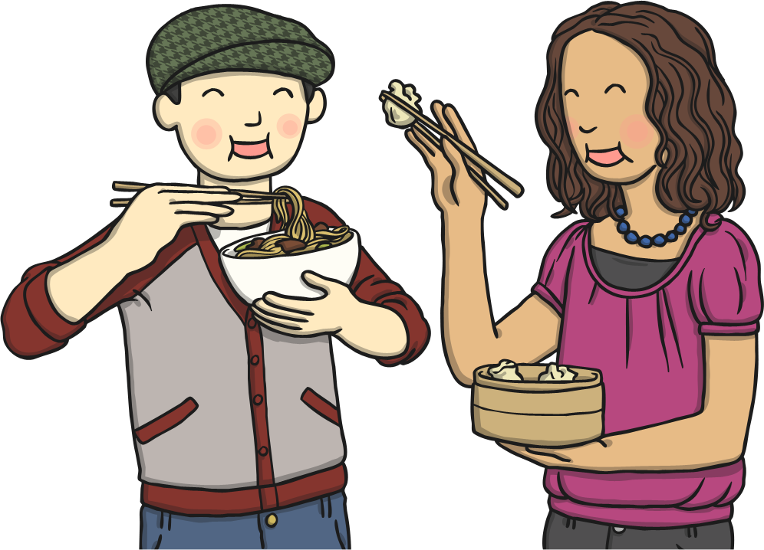

World Diets
Can you identify any similarities between the types of food eaten around the world?
Photos courtesy of Vroig and avlxyz (@flickr.com) - granted under creative commons licence - attribution

Slide 8
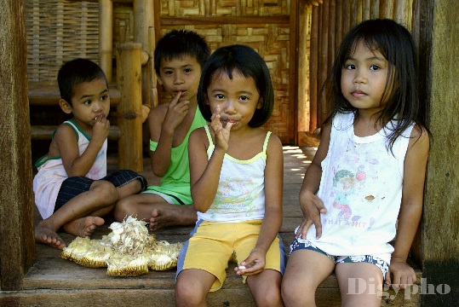

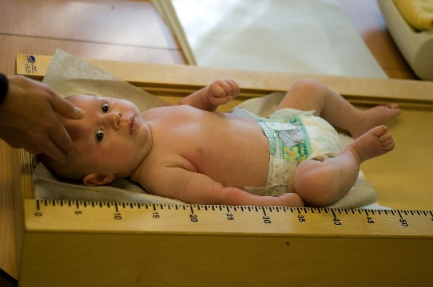
World Diets
The food we eat may differ, however, we all need food to:
give us energy
help us grow
stay healthy
For this reason the foods groups are the same.
Photos courtesy of digypho, Tobyotter and maessive (@flickr.com) - granted under creative commons licence - attribution

Slide 9
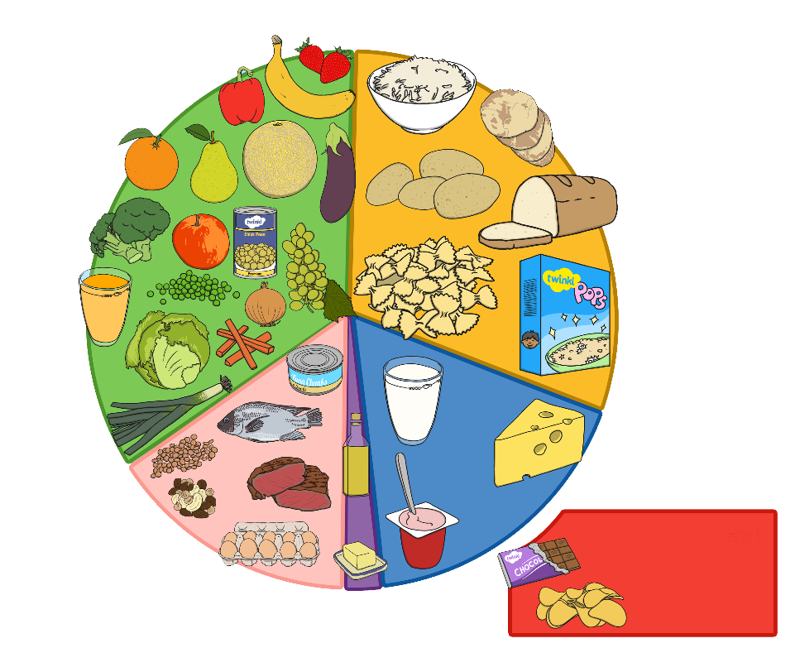
What Have We Learnt?
Although there are lots of different foods, diets around the world are based on similar food groups to help people to stay healthy.
Most diets in the world are made up of:
Bread, rice, potatoes, pasta and other starchy foods, e.g. yam, plantain, couscous (sometimes these are known as staple foods, forming the bulk of the diet.)
Fruit and Vegetables.
1
2
3
Milk and dairy foods.
4
Meat, fish, eggs, beans and other non-dairy sources of protein.
6
Foods high in sugar
5
Oils and sugars.

