Slide 1
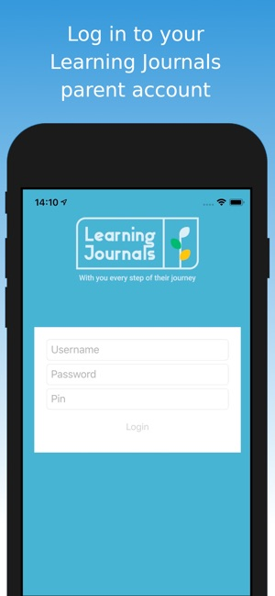
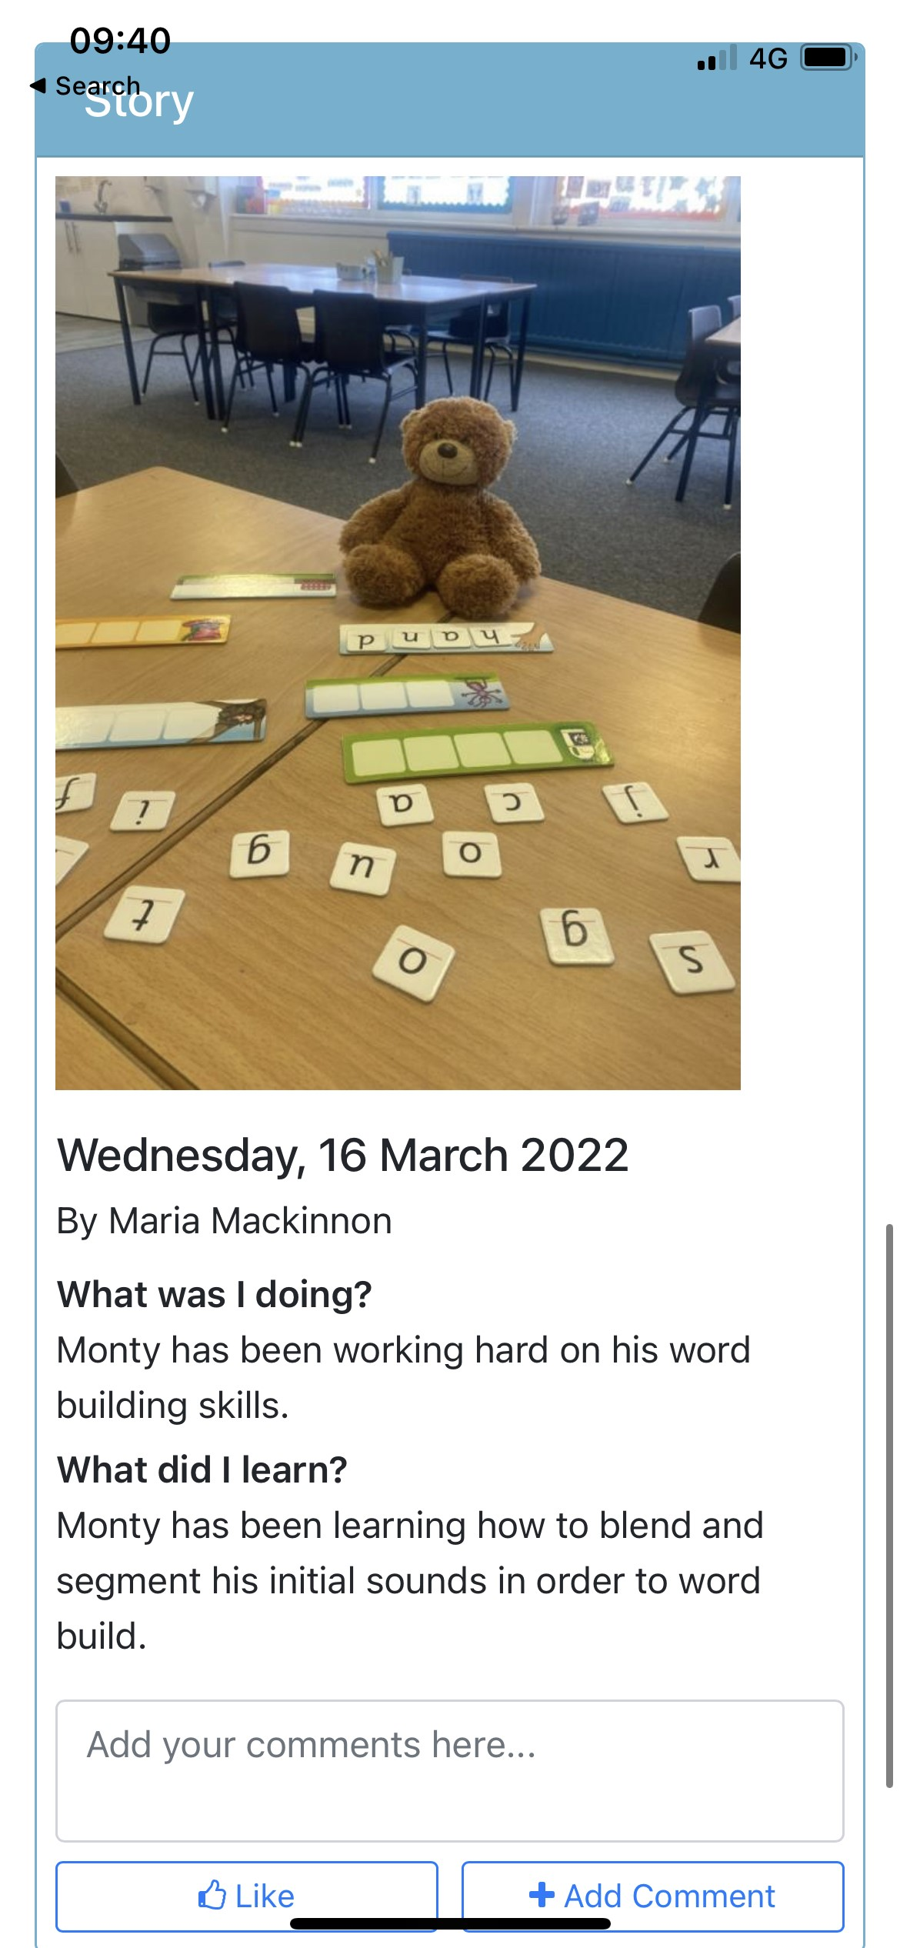
Step 1.
Download Learning Journals App on smart phone / tablet.
Step 2.
View stories,
Like / add comment
Learning Journals is a very secure platform which enables us to share with you some of the highlights of your child’s learning.
Parent/Carers will be able to access their child’s profile from home online.
Like
Comment
If you require your log in details, please get in touch. These will be sent to the email address that you have given to the school.

