Slide 1

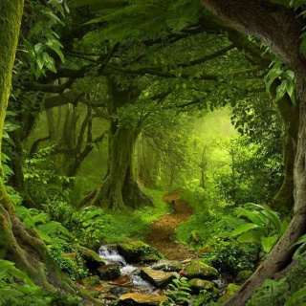
Rainforest Homework Task
Exploring the Amazing Rainforest from Home

Slide 2

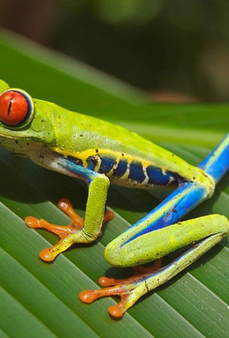
What is a Rainforest?
Lush, Green, and Full of Life
Rainforests are dense, warm, wet forests with tall trees, abundant plants, and diverse animals, raining almost daily. Found near the equator (e.g., South America, Africa), they house half the world's plant and animal species.

Slide 3
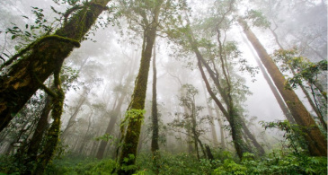
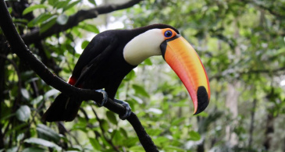
Why Rainforests Matter
Home for Wildlife
Rainforests house jaguars, toucans, & tree frogs. Many species are found nowhere else!
Clean the Air
Rainforests, Earth's "lungs," clean air by converting carbon dioxide into oxygen.

Slide 4
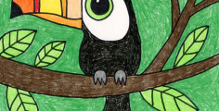
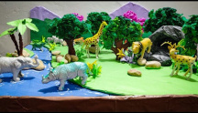

Rainforest Homework Choices
1
2
3
Create a Poster
Design a colourful poster of your favourite rainforest animal/plant with drawings, labels, and fun facts.
Design a Rainforest Habitat
Build a model of a rainforest habitat that would keep you safe, comfortable, and well-fed.
Rainforest Recipe
Explore a rainforest food (e.g., chocolate). Create a simple recipe or illustrate its journey.

Slide 5
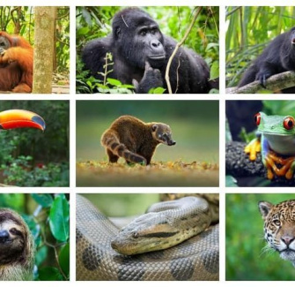
Rainforest Wonders
Let’s Recap!
Rainforests are vibrant ecosystems vital for Earth's air, food, and medicine. Explore them at home through creative projects. Get ready to share your rainforest discoveries with the class!

