Slide 1

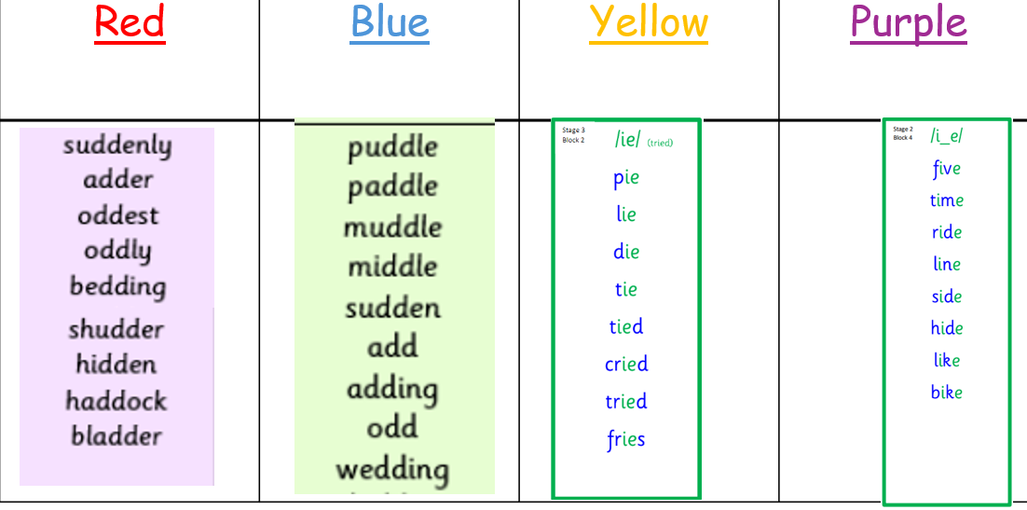
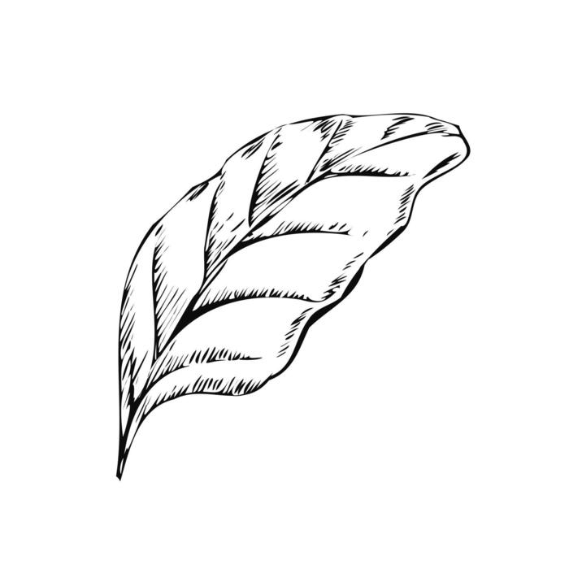
P4/5 Homework:
Homework will be given out every week on a Monday and will be collected on a Friday. Please let Mrs Ferguson or Mrs Morrison know if this does not work for your child☺
Monday 26th October 2026
Spelling Practise: dd. ie. i-e
Reading
Bug club books will be kept in school and read within class. We have a class reading tree display that showcases all of the books we will be reading this year. If your child finishes a book at home, then they can complete a leaf to add to the tree.
Numeracy
Your child has been sent home with a times table drill booklet. This can be done with or without a timer at their own pace. We have started revising the 2, 4, 5 & 10 times tables in class. This does not need to be completed each week, but it can be used for extra revision or if you have a spare 5 minutes!

