Slide 1

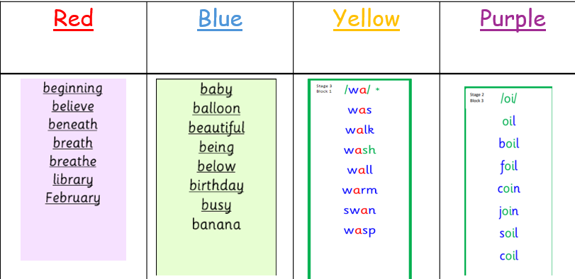

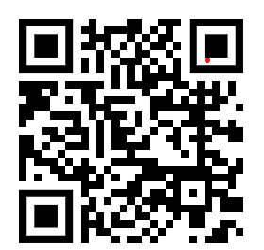
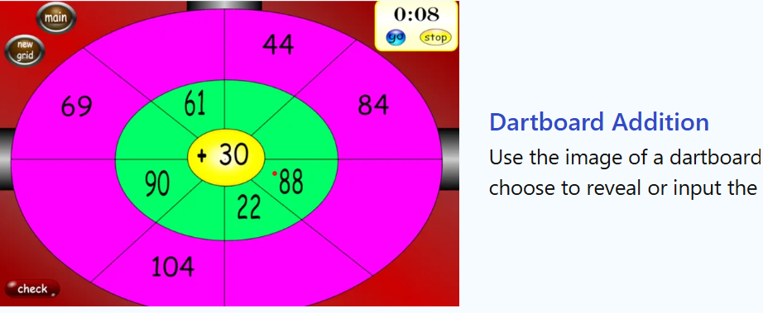
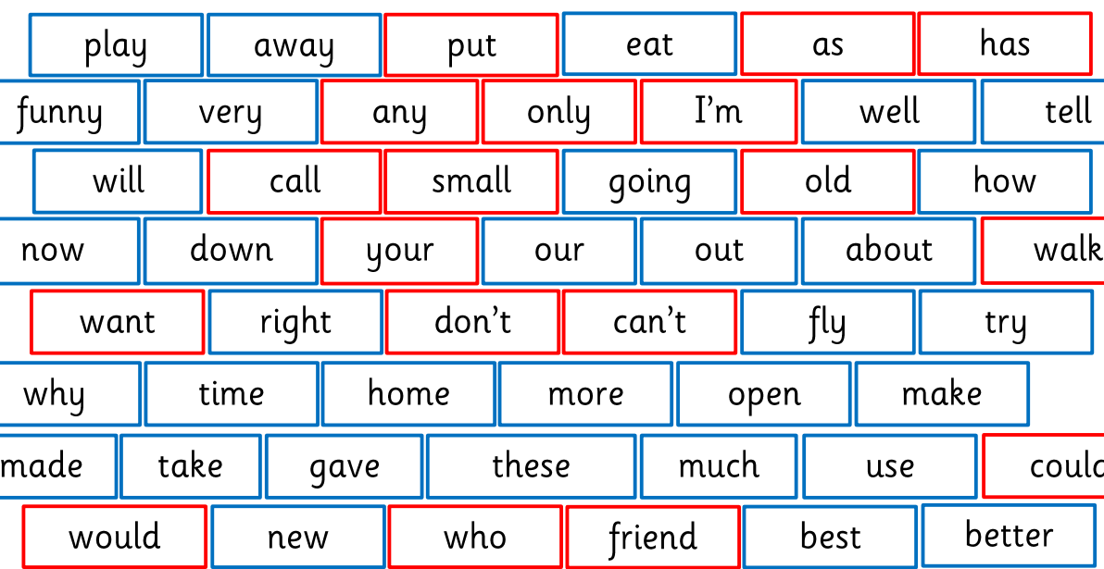
P4/5 Homework:
Homework will be given out every week on a Monday and will be collected on a Friday. Please let Mrs Ferguson or Mrs Morrison know if this does not work for your child☺
Monday 13TH September 2026:
Spelling Practise:
Every Monday a new spelling phoneme is introduced to the class and will be practised over the week. Please could you copy your spelling words x3 in your jotter and write five sentences using any of your spelling words.
Reading
Bug club books will be kept in school and read within class. We have a class reading tree display that showcases all of the books we will be reading this year. If your child finishes a book at home, then they can complete a leaf to add to the tree.
Numeracy:
This week we
are learning
about different
Mental maths strategies.
Some Children have received a common word wall home to practise. The common words to practise will be highlighted on the wall. This can be done in their jotter, out loud at the dinner table, chalk outside or any other way. Once your child has confidently spelt the word more than x3 times then they can colour it in!

