Slide 1

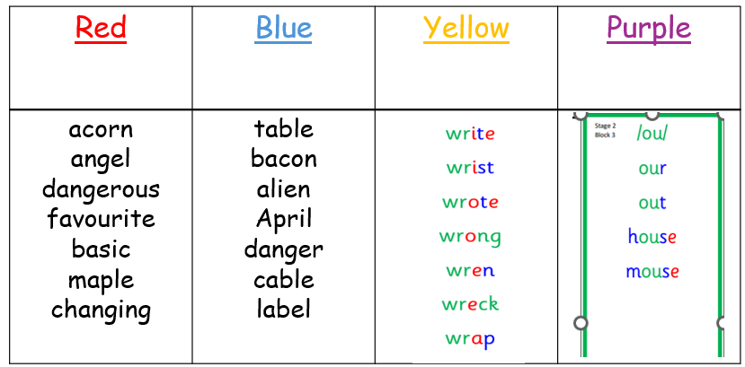

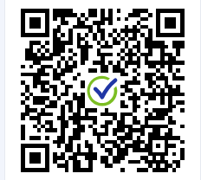
P4/5 Homework:
Homework will be given out every week on a Monday and will be collected on a Friday. Please let Mrs Ferguson or Mrs Morrison know if this does not work for your child☺
Monday 7TH September 2026:
Spelling Practise:
Every Monday a new spelling phoneme is introduced to the class and will be practised over the week. Please could you copy your spelling words x3 in your jotter and write five sentences using any of your spelling words.
Reading
Bug club books will be kept in school and read within class. We have a class reading tree display that showcases all of the books we will be reading this year. If your child finishes a book at home, then they can complete a leaf to add to the tree.
Numeracy:
This week we have been focusing on rounding to the nearest T,H,TH.
Practise your rounding skills below:

