Slide 2
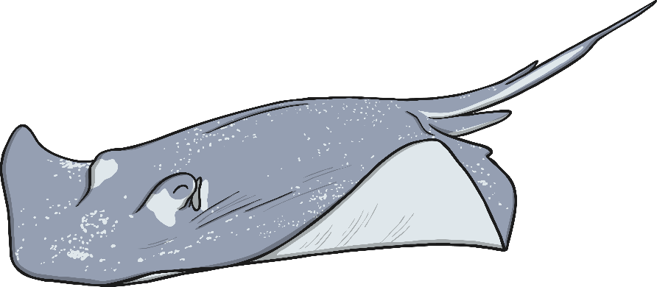
What Is an Acrostic Poem?
Acrostic poems are written by choosing a word to go vertically down a page. Like this…
P
O
E
M

Slide 3
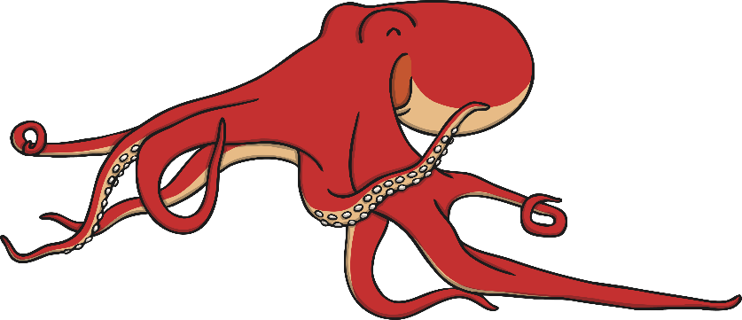
What Is an Acrostic Poem?
Then, you think of words or phrases beginning with each letter.
Like this…
P
O
E
M
ersonal thoughts
n each line
xpress your feelings
ake people happy

Slide 4
Spot the Subject
Can you use the first letter of each line to help you to work out what each acrostic poem is about?
Fins are moving
I am swimming
Salty ocean is my home
Hurry, a shark is coming!
Sneakily glide
Hunting for prey
Always silently watching
Ready for a chase
Krill, dolphins or YOU!
Dancing on the waves
Over the water I jump
Long strides swimming
Perfectly gliding
Happy and playful
I laugh all day
Never-ending adventures
Over the waves
Creeping under the water
Every type of creature
Animals that breathe underwater
Near the ocean floor

Slide 5
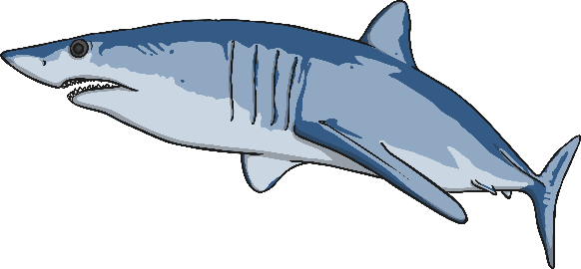
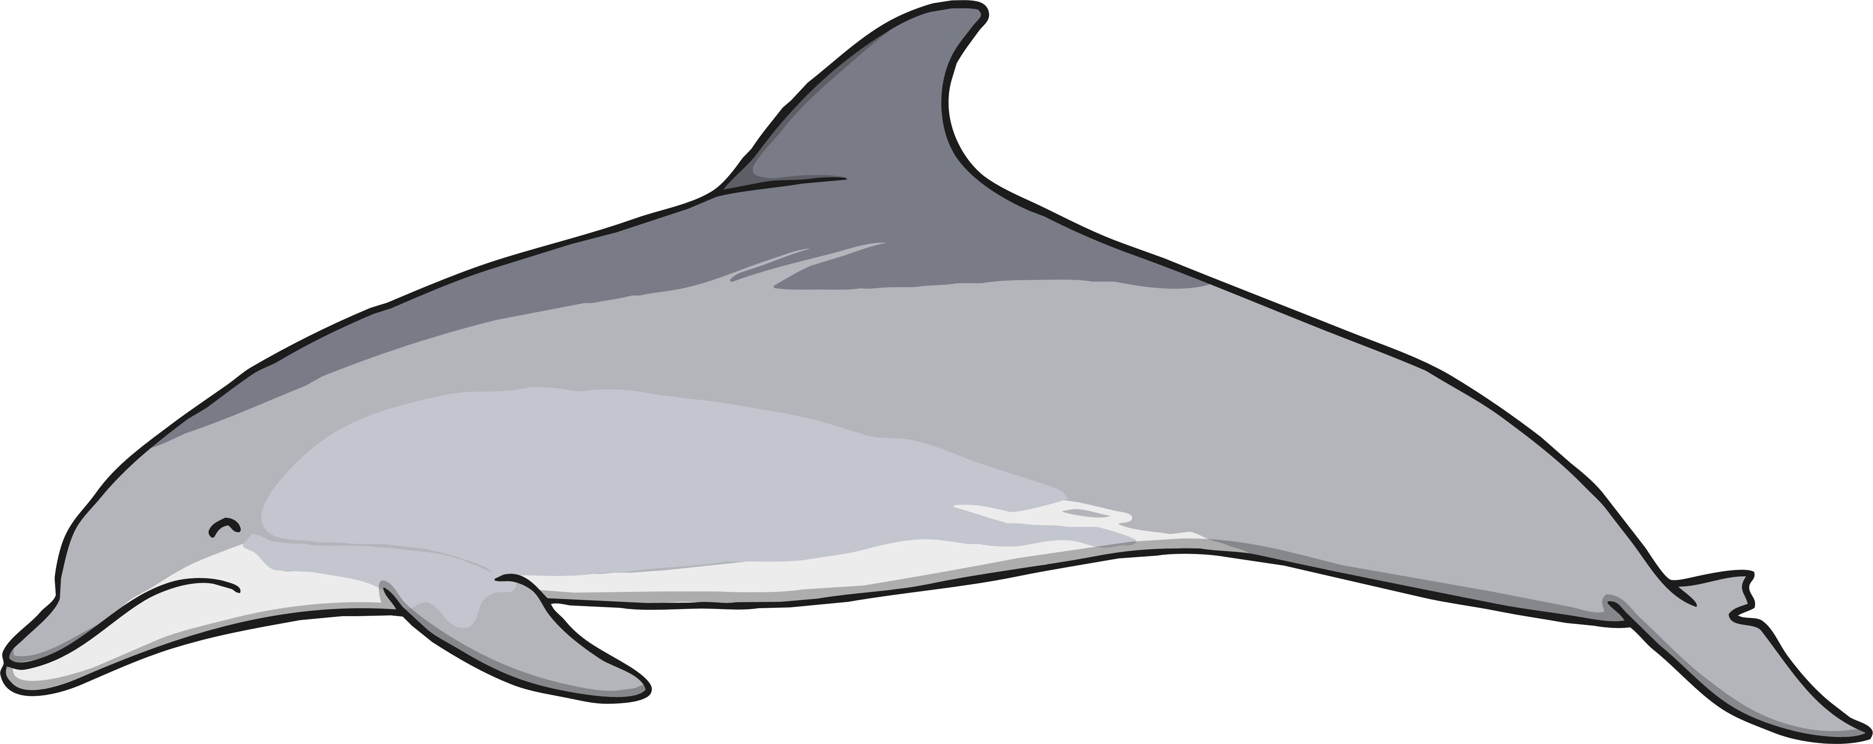
Spot the Subject
Can you use the first letter of each line to help you to work out what each acrostic poem is about?
Fins are moving
I am swimming
Salty ocean is my home
Hurry, a shark is coming!
Sneakily glide
Hunting for prey
Always silently watching
Ready for a chase
Krill, dolphins or YOU!
Dancing on the waves
Over the water I jump
Long strides swimming
Perfectly gliding
Happy and playful
I laugh all day
Never-ending adventures
Over the waves
Creeping under the water
Every type of creature
Animals that breathe underwater
Near the ocean floor

Slide 6
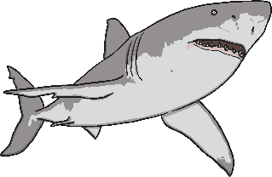
Writing an Acrostic Poem
hunter
First, think of a theme, e.g. sharks.
teeth
circling
Next, collect lots of ideas about
that theme.
fin
Then, write the letters of your
theme word vertically down the
page in capital letters, like this:
S
H
A
R
K
SHARK

Slide 7
Writing an Acrostic Poem
Finally, use your ideas to write each line
of the poem. Don’t worry if you can’t think
of the lines in order. It is fine to go back and
add any missing lines afterwards as long as
your poem makes sense.
Stealthily glides
Hunting for prey
Angry and waiting
Rapidly chasing his meal
Kicking and swimming, the fish escapes

