Slide 1
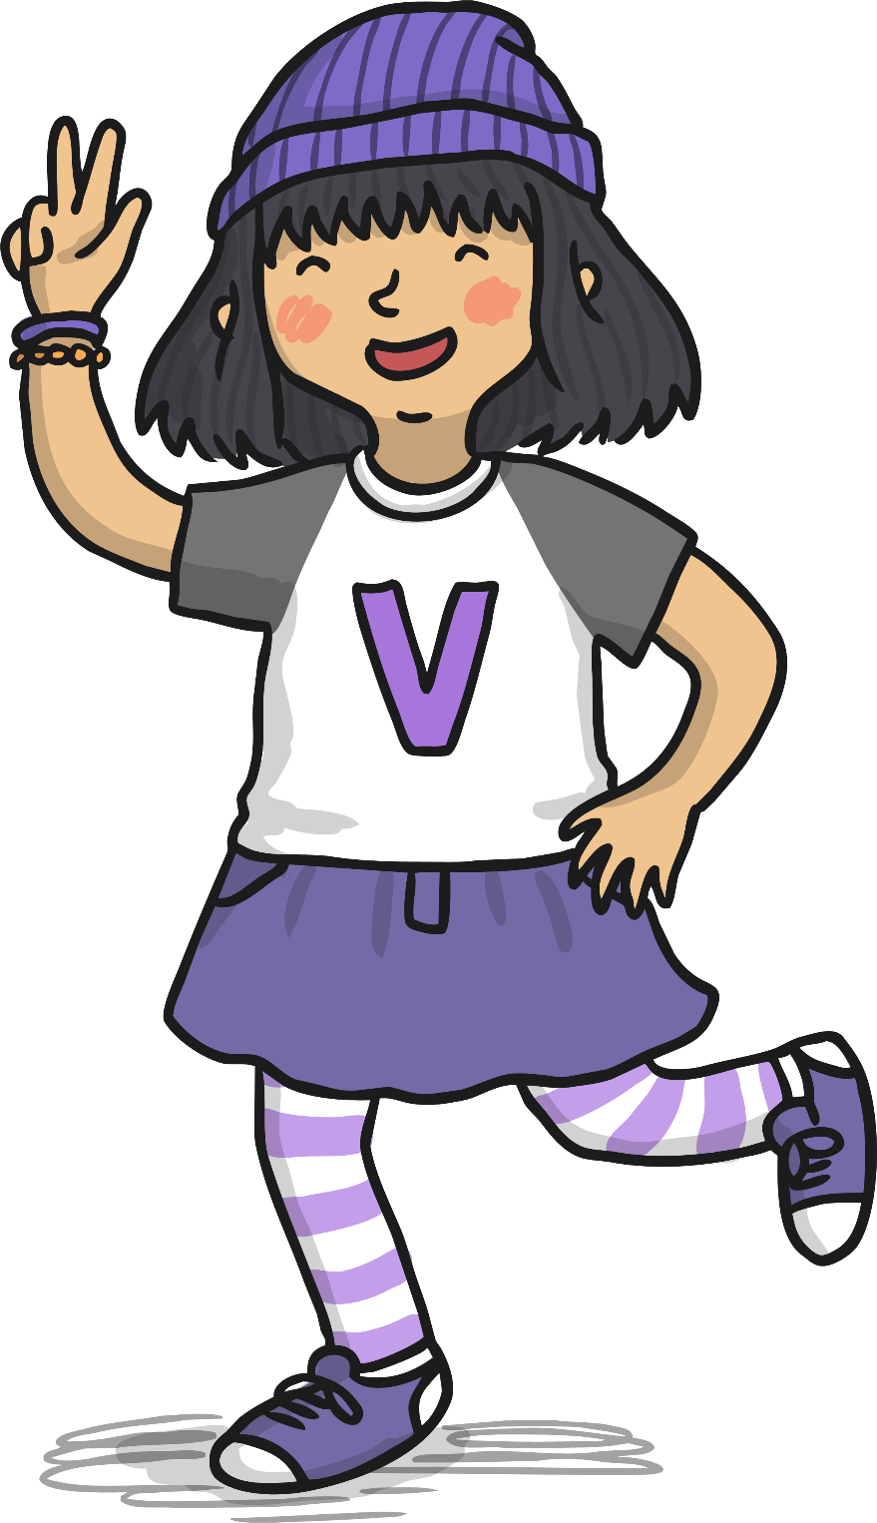
Verbs
With Veronica Verb

Slide 2
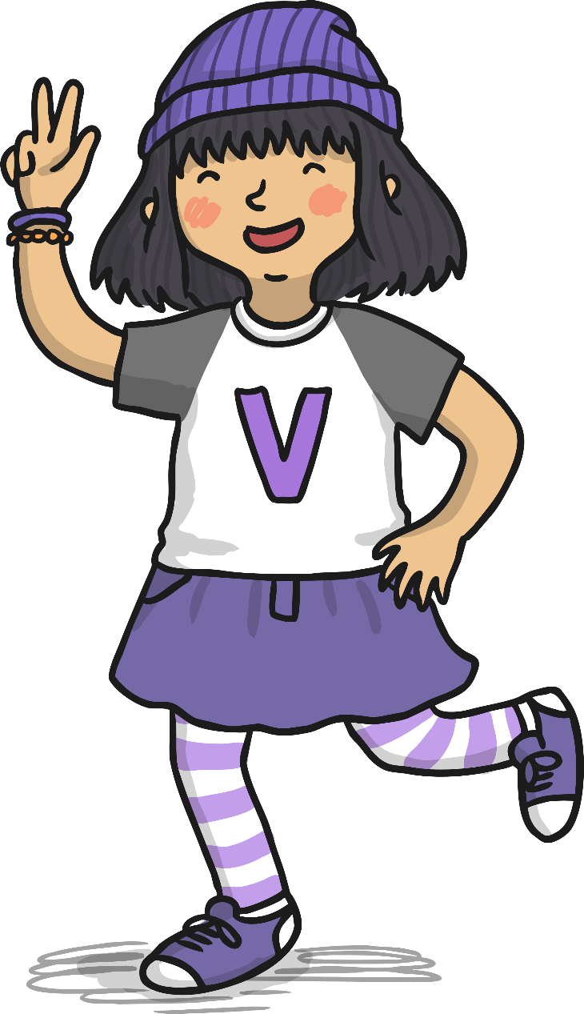
Hi, my name is Veronica Verb. I love to move and am always busy doing different actions.
Do you know what a verb is?
Let’s look at some pictures on the next few pages to try to work it out.
twinkl.com

Slide 3
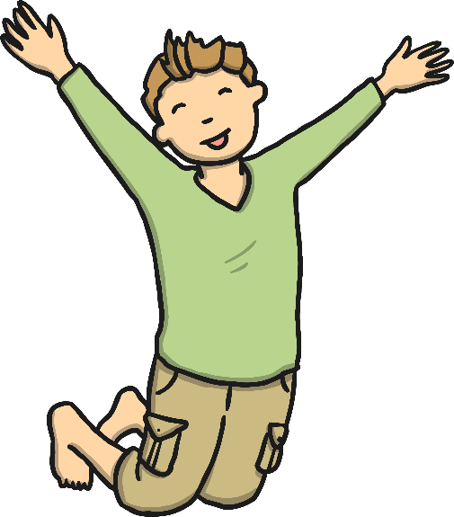
What Is a Verb?
jump
twinkl.com

Slide 4
What Is a Verb?
clap
twinkl.com

Slide 5
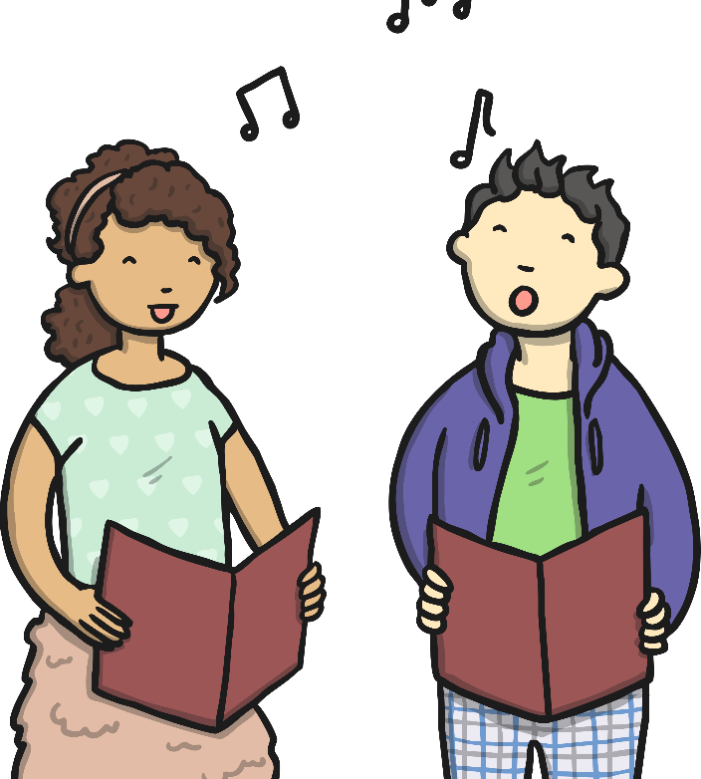
What Is a Verb?
sing
twinkl.com

Slide 6
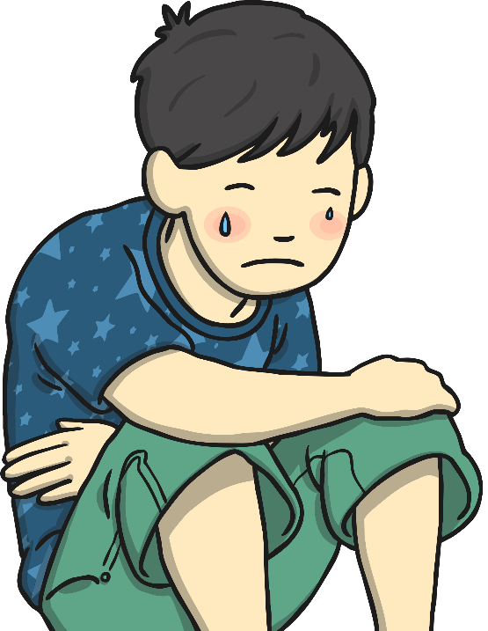
What Is a Verb?
cry
twinkl.com

Slide 7
What Is a Verb?
laugh
twinkl.com

Slide 8
What Is a Verb?
jump
clap
sing
cry
laugh
Verbs are action words. They describe what someone is doing.
twinkl.com

Slide 9
Find the Verbs
Tom painted his picture.
Tom painted his picture.
Annie brushed her hair.
Annie brushed her hair.
Amjid read his books in the library.
Amjid read his books in the library.
Neena swam without arm bands.
Neena swam without arm bands.
Ben rode his bike to school.
Ben rode his bike to school.
twinkl.com

