Slide 1
Lockerbie 2023
23rd January – 25th January
https://www.manoradventure.com/lockerbie-manor.php

Slide 2
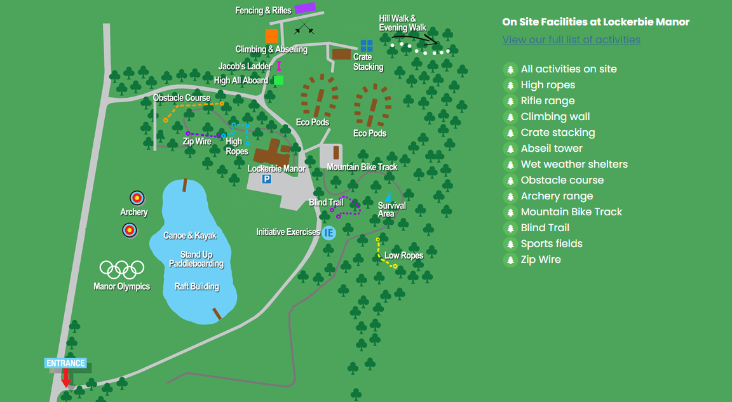

Slide 3
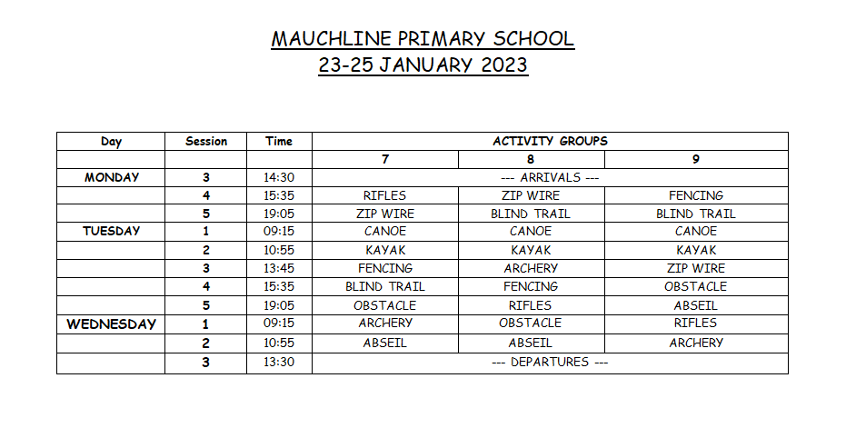

Slide 4
What to bring
This information has already gone out on the school app . . .
One piece of luggage with identification label (case/soft-bodied rucksack/holdall)
One piece of hand luggage with identification label (school bag size).
A clean sleeping bag and pillow
A maximum of £10 to spend on souvenirs and snacks. We suggest coins rather than notes as it can be difficult to get change.
A refillable water bottle
Washbag & Toiletries
Large plastic bag for dirty/wet clothes
Water bottle – not glass
Book, board game, cards, any other activities for evening
You might also want to bring A torch/Headlamp

Slide 5
Clothes (everything must have your name on it)
Some warm pullovers/sweatshirts/zippy tops.
Some trousers/tracksuit/jogging bottoms (a decent thickness – you don’t want them to rip). No Jeans.
T-shirts/tops/long-sleeved tops
Waterproofs trousers and jacket (with a hood).
Hat, gloves (for protection on ropes as well as warmth).
3 pairs of ‘strong’ shoes/trainers/walking boots (one clean pair for indoors, 2 for activities – in case one pair gets wet). No Wellies.
Tops/jumpers/sweatshirts/zippy tops
Pyjamas
Dressing Gown?
Underwear
socks
Two towels
Slippers/Sandals
Bring separate clothes to change into each evening as it is likely that you will get dirty during the day.

Slide 6
Long sleeves must be worn at all activities for safety reasons.
The activity will not start until you are there ready.
Jackets must be taken with you also even if it is not raining.
The general rule is to wear 3 layers for every activity.
No jewellery to be worn for any session & all long hair tied back.
No nail extensions!
No football clothing.
The instructor will send you back if you do not have your hair tied back, have a jacket with you, etc. This will delay the start of your activity.

Slide 7
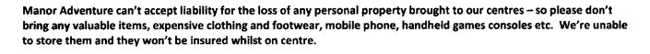
No electronic equipment allowed at all, including mobile phones.
No jewellery
If a parent needs to get in contact they should call the school or (in an emergency only) Lockerbie. tel:01584861333

Slide 8
Monday 23rd January
Arrive in school by 12pm with all of your belongings & meet in the dinner hall.
Have lunch before you come.
You can bring snacks for the bus – no fizzy drinks.
The journey will take approx. 1hr & a half.
When we arrive at Lockerbie, you will be shown to your room and will practise fire evacuation procedures with Lockerbie staff.
Next you will have an activity so come dressed for it. Then it will be dinner followed by another activity.
This is a strike day so the school is likely to be closed to other pupils.

Slide 9
Wednesday 25th January
You will arrive back in school by 3pm.
You must be collected by an adult.
The school blog/app/twitter will be updated throughout the residential with photos (reliable wifi signal permitting) & arrival time back at school on the Wednesday.

Slide 10
Food
Lockerbie cater to all dietary requirements. We have let them of all dietry requirements.
At all meal times there are many options – all delicious e.g. hot & cold options, salad bar, etc!
Pupils have a time slot for meal times - we all go to together.
Pupils can purchase a snack for the evening which we pre order.

Slide 11
Other info
There will be a maximum of four pupils in each room.
There is an ensuite bathroom with a shower in each room.
We are across two floors, members of Mauchline staff will be staying on each floor.
We are hoping to have use of a communal room for the evenings after the last activity but we won’t know that until we get there.
Pupils can bring items to entertain themselves in the evenings after their last activity e.g. books, magazines, board/card games.
School staff will supervise pupils in the evenings and between and during activities as well as centre staff.
Centre staff and duty manager will be there 24 hours a day.
Bed-time is usually about half 9 with ‘lights out’ about 10.
The nearest hospital is Dumfries.
Pupils can bring a hair-dryer but the recommendation is one per room.

Slide 12
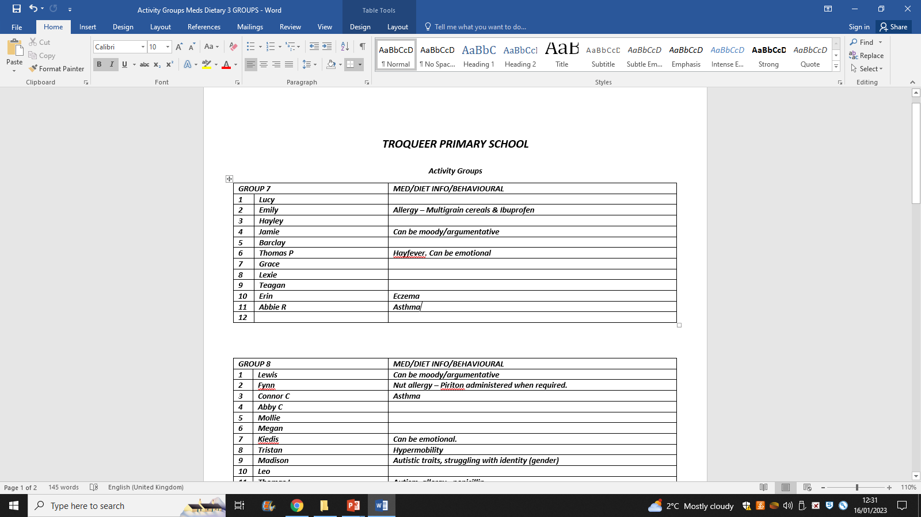
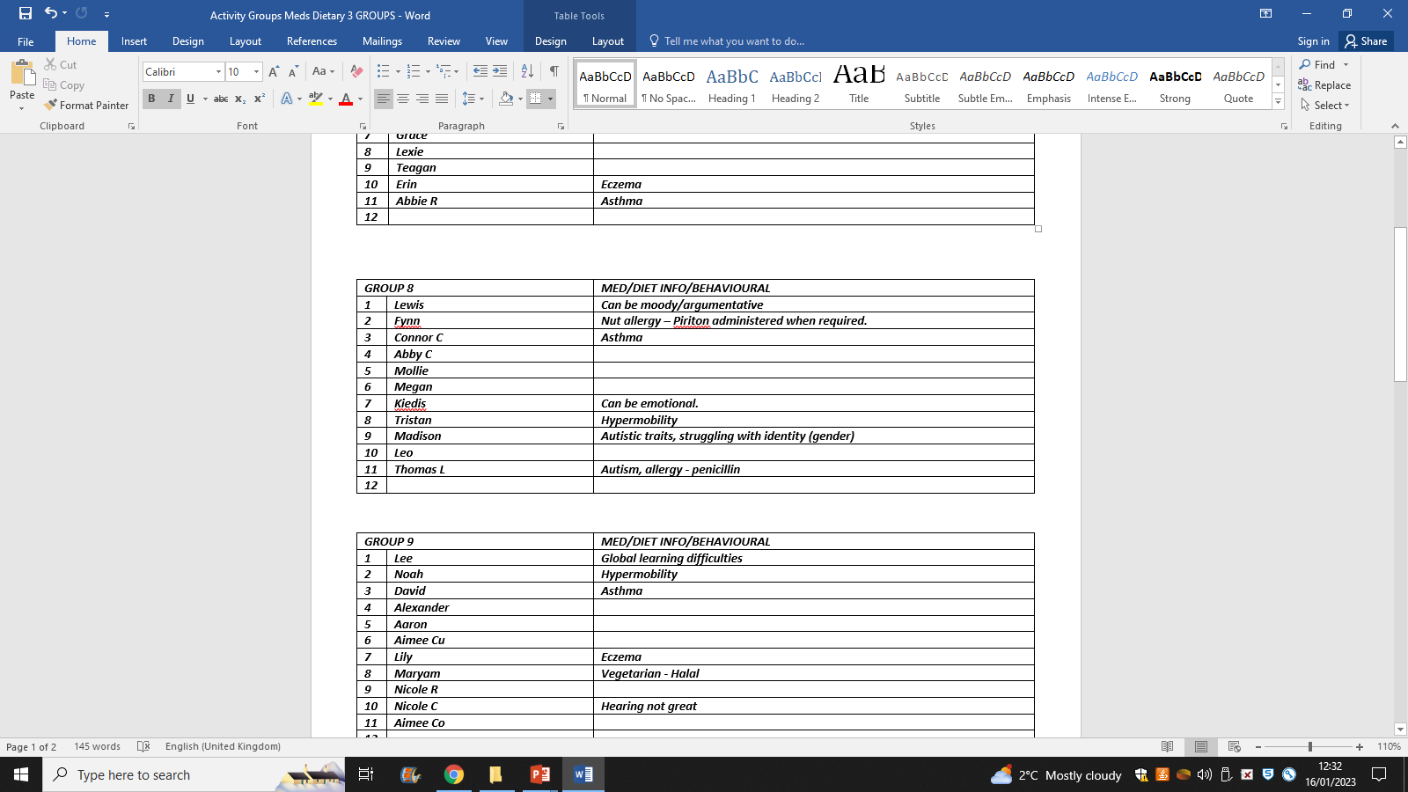
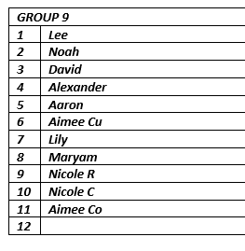
Activity groups

Slide 13
Room allocation

Slide 14
Medicines
If you are bringing any medicine, a parental request form (for self administration) needs to be filled out. These can be picked up from the school office.
All medicines should be labelled with the your name.
All medicines should be up to date.
All medicines should be stored in a clear bag with your name on it.
Please also include a written note of the administration/dosage. This also applies to travel sickness medication.
Medicines will be kept by a mauchline member of staff while at Lockerbie.

Slide 15
Staff
Mrs Cross
Miss Little
Mrs Jamieson

Slide 16
Any Questions?

