Slide 1
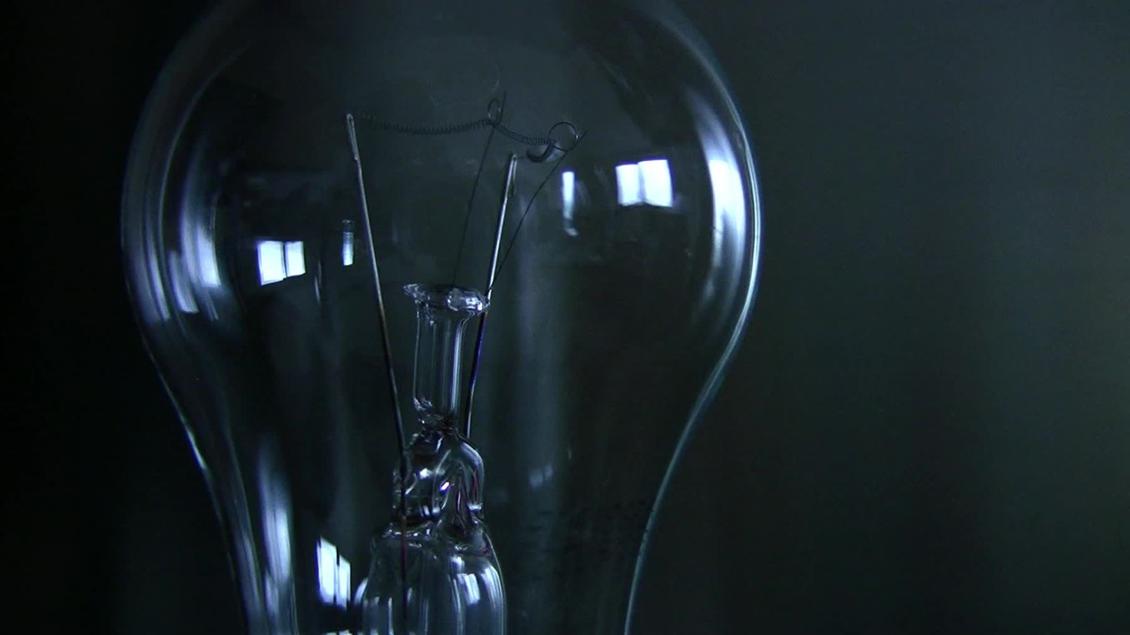
All about electricity safety
By Reilly and Noah

Slide 2

Section 1 How to spot a pylon or power line

Slide 3
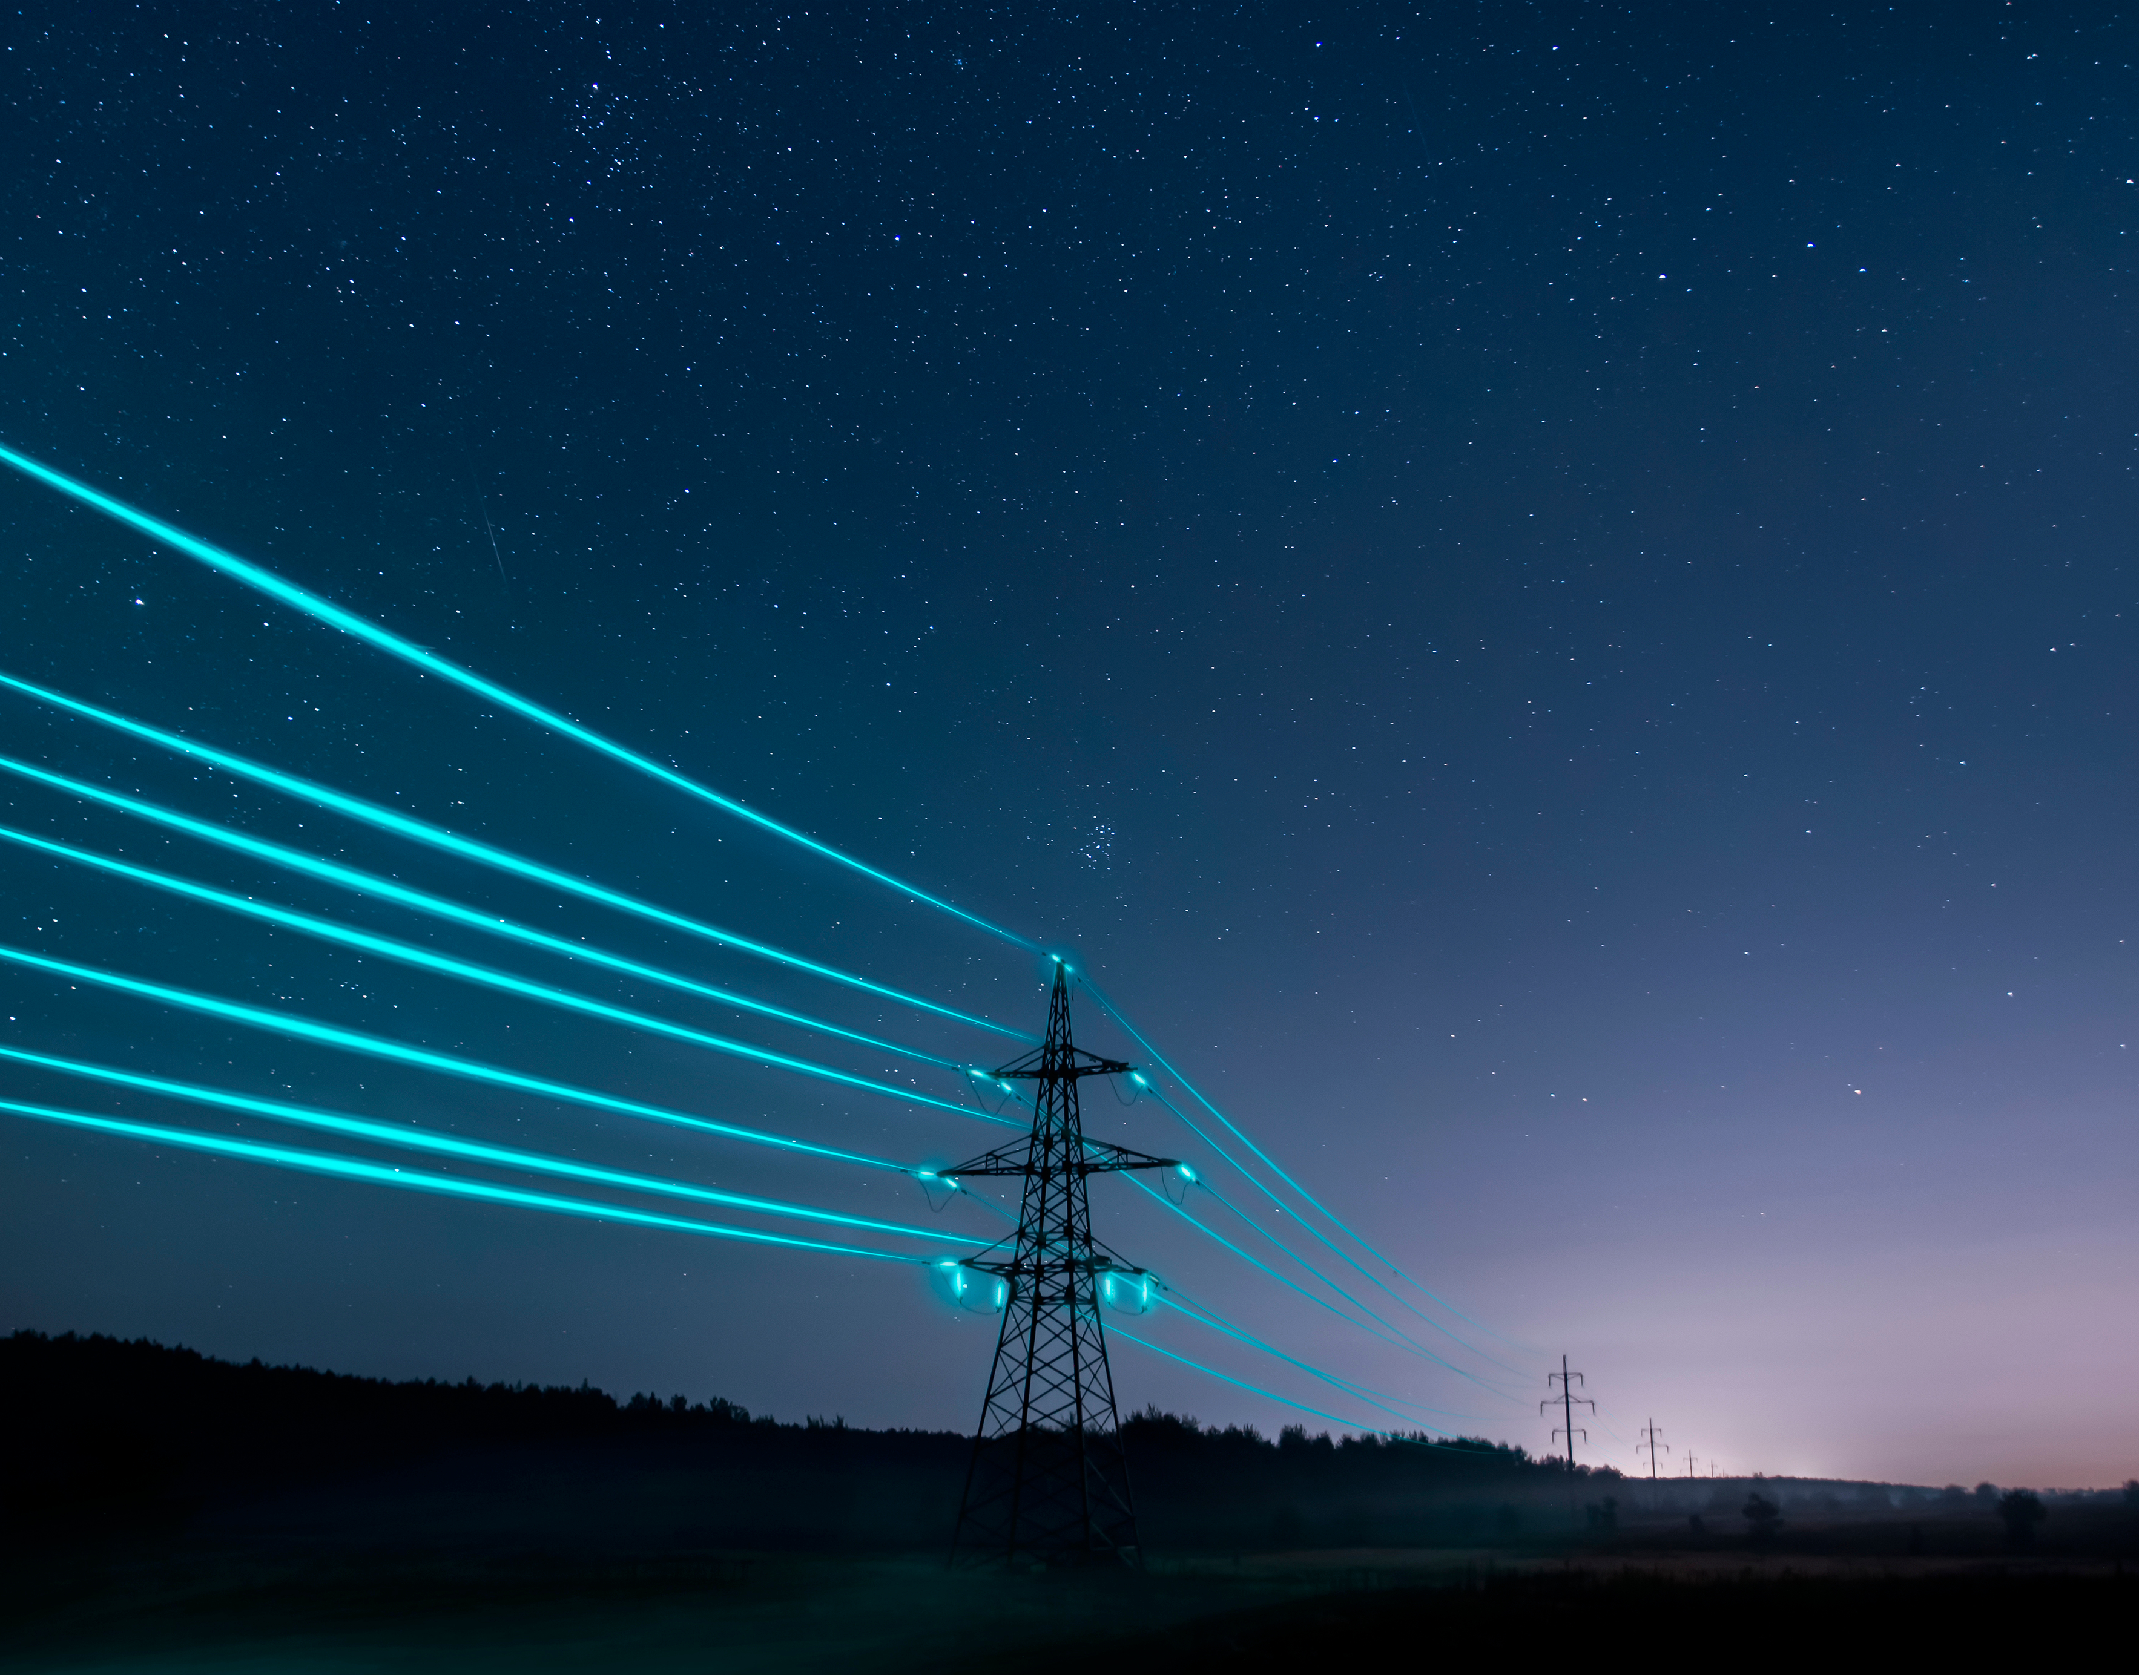
What does a pylon look like?
A pylon looks like the Eiffel tower, it carry's 275,000 volts of electricity wich is 1000x more than comes out your wall socket,230 volts comes out of your wall sockets wich is enough to kill you

Slide 4
https://www.clickview.net/primary/videos/53682710/all-about-electricity

Slide 5

Section 2

Slide 6
Why birds don’t get electrocuted
Electricity always wants to go into the ground so if a bird is sitting on the line they are fine [don’t try this at home]

Slide 7
How does electricity get Into your home
The wires go through the ground through your walls and out the socket and into your device

Slide 8

BBBBBBBBBBBBYYYYYYYYYYEEEEEEE!!!!!!!!!!

