Slide 1
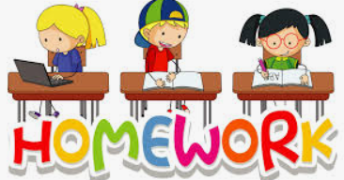
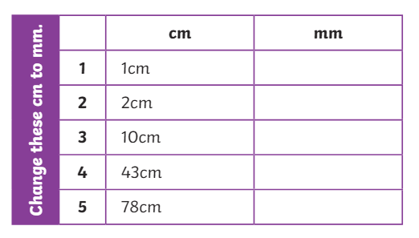
Reading Spend at least 10 minutes every day reading your library book or a book on MyON. Remember to complete a quiz when you have finished your book. You can change your book during quiet reading time in the school library. Tricky Words Practise the spelling of your tricky words using the spelling activities in your jotter. Remember to ask me when you want to be assessed. Nessy Follow the link and login to play https://learn.nessy.com/account/login#/accountLogin | Topic – The Caribbean Use Google to research some facts on Caribbean Islands. Think of questions like: What country has the biggest population? What country has the biggest land mass? Can you fly to all Caribbean Islands? What is produce does the Caribbean export? | Maths Log onto sumdog. I have set a class competition. You will be practicing times tables to help with our work on fractions. Good Luck!
 | WB: 29/04/24
 | Measuring Copy the chart into your jotter and convert the centimetres to millimetres. Remember 1cm = 10mm. Measure some items in your house or garden. Measure in centimetres and convert to millimetres.

