Slide 1
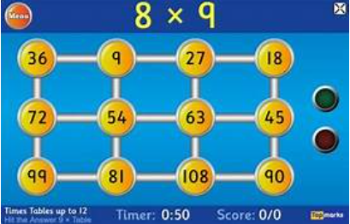
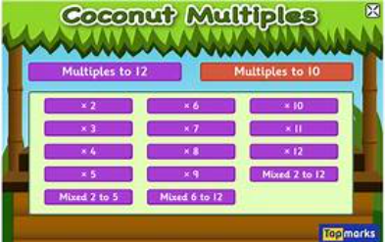
Literacy
Phoneme of the week ‘oo’
Tricky Words
Practise the spellings of your tricky words using the spelling activities in your jotter.
Nessy
Follow the link and login to play
https://learn.nessy.com/account/login#/accountLogin
Reading
Try to spend 10-15 mins each reading your book. MyON is available too.
Remember to be quizzing on your books.
Writing (Persuasive)
Think of something you have always wanted. Try and persuade your adult(s) to get it for you / do it for you.
Numeracy
Work on your times tables!! Follow the links below for Topmarks games.
https://www.topmarks.co.uk/maths-games/hit-the-button
https://www.topmarks.co.uk/times-tables/coconut-multiples
Primary 5/6
Homework Tasks
Week Beginning 11/03/24
STEM WEEK
We have several challenges and experiments going on this week as part of STEM week.
One challenge in particular is creating parachutes as part of our forces Topic.
We would appreciate your help in collecting materials for constructing the parachutes.
Don’t spend money on these materials, it is only if you have any lying around the house that are not in use.
E.g., plastic carrier bags, fabric, plastic cups, string, sponges etc
Maths
Login to Sumdog and complete the Homework Task
https://www.sumdog.com/user/sign_in

