Slide 1
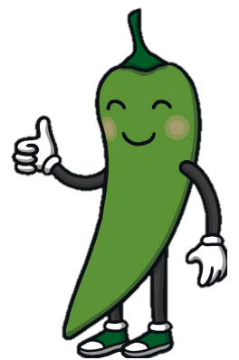
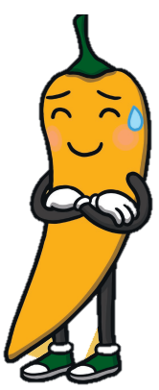
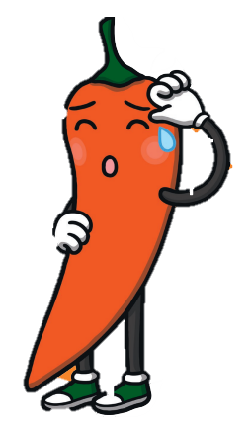
Reading Spend at least 10 minutes every day reading your library book or a book on MyON. | Topic – Middle Ages (Continued) Continue your research on Robert the Bruce. Find out about the battles he fought. Use Google to research Robert the Bruce. Record your research in any way you choose, for example, Power point, information poster or list. | Maths Log onto sumdog. I have set another challenge for you. You will be practicing place value skills and rounding.
Literacy Choose 5 of the ‘b’ words and write a sentence for each word. Remember capital letter and full stop for each sentence. | Monday 9th October 2023
 | Rounding Choose which set of calculations to complete. Record in your jotter. Talk to an adult about the rule for rounding. You will have 3 answers for each number.
b | bb | bu | pb
busy buy build business Bedroom wardrobe | babble rabble scribble dabble | build builder building | cupboard
Round to nearest 10, 100 and 1000
4563
7894
3549
8932
6721
Round to the nearest 1000, 10 000 and
100 000
78,432
98,342
56,020
78,403
57,453
Round to the nearest 1000, 10 000 and 100 000
176,895
390,786
786,123
890,003
675,883

