Slide 1
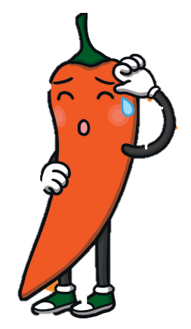
Reading Spend at least 10 minutes every day reading your library book or a book on MyON. | Topic – Middle Ages Use Google to research Robert the Bruce. Record your research in any way you choose, for example, Power point, information poster or list. | Maths Log onto sumdog. I have set some challenges for you. You will be practicing times tables and place value skills.
Literacy This week's phoneme is /b/. It can be represented in different ways. Look around your house and see if you can find something with representations shown below. Make a list of the items you find. | WB: 2nd October 2023
 | Number Talks Choose which set of calculations to complete. You choose the strategy, e.g. partitioning.
b | bb | bu | pb
233 + 163
379 + 210
174 + 424
258 + 323
647 + 343
593 + 309
658 + 335
750 + 853
7147 + 735
2233 + 769
6356 + 695
2740 + 853

