Slide 1
Welcome to
Primary 5/6

Slide 2
Our Class
Timetable
Term 1

Slide 3
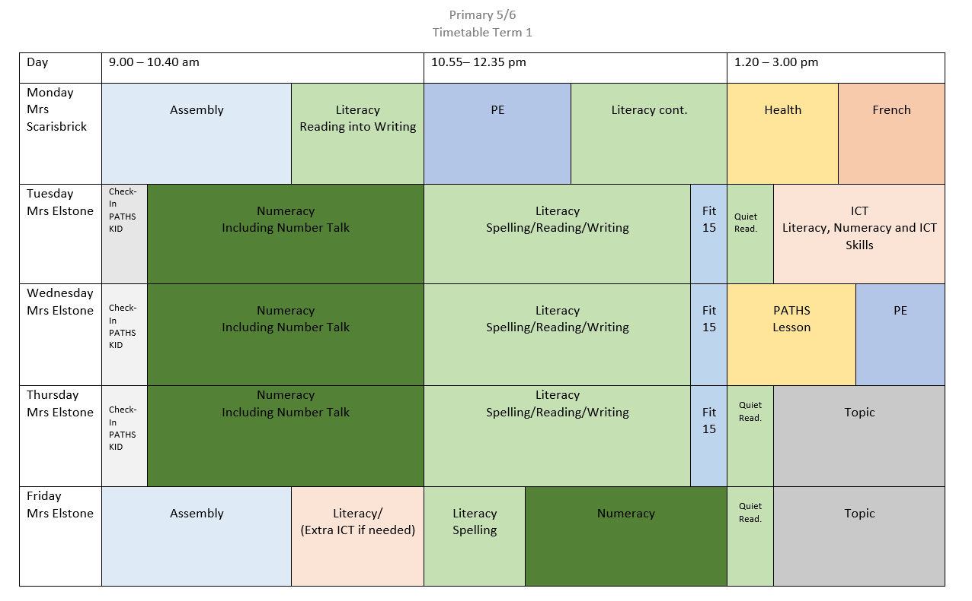

Slide 4
Our Learning In Term One

Slide 5
Reading
Our Class Novel is Stig of the Dump
by Clive King

Slide 6
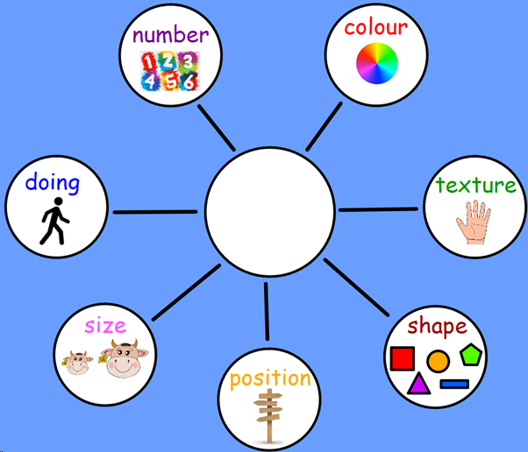
Writing
We are learning to make our writing more interesting by using description wheels.

Slide 7
Spelling
We are using East Ayrshire’s Strategy for Spelling

Slide 8
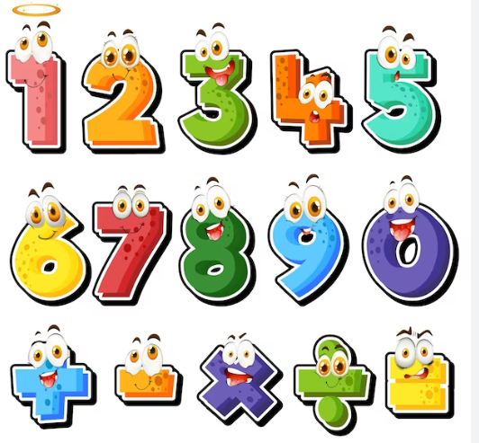
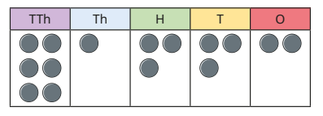
Numeracy
Our topic is Place Value, we are learning to read, write and order larger numbers. We are also learning to round to the nearest 10, 100, 1000 and 10,000.

Slide 9
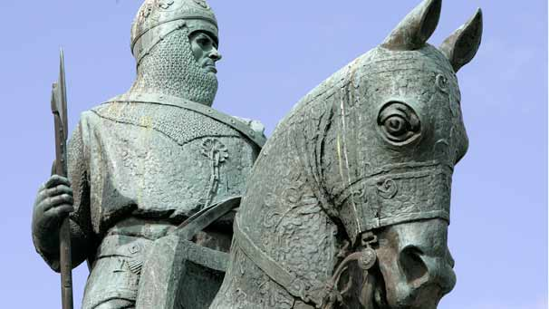
Our Topic is
The Middle Ages

Slide 10
In PE we are developing our athletics skills and dancing skills.

Slide 11
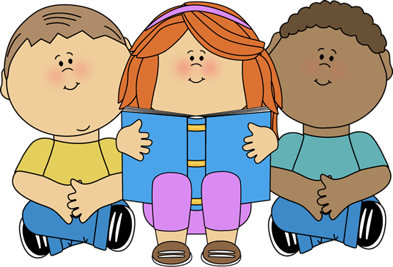
Weekly Homework Tasks
One reading activity per week. Remember to access MYON.
One literacy activity per week.
Remember to access MYON.
Occasionally a topic related activity.
One numeracy/maths activity per week.
Remember to access Sumdog.

