Slide 1
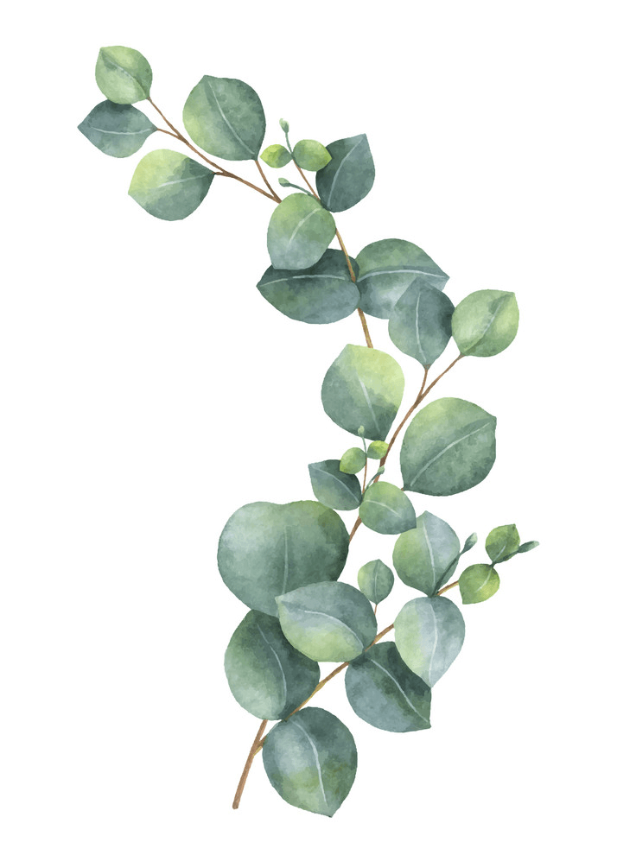
Maths: Let's Explore perimeter and Area!
Find 5 different size objects or containers at home.
Measure the length of each object using a ruler.
Write down the perimeter of each object (cm)
Arrange the objects in order from the one with the smallest perimeter to the one with the largest.
Draw a picture of each object and write down its dimension and perimeter in your homework jotter in the arranged order.
Challenge: Can you figure out the area of each object.
Class Competition
Compete in the class competition.
Good luck!
Winner will also be awarded Class counters!
Last week's Sumdog
Competition Winner's
1st place – Thomas
2nd place – Oscar
3rd place – Kalvyn
Congratulations!
Literacy
Phoneme of the week ‘ou’. List 5 things around the house that have the 'ou' sound
Tricky Words
Practise the spellings of your tricky words
using the spelling activities in your jotter.
Nessy
Follow the link and login to play
https://learn.nessy.com/account/login#/accountLogin
Reading
Try to spend 10-15 mins each reading your book. MyON is available too.
Remember to be quizzing on your books.
Writing (Recount)
Tell 3 things you got upto during the Easter Holidays. Remember to uplevel your sentences using adjectives.
Week Beginning
22nd April 2024

