Slide 1
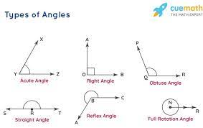
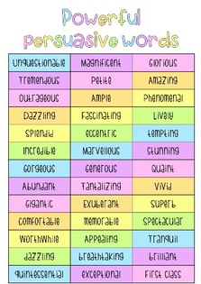
Maths
Log onto sumdog. I have set homework activities.
This week we are learning to measure Angles
Class Competition
Compete in the class competition.
Good luck!
Winner will also be awarded Class counters!
Last week's Sumdog
Competition Winner's
1st place – Thomas
2nd place – Lilly
3rd place – Oscar
Congratulations!
Week Beginning
4th March 2024
Literacy
Skills & Qualities
This week I would like you to think about what your skills and qualities are!
Why should Wonka Hire you?
Why would you make a good employee?
What skills and qualities would you bring to the job?
Example: I am a team player and work well in groups. I can stay focused and make you lots of chocolate!
Remember to use persuasive words to convince Wonka.
Write 6 sentences in your Homework Jotter!

Slide 2
