Slide 1
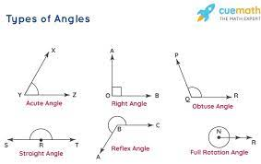
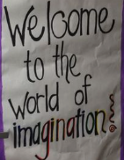
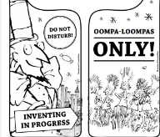
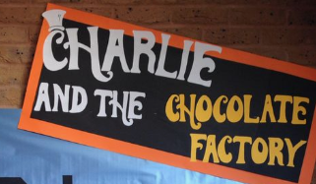
Maths
Log onto sumdog. I have set homework activities.
This week we are beginning
to look at Angles
Class Competition
Compete in the class competition.
Good luck!
Last week's Sumdog
Competition Winner's
1st place – Lilly W
2nd place – Thomas
3rd place – Logan M
Congratulations!
Week Beginning
26th February 2024
Design Challenge
Create a sign for our World Book Day door!
Theme: Charlie in the Chocolate Factory
The sign should be Eye-Catching and Colourful. It should make you want to enter our classroom.
Here are some ideas below.
Reading
Log onto Nessy
https://learn.nessy.com/account/login#/accountLogin
Try to spend at least 10 minutes 3 nights a week.
I will award 10 Star points to every person that spend more than 30 minutes on Nessy this week.

Slide 2
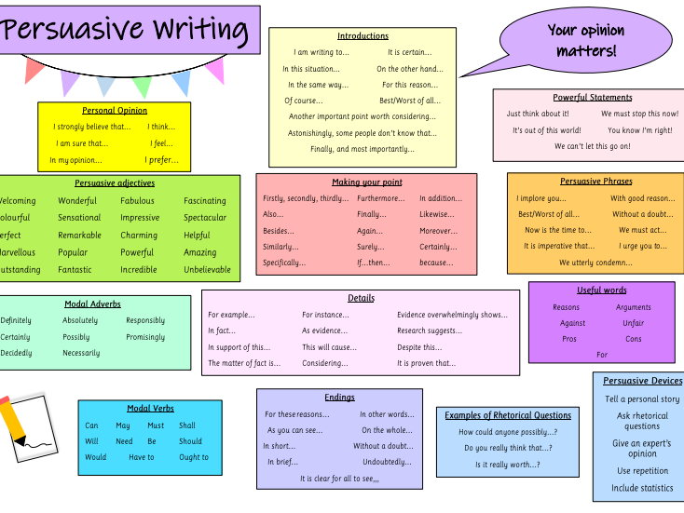
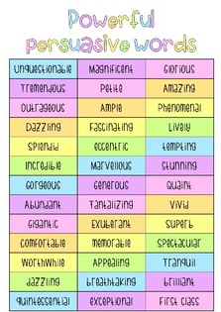
Literacy
Skills & Qualities
This week I would like you to think about what your skills and qualities are!
Why would you make a good employee?
Why should Wonka Hire you?
Example: I am a team player and work well in groups. I can stay focused and make you lots of chocolate!
Remember to use persuasive words to convince Wonka.
Write 5 sentences in your Homework Jotter!

