Slide 1
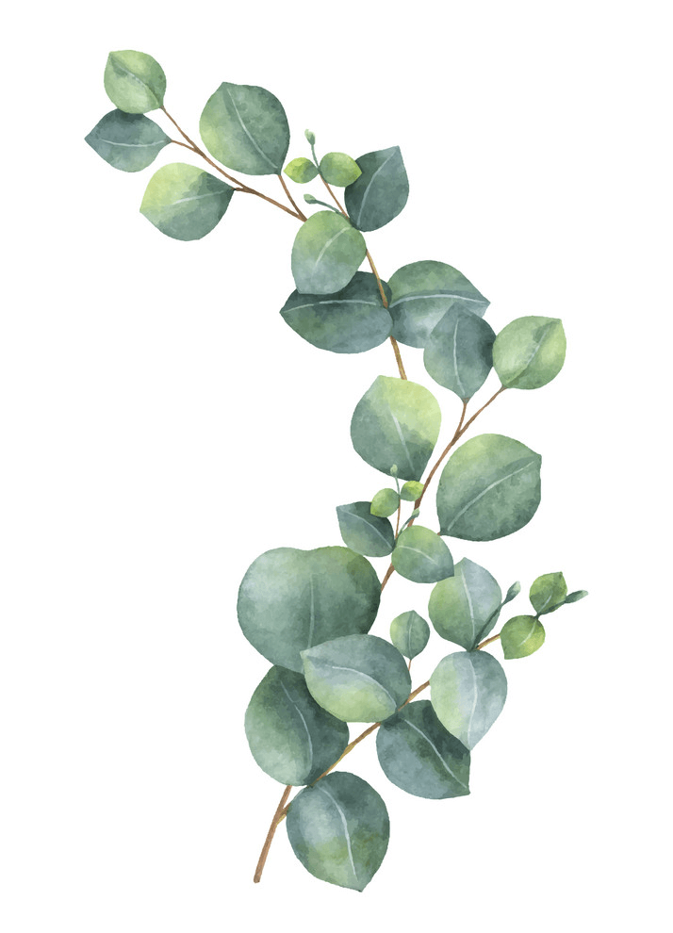
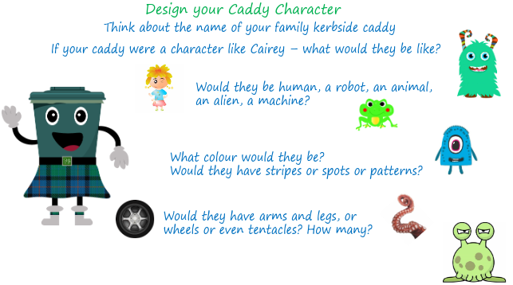
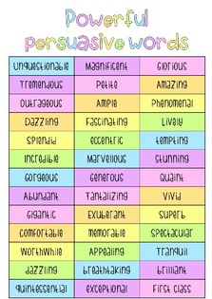
Maths
Log onto sumdog. I have set homework activities.
This week we are beginning to look
Coordinates and symmetry.
Class Competition
Compete in the class competition.
Good luck!
1st place will receive 150 coins
2nd place will receive 100 coins.
3rd place will receive 50 coins.
Last week's Sumdog
Competition Winner's
1st place – Thomas
2nd place – Lilly W.
3rd place – Riley
Congratulations!
Week Beginning
19th February 2024
Design Challenge
Look at the photo on the blog page and design your own caddy!
Reading
Log onto Nessy https://learn.nessy.com/account/login#/accountLogin
Try to spend at least 10 minutes 3 nights a week.
I will award 10 Star points to every person that spend more than 30 minutes on Nessy this week.
Literacy
Find a random item in your house. Your task is to try to persuade your parent/carer to swap you something for it! Use persuasive words to help you.

Slide 2
