Slide 1
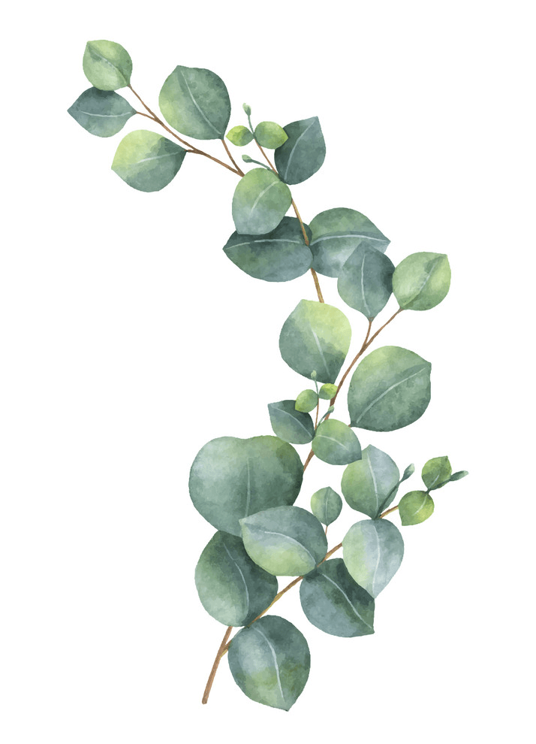
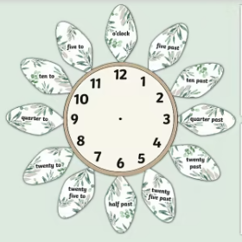
Maths
Log onto sumdog. I have set homework activities.
This week we are beginning to look
at 24-hour time.
Class Competition
Compete in the class competition.
Good luck!
1st place will receive 150 coins
2nd place will receive 100 coins.
3rd place will receive 50 coins.
Week Beginning
22nd January 2024
Literacy
Practice and learn your burns poem off by heart. To present to either class or Miss Duff
Reading
Log onto Nessy and try to spend at least 10 minutes 3 nights a week.
I will award 10 Star points to every person that spend more than 30 minutes on Nessy this week.
Last week's Sumdog Competition Winner's
1st place – Thomas
2nd place – Oscar
3rd place – Paul
Congratulations
Complete before Friday.

