Slide 1
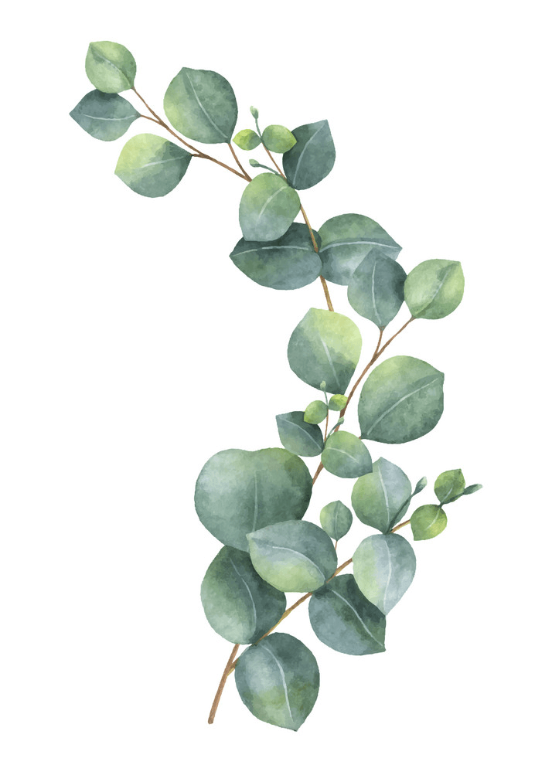
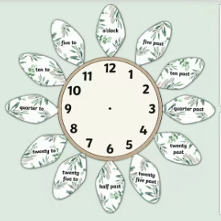
Maths
Log onto sumdog. I have set homework activities.
This week we are beginning to look
at 12-hour time.
Class Competition
Compete in the class competition.
Good luck!
1st place will receive 150 coins
2nd place will receive 100 coins.
3rd place will receive 50 coins.
Week Beginning
8th January 2024
Literacy
Practice the first versus of your Robert Burns poem
An Extract from
TO A MOUSE by Robert Burns
Wee, sleeket, cowran, tim’rous beastie,
O, what a panic’s in thy breastie!
Thou need na start awa sae hasty
Wi’ bickering brattle!
I wad be laith to rin an’ chase thee,
Wi’ murd’ring pattle!
Complete before Friday.

