Slide 1
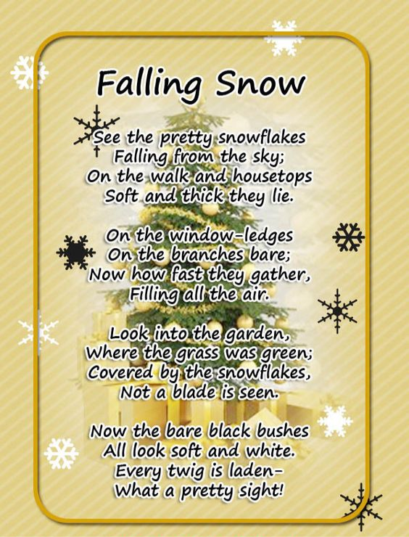
Week Beginning 20th November 2023
Maths
Log onto sumdog. I have set some games for you.
You will be practicing Money
Reading
Log onto Nessy and try to spend at least 10 minutes on it every night.
Christmas Church Service Practice
Practice your Christmas poem and Christmas songs:
Merry Christmas everyone by Shakin Stevens: https://www.youtube.com/watch?v=TYW9o5bFJeE
Midnight: https://www.youtube.com/watch?v=k93EdJwarB0
Christmas Poem Falling Snow By Francis Sherman

