Slide 1
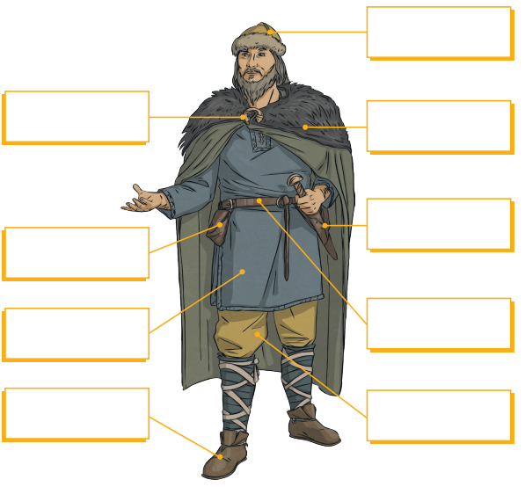
Week Beginning 2nd October 2023
Maths
Log onto sumdog. I have set some games for you.
You will rounding and estimating to nearest 1000.
Reading
Spend at least 10 minutes reading your library book or a book on MyON. Everyday.
Literacy
This week's phoneme is /b/. It can be represented different ways. Look around your house and see if you can find something with representations shown below. Make a list of the items you find in your homework jotter.
Example
Topic
Research Viking clothing to find out what they would have worn and any accessories that they might have owned.
Design in your jotter a Viking and label the items of clothing.
d | dd | ed | de | dh

