Slide 2
Our Class Timetable
 | 9.10 – 10.00 | 10.00 – 10.40 | B R E A K | 10.55 – 11.45 | 11.45 – 12.35 | LUNCH | 1.20 – 2.10 | 2.10 – 2.55
Monday | ASSEMBLY | HWB Check-ins |  | ALP | READING |  | NUMERACY
Tuesday NCCT | READING INTO WRITING | NUMERACY |  | PE | NUMERACY |  | HWB | FRENCH
Wednesday | NUMERACY | PE |  | ALP | READING |  | IT
Thursday | ALP | READING |  | STEAM AREA |  |  | IDL : Vikings
 |  |  |  | ART | IT
Friday | ASSEMBLY | LITERACY |  | NUMERACY |  |  | IDL : Vikings | HWB (HALL)

Slide 3
Our Novel this term is ...

Slide 4
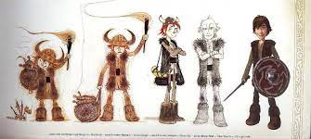
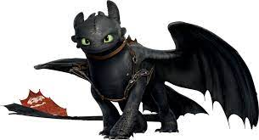
This term we are learning to use the description within a text to visualise characters and settings. As well as learning to summarise key points within a chapter.

Slide 5
We are learning to uplevel and make our writing AMAZING!
This term we will be focusing on openers, connectives, paragraphs, and different features of language such as adjectives.

Slide 6
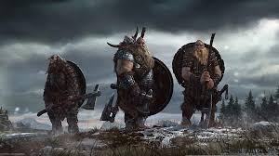
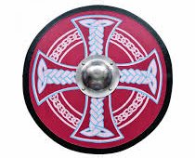
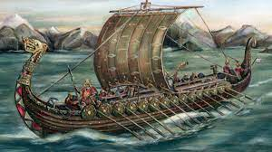
Our Topic this term is…
Vikings

Slide 7
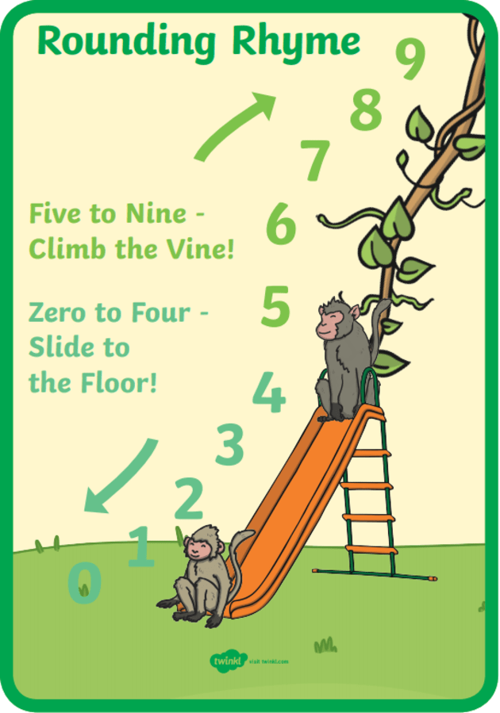
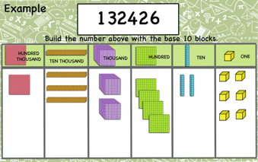
We are learning to partition six figure numbers and round to the nearest 1000, 10 000 and 100 000.

Slide 8
&
For PE Mrs Scarisbrick will take primary 5 for gymnastics on Tuesdays and on Wednesday Miss Duff will be teaching netball.

Slide 9
This term we are experimenting with a range of mixed media to create different pieces of artwork. We will be creating Viking shields and longboats.

Slide 10
We are learning about the key features of a Word document and enhancing our online research skills.

Slide 11
'All Star Awards'
We have weekly awards in our class which are …
Group of the Week
Is for the group that have worked extremely hard and holding the school values.
AMAZING AUTHOR
for creative ideas, correct punctuation, use of figurative language in writing lessons.
AWESOME ATTITUDE
For initiative during lessons, kindness, responsibility and overall effort.
MATHS MAGICIAN
for effort, skill or understanding in a numeracy tasks.
HANDWRITING HERO
for writing on the line, forming letters carefully and neat layout.
SPORTS CHAMP
For skill, agility or sportsmanship in PE lessons.

Slide 12
Reward systems within our class
We have daily class rewards which are our group points and individual 'Star Points' .
The group with the most counters at the end of the week wins and gets to choose the reward on Friday afternoon.
Star points are earned by pupils upholding the school values and producing phenomenal work. Points gained can be exchanged for rewards such like sitting beside a friend for the day.

