Slide 1
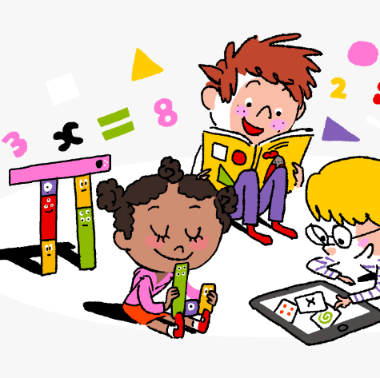
Primary 4 Weekly Learning Update
06/10/24

Slide 2
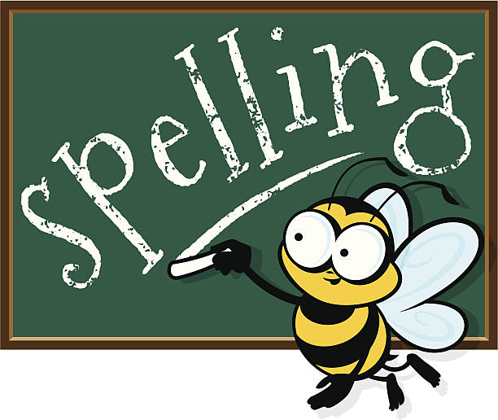
Primary 4
Active Literacy
Children are working on individual common/ tricky words. These can be found in their homework jotters.
Phoneme ‘igh’.
igh | i_e | ie | i | y | eye
night fright right bright high might frightened spotlight fortnight | driveway ice spine side white smiled revise surprise advice | pie die tied cries fries occupies occupied supplies applies | final driving mind mindful blind climb mild triangle quiet | fly my cry why shy July rely deny satisfy | eye eyesight eyebrow eyelid eyelash

Slide 3
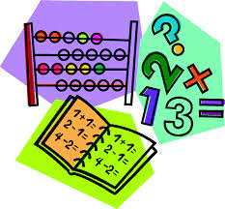
Numeracy
Choose 207, 384 or 9417.
Can you rearrange the numbers to make the:
Largest even number
Largest odd number
Smallest even number
Smallest odd number
This week we will be continuing to work on Place Value, with a focus on ordering numbers.
Th | H | T | U
4 | 1 | 2 | 3
4000 + 100 + 20 + 3 = 4123
4 thousands + 1 hundred + 2 tens + 3 units = 4123

Slide 4
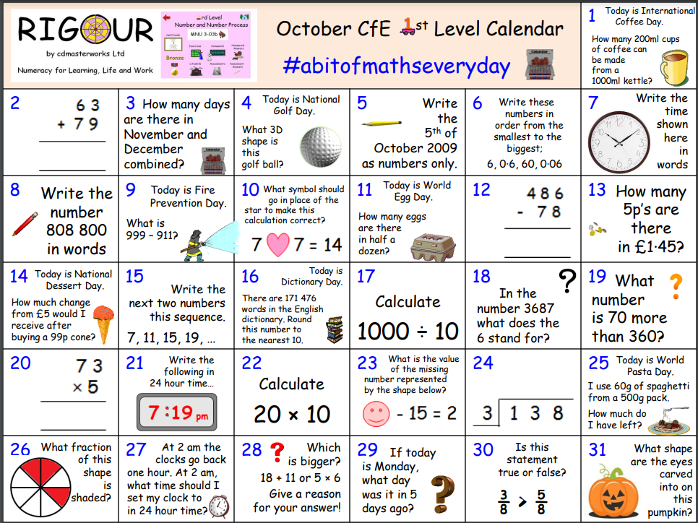

Slide 5

Homework
Active Literacy Spelling
Choose 2-3 words to ‘grow’ by adding a prefix (a group of letters added to the beginning of a word) or a suffix (a group of letters added to the end of a word). e.g. unpopular and fewer.
Use these NEW words in a sentence.
Reading
Aim to read your library book for 10 minutes each night. Remember to quiz yourself on any book(s) you read! Or if you prefer, choose a story on MyON. You can read the story yourself or have it read to you.
Writing
Research task for Report Writing: Choose ONE nocturnal animal. Find out:
*Adaptations- What senses or abilities help your animal thrive at night?
*Diet- What does your animal eat?
*Predators- Is your animal hunted by another animals?
*Any other interesting facts.
Record all facts in home learning jotters.
Numeracy
Click on the link below to work on ordering numbers.
https://www.topmarks.co.uk/maths-games/daily10
Work through the Rigour Calendar for October at your own pace.

