Slide 1
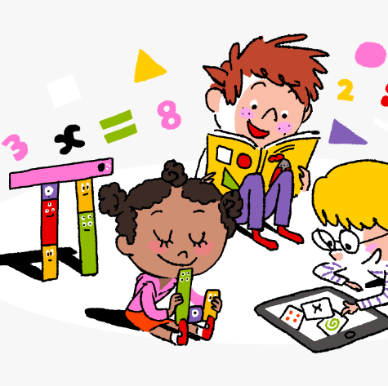
Primary 4 Weekly Learning Update
29/09/25

Slide 2

Primary 4
Active Literacy
Children are working on individual common/ tricky words. These can be found in their homework jotters.
Phoneme ‘igh’.
igh | i_e | ie | i | y | eye
night fright right bright high might frightened spotlight fortnight | driveway ice spine side white smiled revise surprise advice | pie die tied cries fries occupies occupied supplies applies | final driving mind mindful blind climb mild triangle quiet | fly my cry why shy July rely deny satisfy | eye eyesight eyebrow eyelid eyelash

Slide 3

Numeracy
Choose 132, 2617 or 51724.
Can you rearrange the numbers to make the smallest number and the largest number?
Extra challenge: find the smallest even number and the largest even number?
This week we will be continuing to work on Place Value, with a focus on ordering numbers.
Th | H | T | U
4 | 1 | 2 | 3
4000 + 100 + 20 + 3 = 4123
4 thousands + 1 hundred + 2 tens + 3 units = 4123

Slide 4
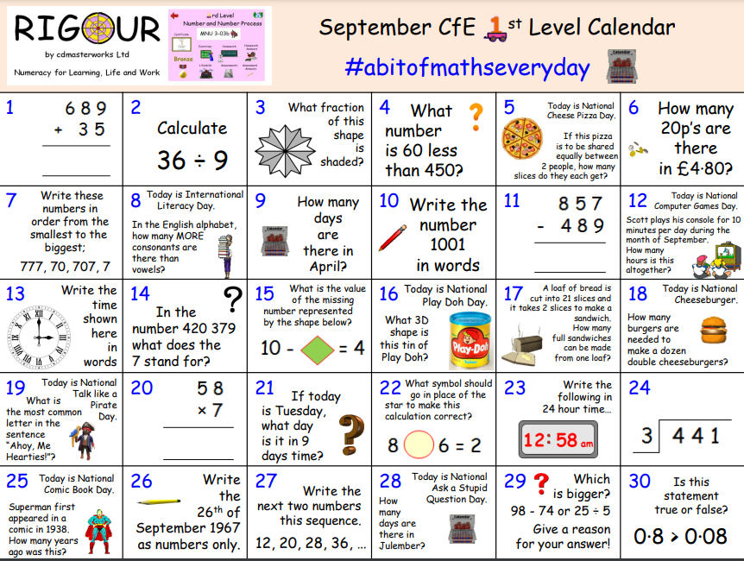

Slide 5

Homework
Active Literacy Spelling
Click on the link below for some spelling games…
Spellzone
Reading
Aim to read your library book for 10 minutes each night. Remember to quiz yourself on any book(s) you read! Or if you prefer, choose a story on MyON. You can read the story yourself or have it read to you.
Numeracy
Click on the link below for some number games…
-Choose level 2, 3 or 4 (depending on individual ability)
-Select Ordering, Partitioning, Digit Values or Rounding.
Topmarks: Daily 10
Work through the Rigour Calendar for September at your own pace.

