Slide 1
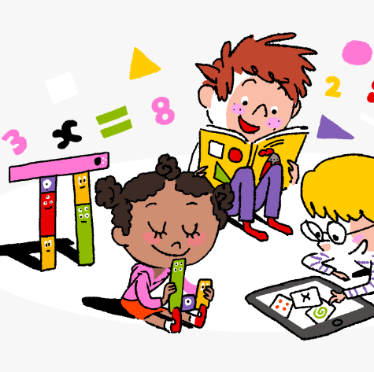
Primary 4 Weekly Learning Update 18/11/24

Slide 2
Primary 4 Active Literacy
Children are working on individual common/ tricky words. These can be found in their homework jotters.
Phoneme ‘oo’.
oo | u_e | ew | ue | u
shook proof swoop school tooth root too | June use cute amuse volume absolute fortune | flew chew knew fewer threw newt jewel | Tuesday statue rescue clue continue venue cue | push pull unicorn tulip usual situation cushion

Slide 3
Numeracy
This week we will be focussing on Money, including:
Recognising all coins & notes
Paying for goods using the least amount of coins
Calculating change
Converting £ to p and p to £

Slide 5
Homework
Active Literacy Spelling
Choose 3-4 words from the phoneme chart. Can you create a sentence for each word? Aim to start each sentence differently and use a connective (and, but, so, because, while).
Click on the link below for some spelling games.
Spellzone
Reading
Aim to read your library book for 10 minutes each night. Remember to quiz yourself on any book(s) you read! Or if you prefer, choose a story on MyON. You can read the story yourself or have it read to you.
Numeracy
Work through the Rigour Calendar for November. Complete as many questions as you can.
Click on the links below for some maths games.
https://www.topmarks.co.uk/money/toy-shop-money/
https://natwest.mymoneysense.com/students/students-5-8/coin-cruncher/

