Slide 1
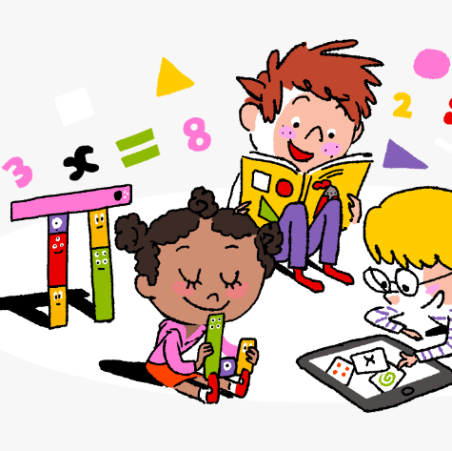
Primary 3/4 Weekly Learning Update 13/5/24

Slide 2
Primary 4 Active Literacy
P4 are working on individual common/ tricky words. Try to bring your homework jotters to school regularly so your new words can be added.
This week P4 are continuing to recognise and use different representations of the phoneme ch to read and spell.
ch | tch | t
change chose choose scorched chance chalk | kitchen scratch blotchy butcher watch stretch | picture creature signature furniture mature nature
Note. Some learners may only be focussing on the ‘ch’ and ‘tch’ representations. Others may be able to challenge themselves.

Slide 3
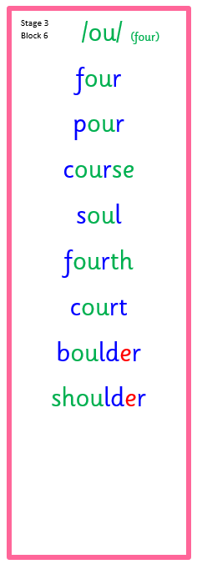
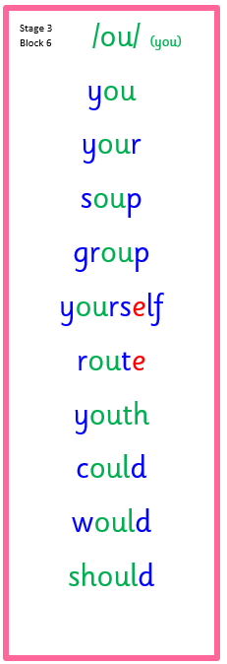
Primary 3 Active Literacy
This week P3 are consolidating previously taught phonemes: ou (pour), oe (toe) and ou (you).
Common Words
you’re
shouldn’t
wouldn’t
couldn’t
Common Words
goes
does
both
most

Slide 4
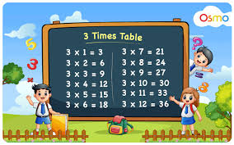
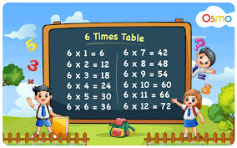
Numeracy
We are working on division. We will begin to look at the link between division and fractions.
Continue to practise your times tables as often as possible at home!

Slide 5
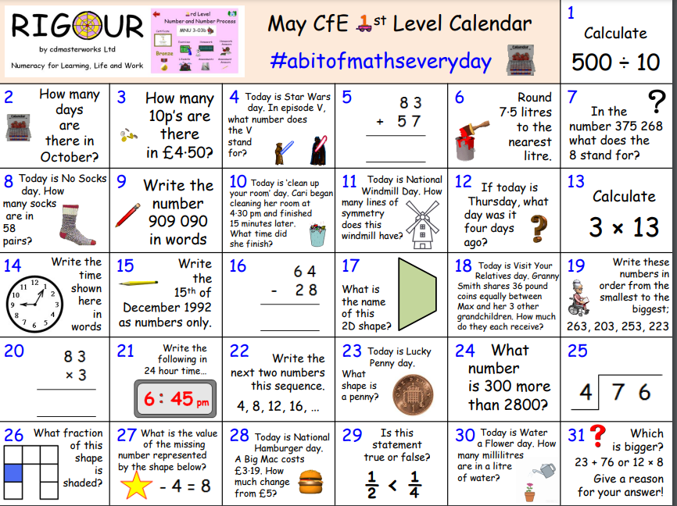

Slide 6
Homework
Active Literacy Spelling
P3: Choose 1-2 words from each phoneme list. How many times can you spell it correctly in 1 minute?
P4: Use ‘fancy writing’ or ‘pyramid writing’ to practise the ch phoneme words.
Continue to work through your individual targets on Nessy. Secret word: RELIEVEDARCH
Reading
Aim to read your library book for 10 minutes each night. Remember to quiz yourself on any book(s) you read! Or if you prefer, log into MyON and pick a book to read for pleasure. You can read the story yourself or have it read to you.
Numeracy.
Follow the link to Topmarks: Hit the Button and practise your times tables. Topmarks is also great for working on division facts!
Work through the Rigour Calendar for May at your own pace. Don’t worry if there are questions you don’t understand, we just maybe haven’t covered this topic yet.

Slide 7
P3/4 Learning Update
Please visit the blog for photos and information about activities taking place in class.
If you have any questions, please do not hesitate to contact me, alana.black@eastayrshire.org.uk

