Slide 1
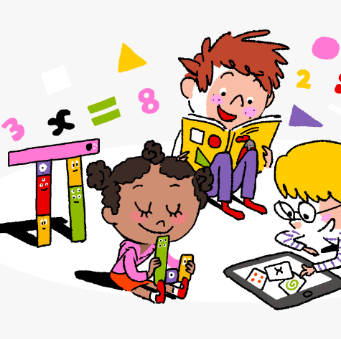
Primary 3/4 Weekly Learning Update 18/3/24

Slide 2
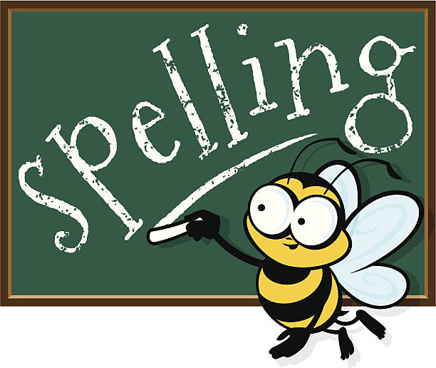
Primary 4 Active Literacy
P4 are working on individual common/ tricky words. Try to bring your homework jotters to school regularly so your new words can be added.
This week P4 are learning to recognise and use different representations of the phoneme j to read and spell.
j | g | ge | dge
judge jaws jungle jaguar jeans | giraffe energy gentle legend generate | strange manage lounge large wage | lodge hedge ridge knowledge sledge

Slide 3
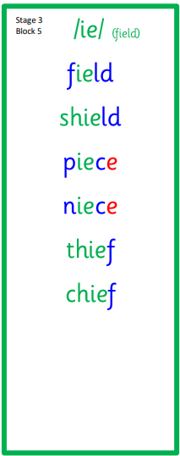
Primary 3 Active Literacy
This week P3 are learning to recognise and use the ie (field) phoneme.
Common Words
looked
jumped
talked

Slide 4
Numeracy
We are continuing to work telling the time:
*o’clock & half past
*quarter past & quarter to
*5 min intervals
*1 minute intervals
*using am and pm
Continue to practise your times tables as often as possible at home!

Slide 5
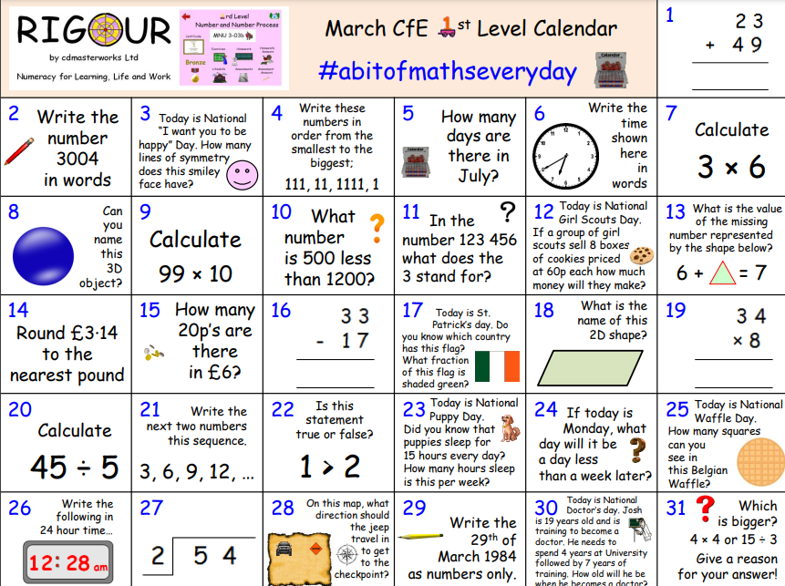

Slide 6
Homework
Active Literacy Spelling
P3: Choose 3 of the ie’ words and write sentences for them. Choose a spelling activity card to practise the words from the list.
P4: Can you add any words to the phoneme chart? Choose 3-4 words to grow by adding a prefix (undone) or a suffix (achievement).
Continue to work through your individual targets on Nessy. Secret word: RELIEVEDARCH
Reading
Aim to read your library book for 10 minutes each night. Remember to quiz yourself on any book(s) you read! Or if you prefer, log into MyON and pick a book to read for pleasure. You can read the story yourself or have it read to you.
Numeracy
Log on to Active Learn and complete all remaining TIME activities.
Follow the link to Topmarks: Hit the Button and practise your times tables.
Work through the Rigour Calendar for March at your own pace. Don’t worry if there are questions you don’t understand, we just maybe haven’t covered this topic yet.

Slide 7
P3/4 Learning Update
Please visit the blog for photos and information about activities taking place in class.
If you have any questions, please do not hesitate to contact me, alana.black@eastayrshire.org.uk

